Slide 1
Negotiating medical invoices
Overcoming the fear of asking

Slide 2
In 2015 the Kentucky Racing Health and Welfare Fund saved $105,000 by negotiating medical invoices and its staff never picked up the phone to dicker, haggle or bargain.
An additional $492,000 was saved with some additional spade work

Slide 3
The Kentucky Racing Health and Welfare Fund utilizes 6 methods to reduce the amount paid for medical invoices from medical providers:
Settlement offers sent via the fax machine.
Automatic savings from negotiated contractual agreements.
Guiding eligible clients to sign-up for Medicaid and Hospital Charity and Financial Assistance Programs and unadvertised physician assistance programs.
Not paying hospital charges for clients who fail to sign-up for those programs.
Taking advantage of hospital uninsured discount rates.
Taking advantage of facility and physician pre-payment discounts.

Slide 4
All lumped together we call this program the Cost Shifting Campaign.
Since May 1997 it has produced for the Fund trackable savings of
$11.9 million
(But who’s keeping score?)

Slide 5
Excerpt from our Funding Legislation
….(licensees) who can demonstrate their need for financial assistance connected with death, illness, or off-the-job injury and are not otherwise covered by union health and welfare plans, workers' compensation, Social Security, public welfare, or any type of health, medical, death, or accident insurance.
Excerpt from Our Disclaimer
The Kentucky Racing Health and Welfare Fund is a non-profit charitable organization that receives no government funding or public tax revenue. It is not an insurance company and does not assume responsibility for any incurred charges nor does it guarantee approval for any request for assistance.
However….
The Fund does issue Authorization Forms for eligible clients to take to medical professionals. These Authorization Forms are specifically issued for each medical provider, appointment date, medical procedure and client. They carry a guarantee of payment within the Fund’s pay scale. Also, whenever we attempt to settle charges we take into consideration any outstanding charges our client may be left with.

Slide 6
Today we want to concentrate on just one component of the Cost Shifting Campaign:
The Faxable Settlement Offer
This method may or may not work for you but you are encouraged to attempt this at the office – some assembly required.

Slide 7
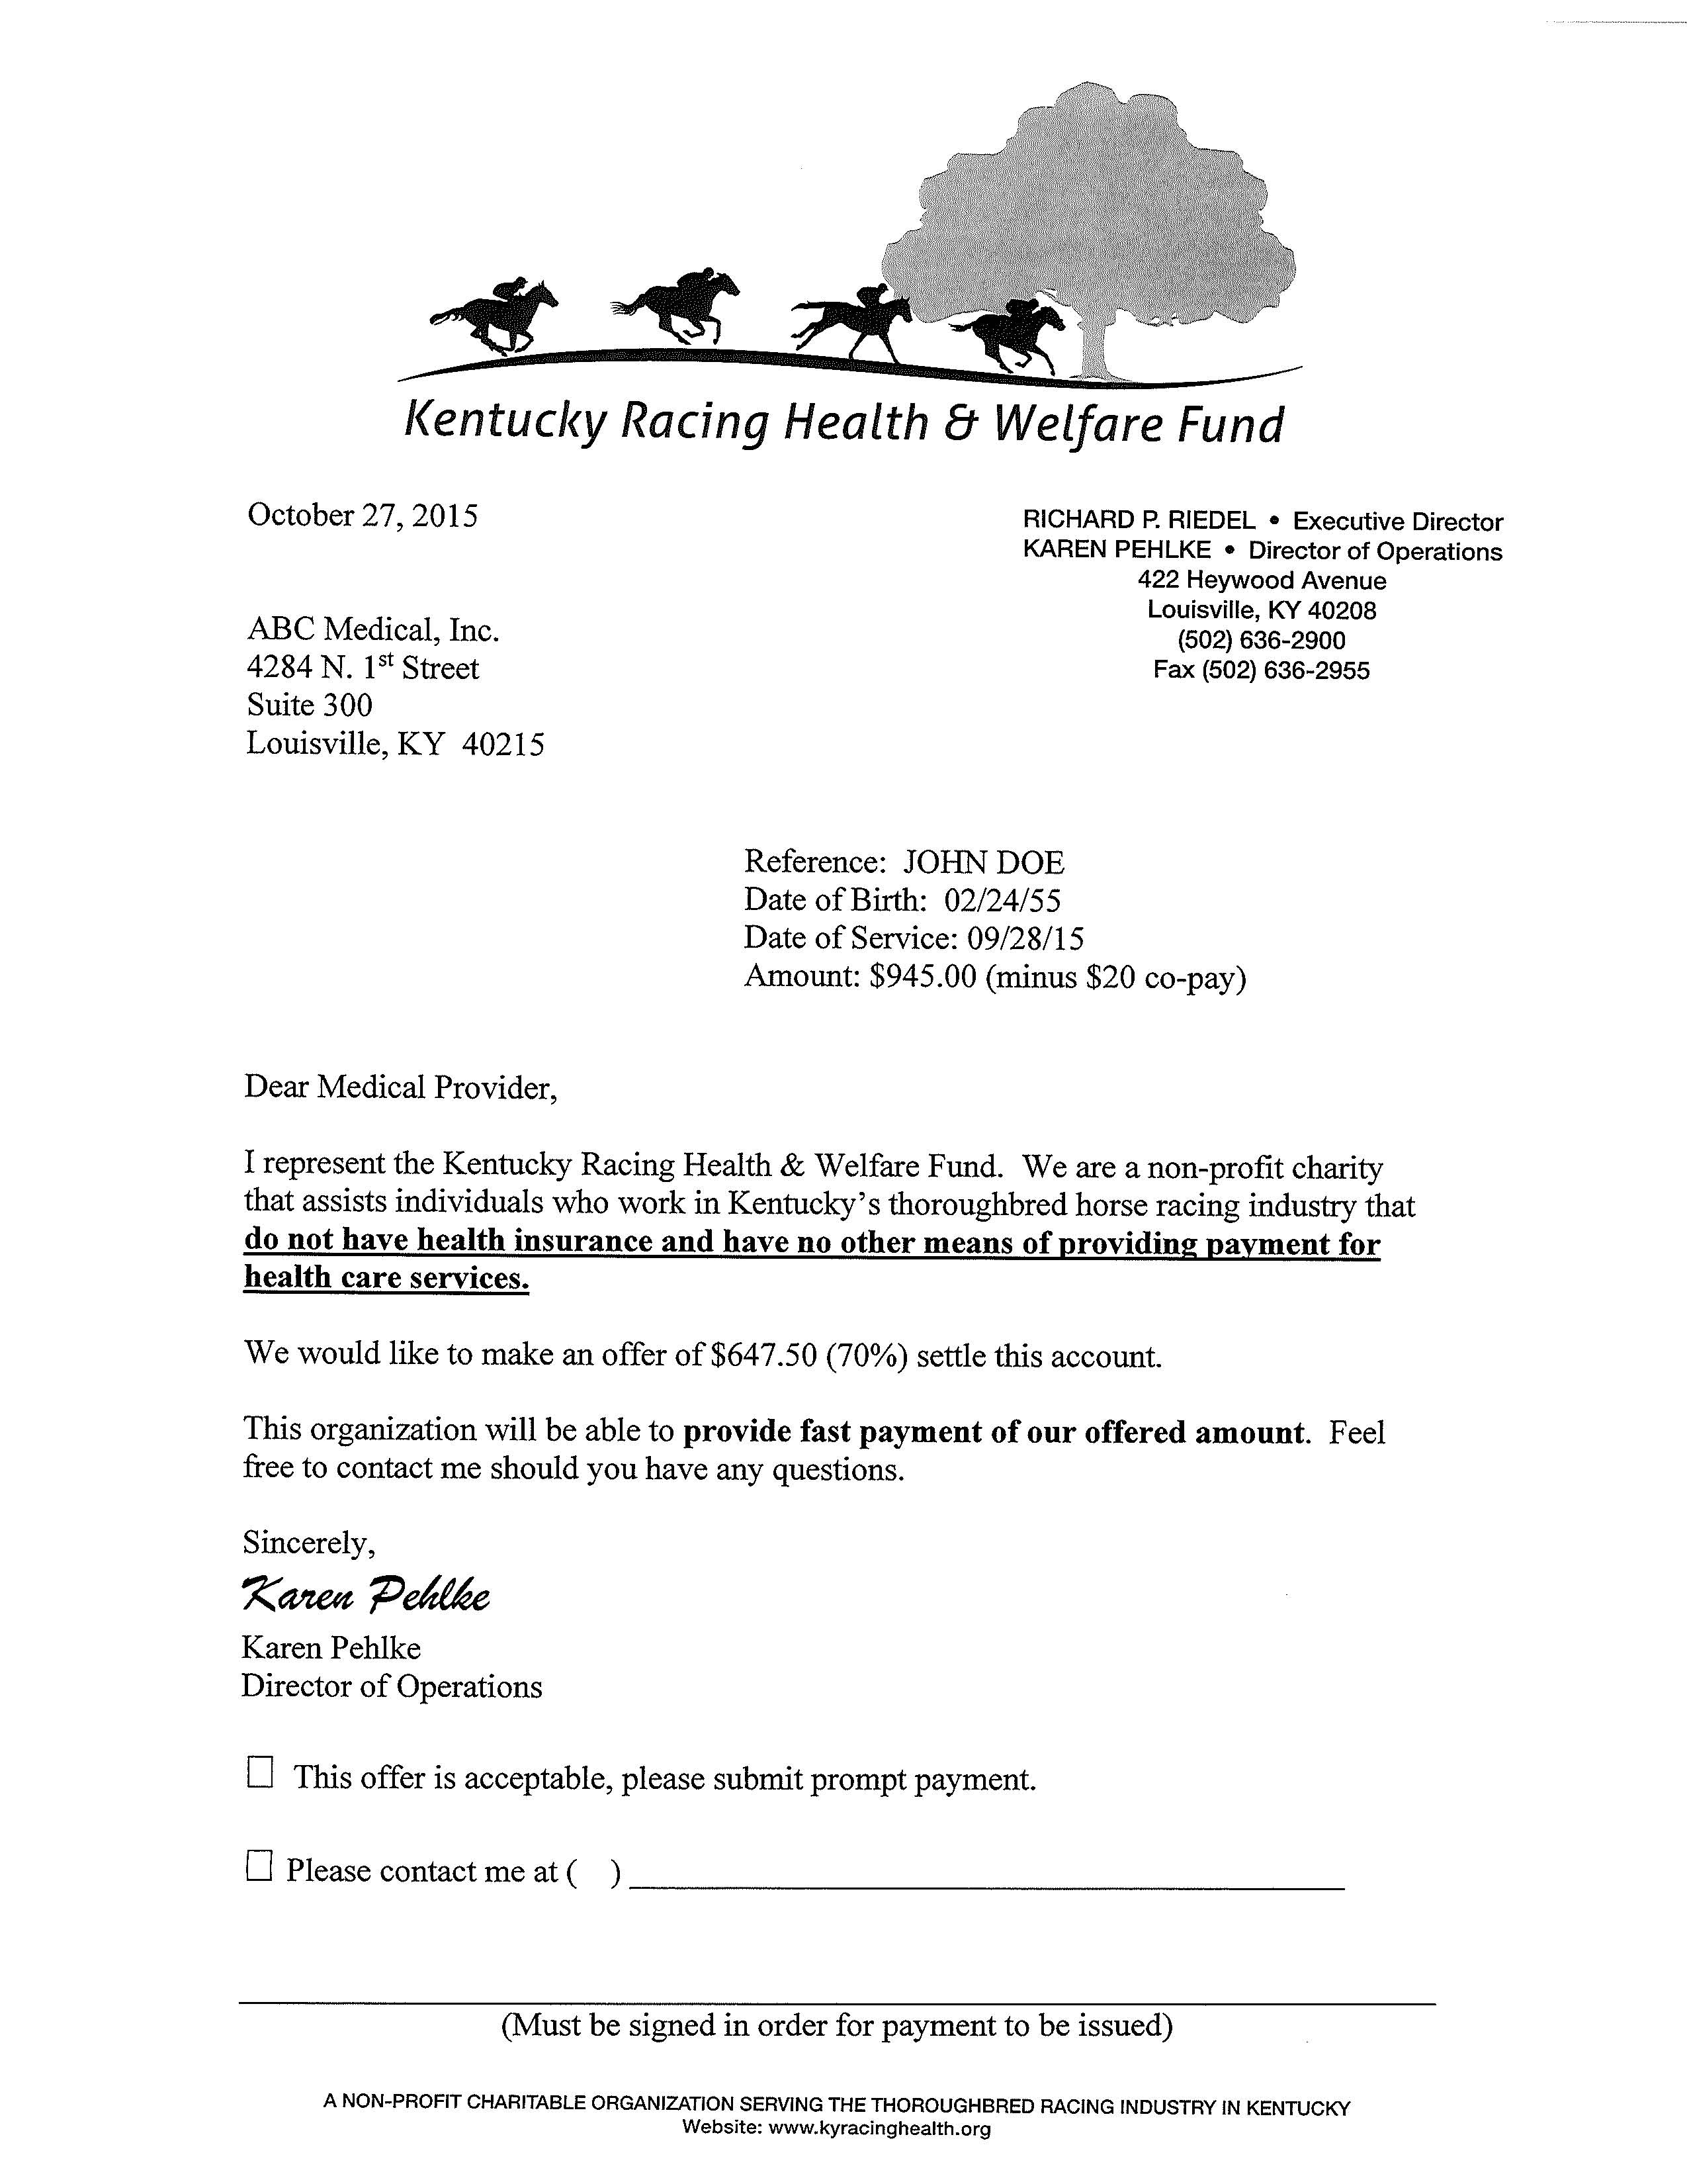
Settlement Offer Template
Date
Medical Provider
Patient and Account information
Invoice Amount
The “Read between Lines” paragraph
Our offer
Check off to accept
Check off counteroffer
Signature of acceptance

Slide 8
The Faxable Settlement Offer has several advantages
The only reason you would need to have a phone conversation is to secure the medical providers fax number (which may be on the medical invoice).
The only other reason you would need to have a phone conversation is to follow-up if you have not had a response to your generous offer (or you could just resend it).
It helps you overcome the reluctance and yucky feeling of asking for the discount.
It will save you hours of trying to reach the decision maker by phone.
It will save you hours of not being placed on hold.
It provides a permanent record of the providers’ response in case they or your client ever come back on you or your horsemen.

Slide 9
The Acceptance
Invoiced Amount: $1,383
Settlement Offer: $656.50
Accepted
Savings to Fund $691.50

Slide 10
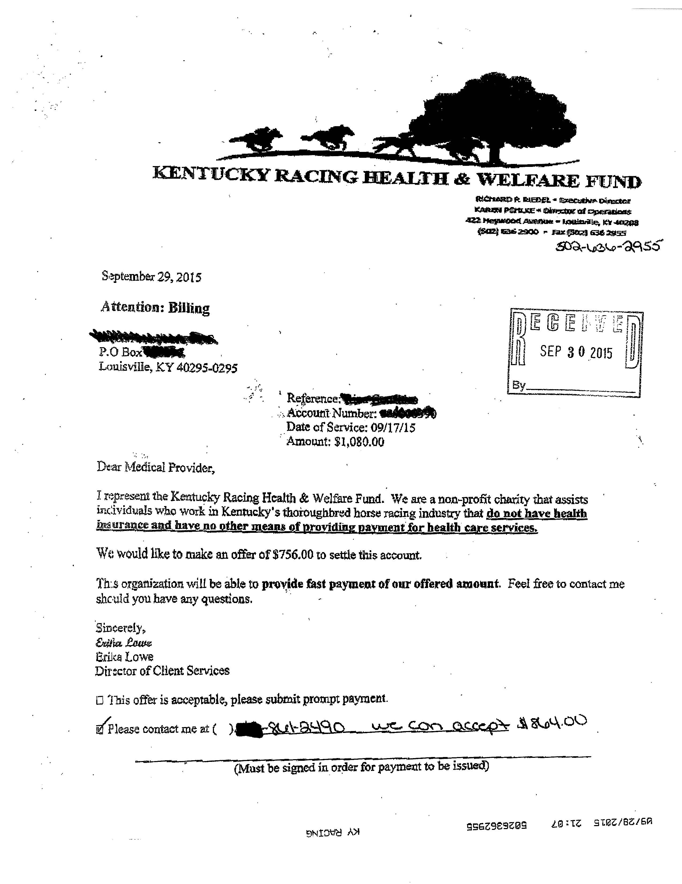
The Counteroffer
Invoiced Amount: $1,080.00
Settlement Offer: $756.00
Counteroffer: $864.00
Savings to Fund $216.00

Slide 11
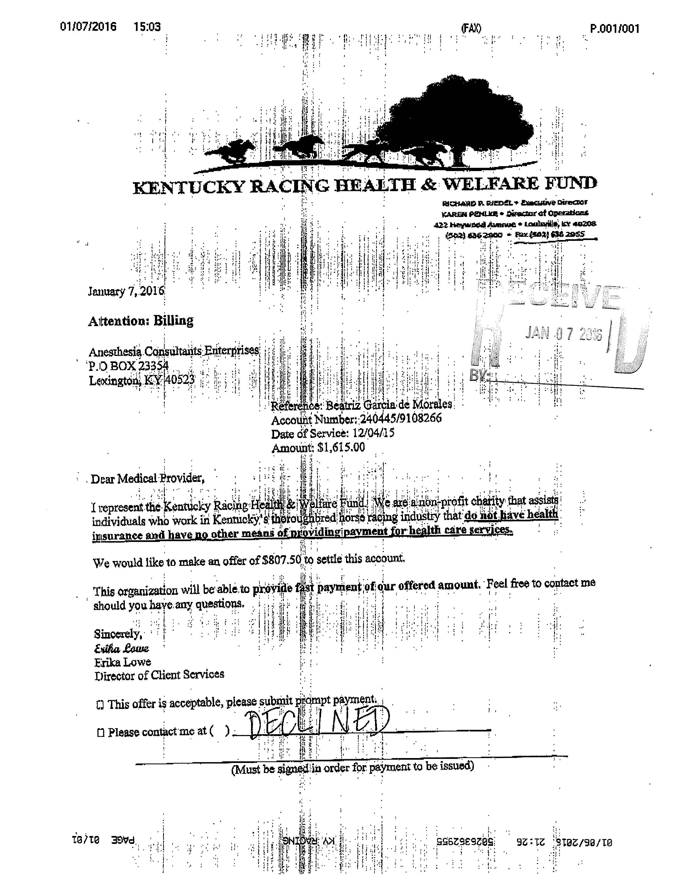
The thanks, but no
Invoiced Amount: $1,615
Settlement Offer: $807.50
Declined with no Counteroffer
Savings to Fund: $0
Sometimes “Declined” does not mean “no” but sometimes it does.

Slide 12
What Happens when a provider declines our generous offer
IN most cases when a provider Does not want to accept a settlement offer, That provider is paid last. Those who will accept a settlement offers are paid first and if there are any funds remaining then that Disagreeable provider is paid. They may Actually receive less than the settlement offer or nothing at All.
In This particular case the Client was close to maxing out his benefits. Usually this provider provides a 40% discount. Erika pushed the envelope (50%) in order to avoid the client having to pay the balance. Several days after receiving the “Declined” Offer Erika contacted the provider, explained the situation, and the Provider “declined” the Offer .

Slide 13
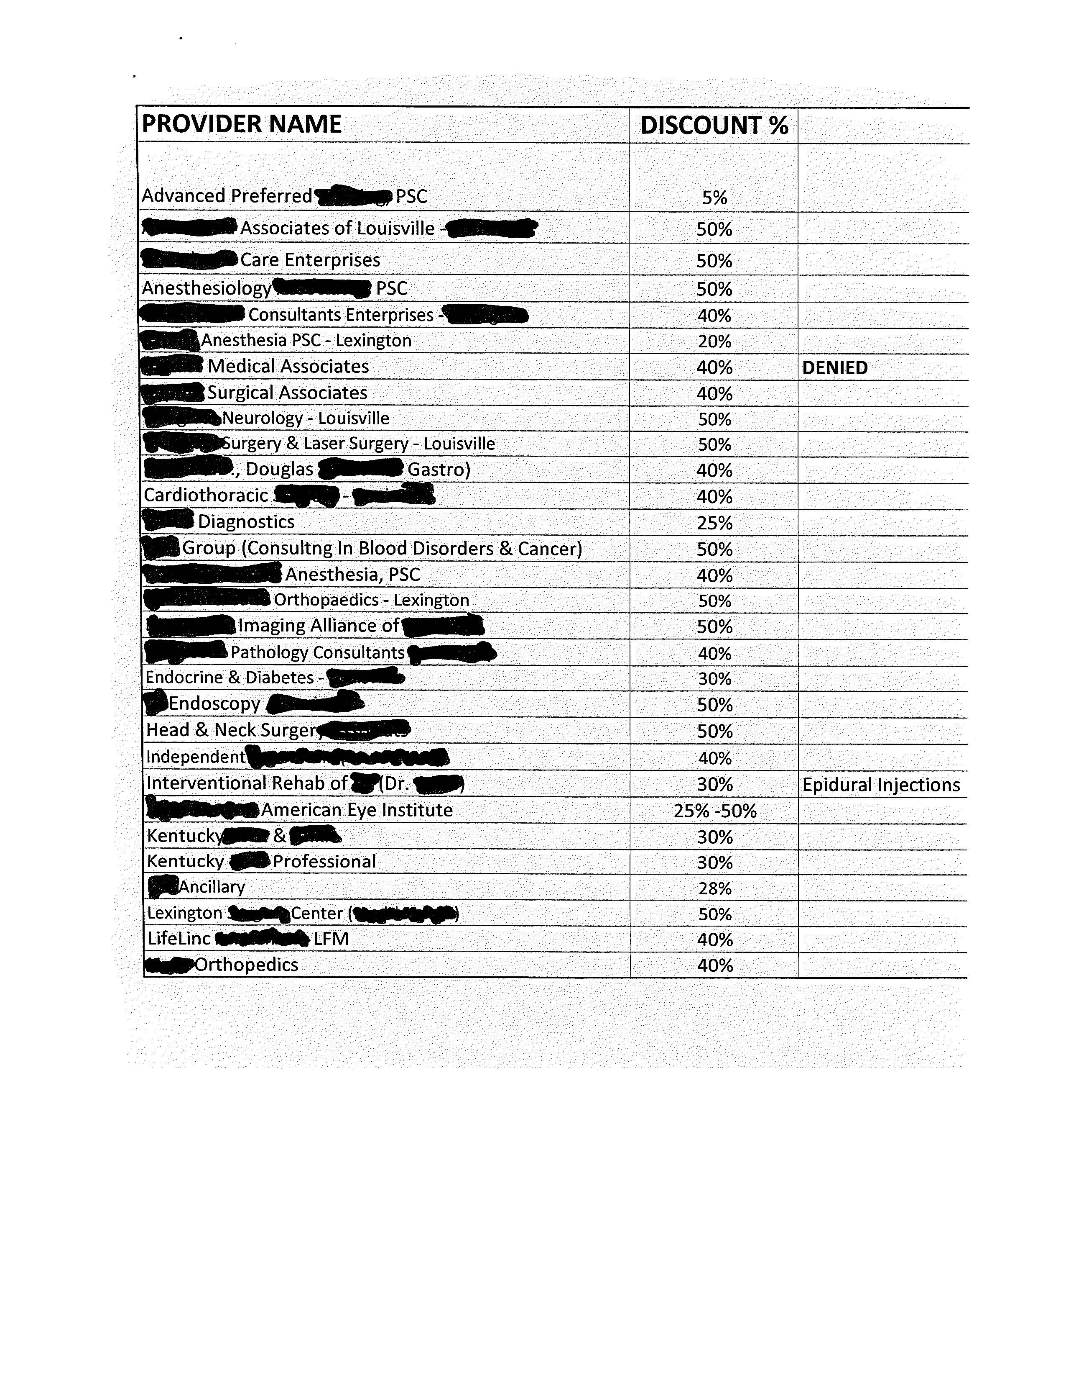
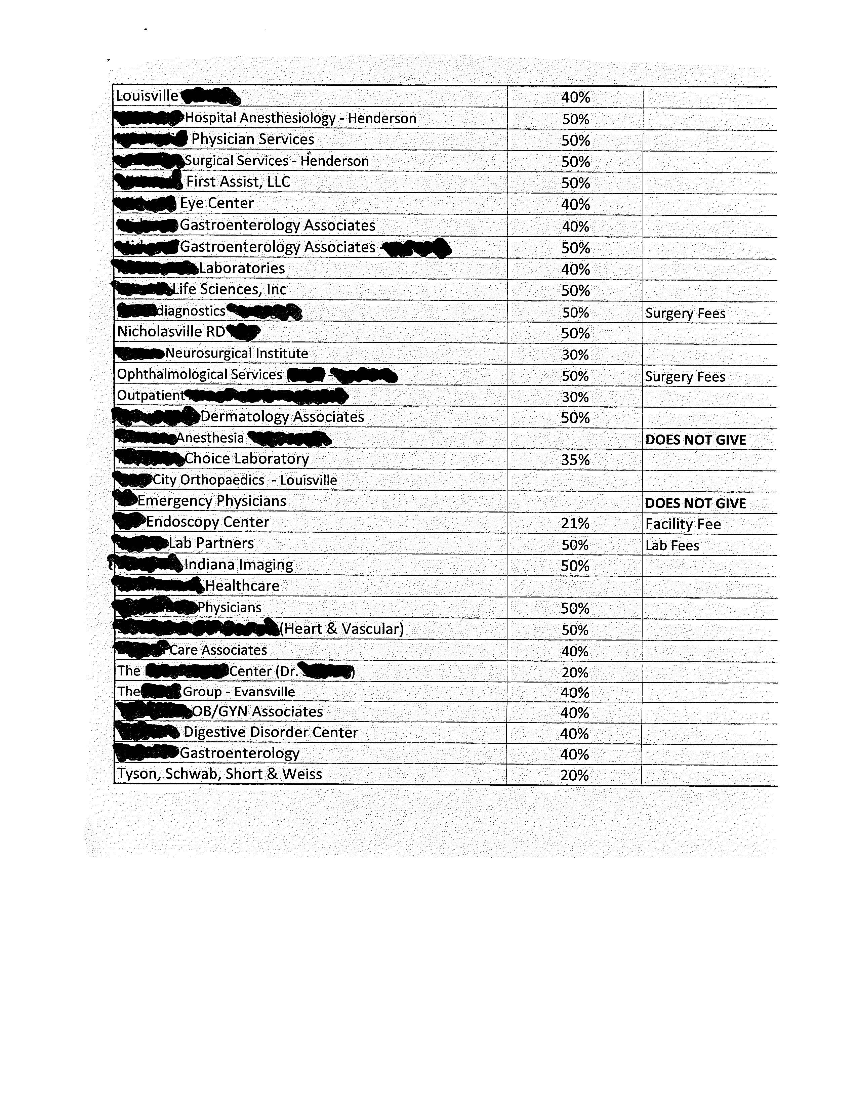
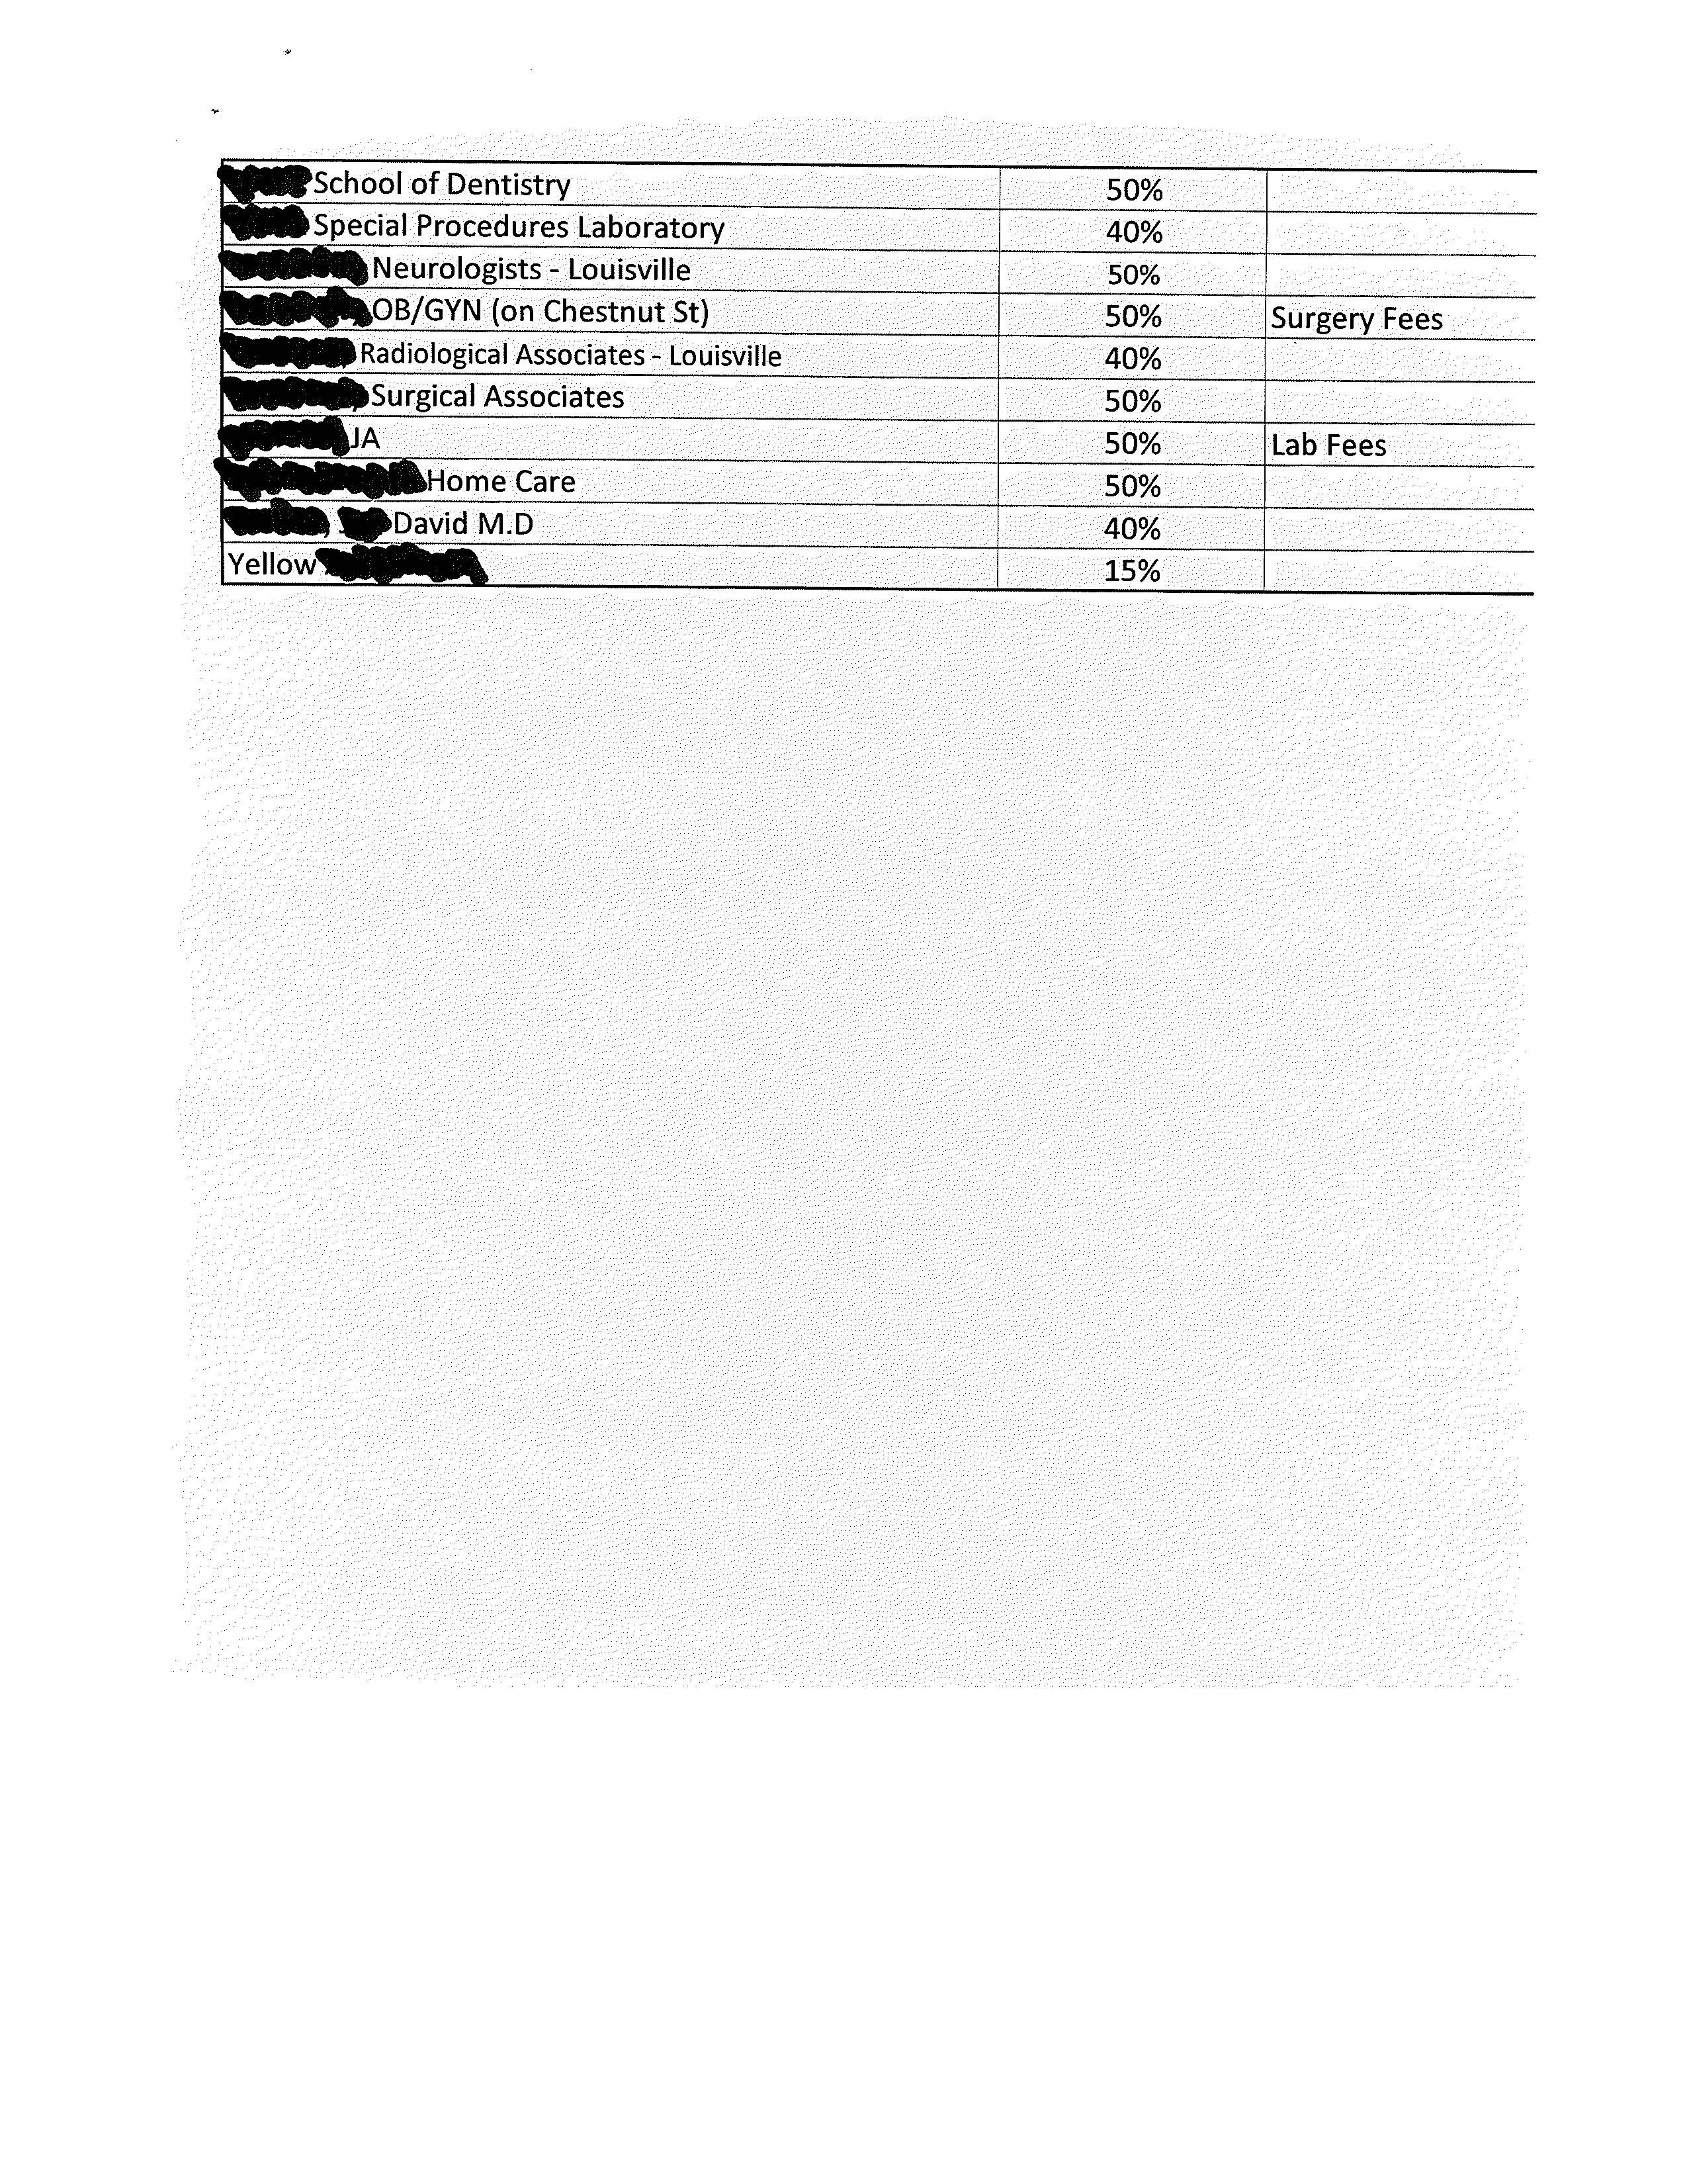
Knowing where to start your offer
List of 70 providers that we know will accept a settlement offer ranging from 5% to 50% and 3 who won’t.

Slide 14
Sending a settlement offer
We don’t send settlement offers :
to any provider with whom we have a contract
To Hospitals – As we Pay them at the uninsured discount rate.
To Any Doctor to whom we have guaranteed payment (Such as a primary care doctor)
To Dentists /Optometrist/eyeglass makers - We have a fee schedule that states our maximum dental payments
For Medical Invoices Less than $500
We do send settlement offers:
To Any Provider with Whom we Do not have a contract that has invoiced us for medical charges of $500 or more. Mostly these are specialist, but it could be any provider not mentioned in the panel to the left. When an offer is flatly declined it is usually from an Anesthesiologist.

Slide 15
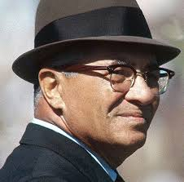
Keeping score
If winning isn't everything, why do they keep score?
Vince Lombardi
Keeping track of how much money you are saving is almost as important as the act of saving money. Sure it’s a pain keeping track of your efforts but you and your board will love the Tangible evidence of your hard work.
Keeping score of your savings is the most palpable method of showing the value of your program and your value to the organization.

Slide 16
Without getting too deep into the nuts and bolts of our record keeping
As settlement offers are received the staff members make a copy.
Once a month they give all of the copies to me.
I enter the information into a Spread Sheet.
Once a month this Tabulation and summarized information is provided to the board in a monthly summary report which includes all of the fund’s financial activity.
At our quarterly board meetings the gross figures are broken down and compared to the prior year’s activity.

Slide 17
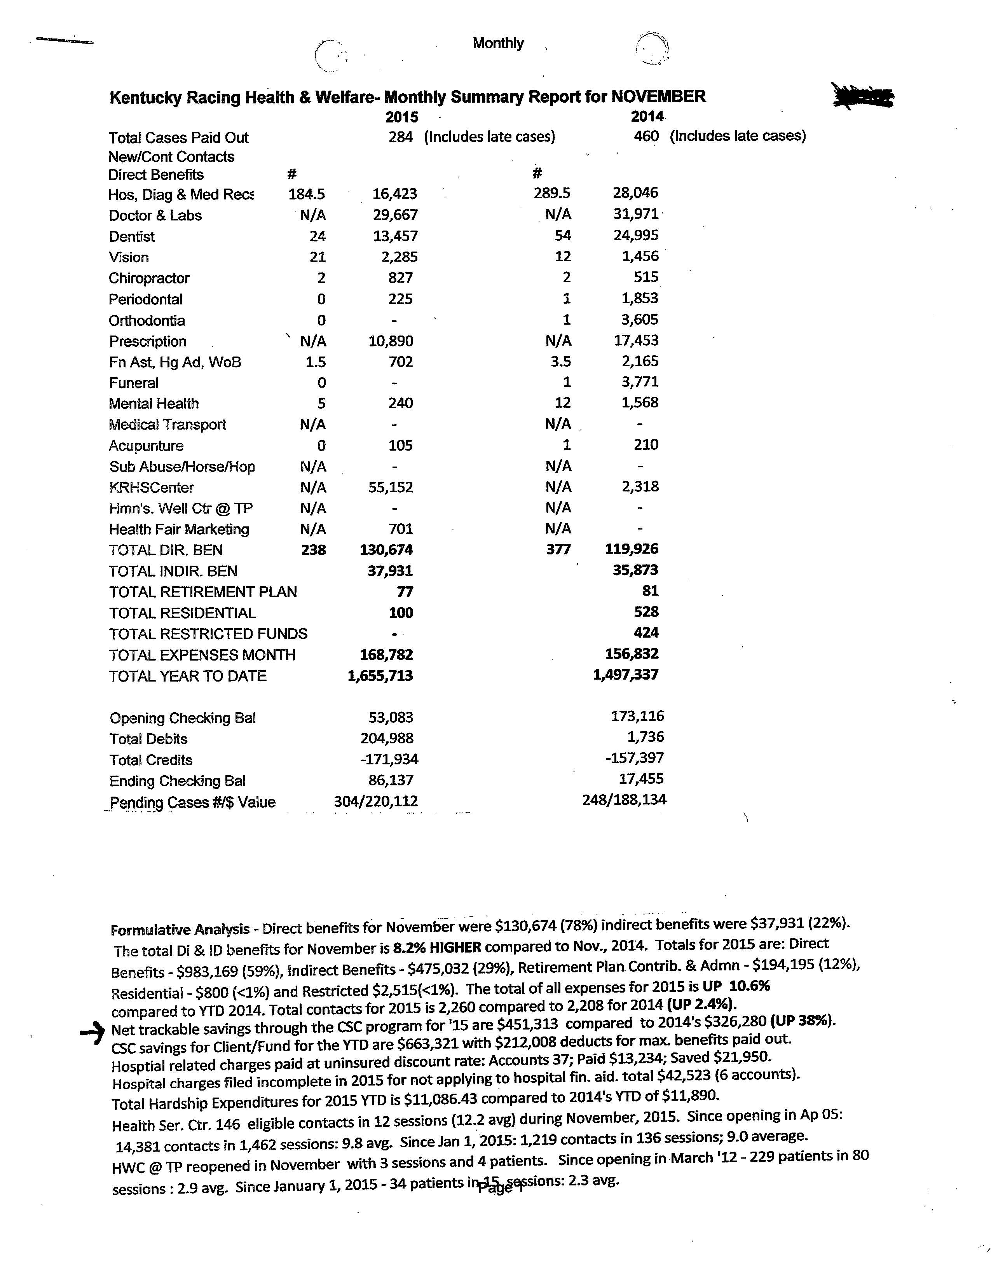
Monthly Summary Report from November 2015
CSC information contained in the body of the Formulative Analysis

Slide 18
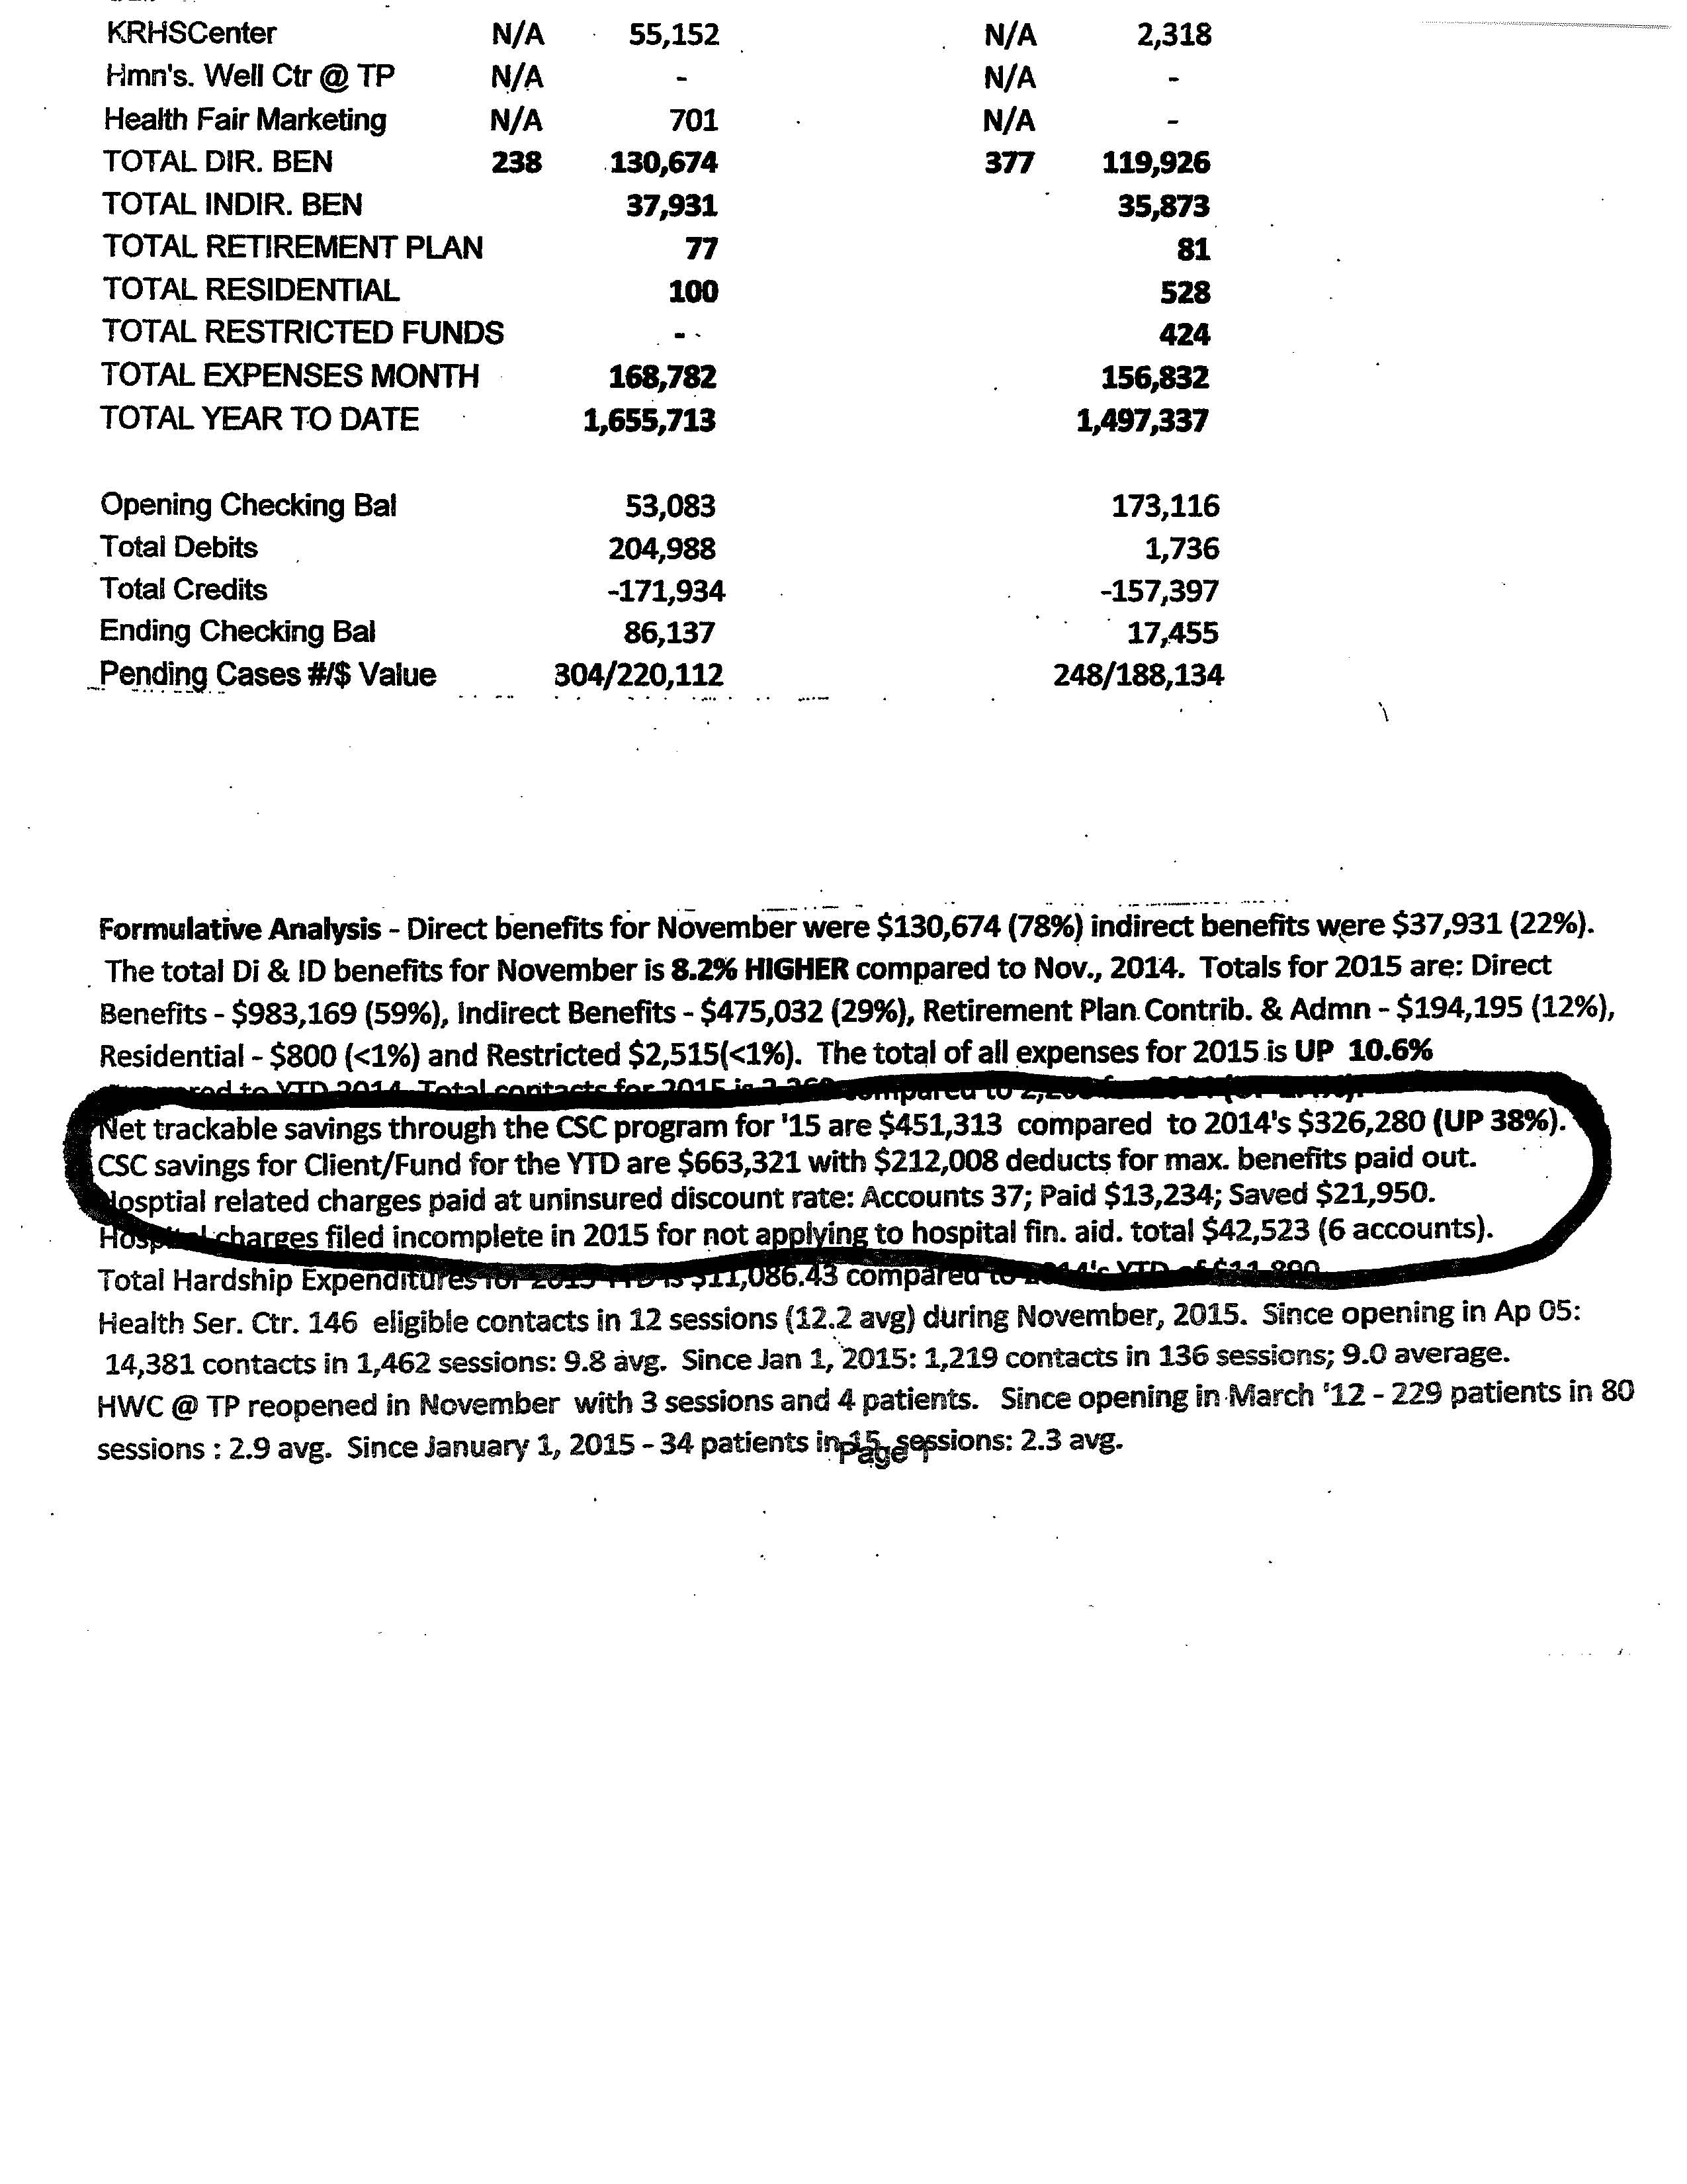
Net trackable saving through the CSC program for ‘15 are $451,313 compared to 2014’s $326,280 (UP 38%), . . . . . . . .
Hospital related charges paid at uninsured discount rate: 37 accounts; Paid out $13,234; Saved $21,950.
Hospital charges filed incomplete in 2015 for not applying to hospital fin. aid. total $42,523 (6 accounts)

Slide 19
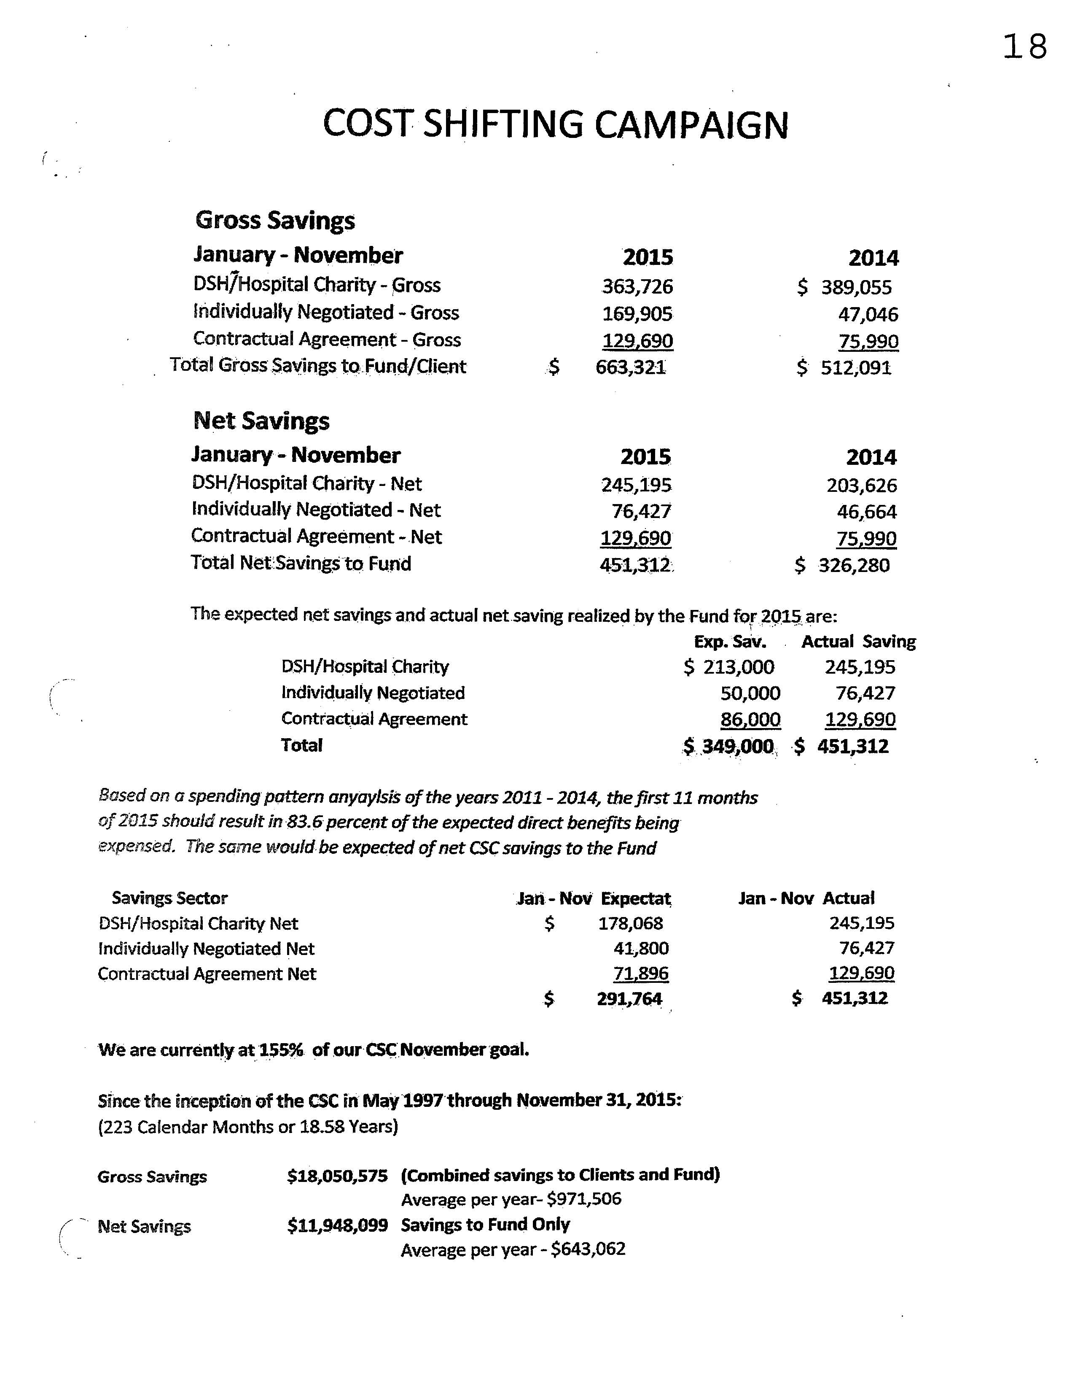
Page 18 from Quarterly
Board Meeting Book

Slide 20
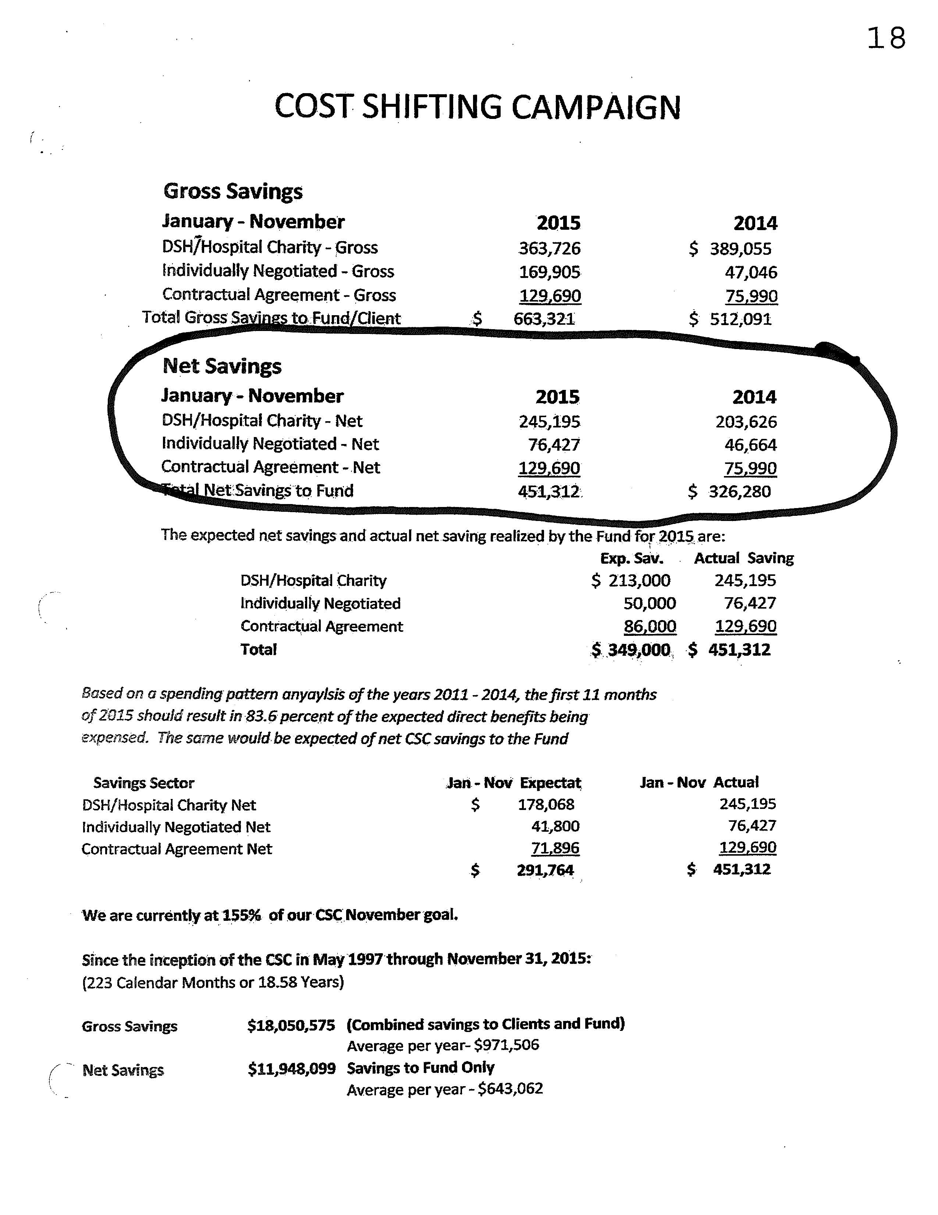
Page from Quarterly
Board Meeting Book

Slide 21
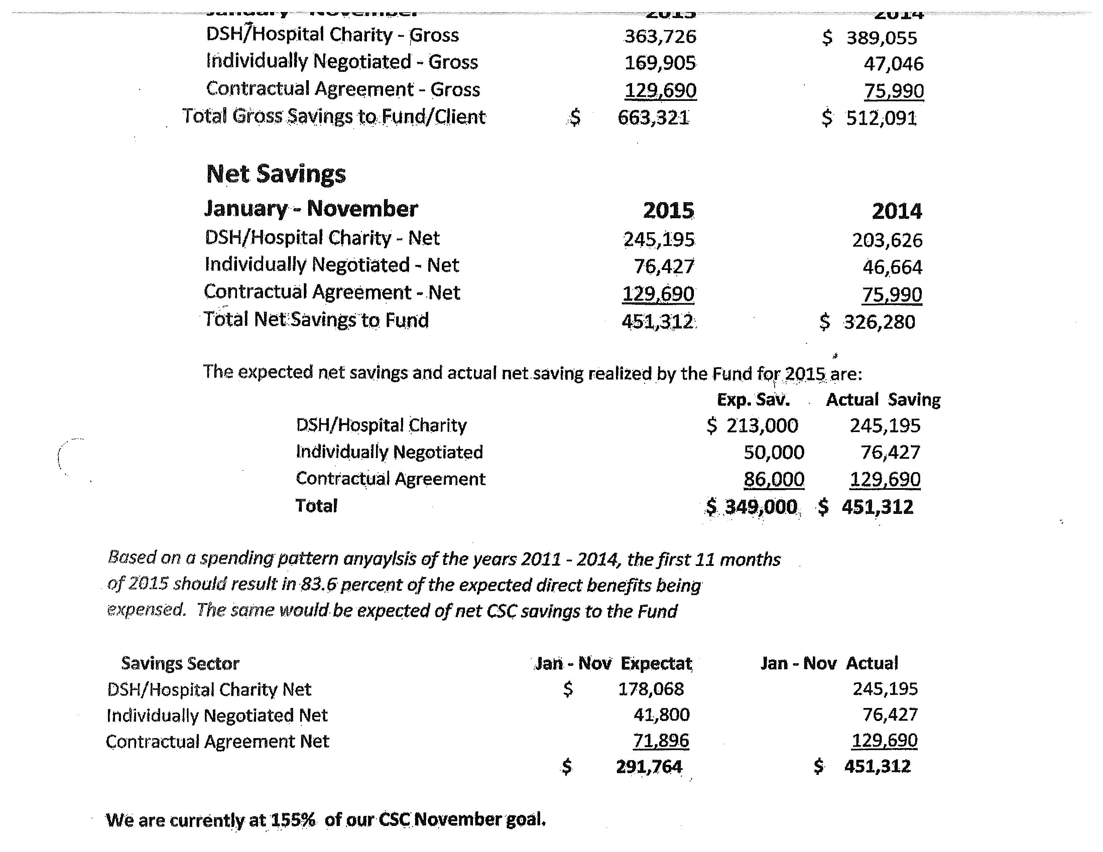
Jan-Nov 2015 the Fund paid doctor charges totaling $251,021 while saving $76,427 a discount rate of 23.3%
Before we end I want to touch on the other two components of the Cost Shifting Campaign: Hospital/Charity Programs and Contracts.

Slide 22
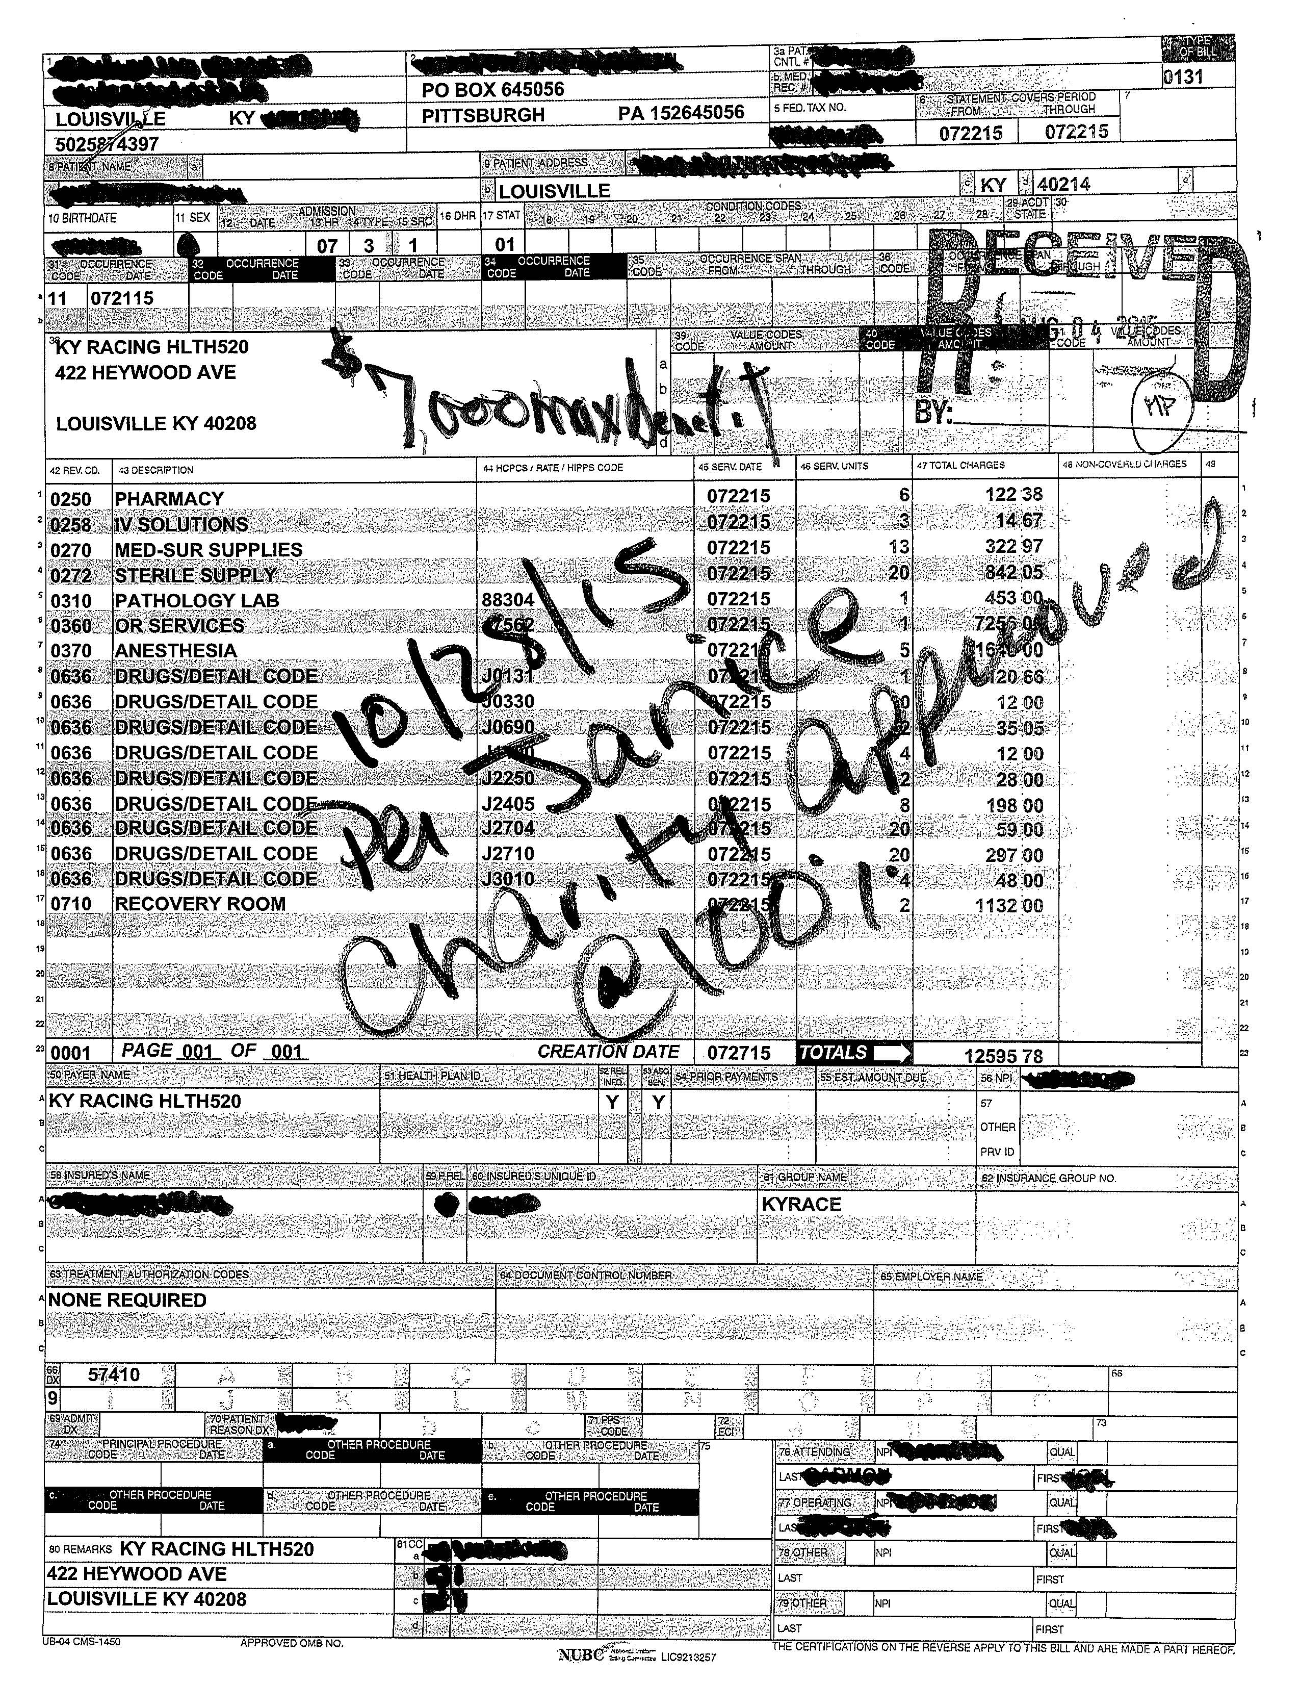
A client incurred $12,595.78 in charges at a Kentucky hospital on July 28, 2015.
We received the invoice from the hospital on August 2, 2015. Staff contacted the client and assisted in completing the hospital charity assistance application.
On October 28, 2015 we received notification from the hospital that the client was approved for a 100% write-off
This was client’s first year in Kentucky and maximum benefit was $7,000.

Slide 23
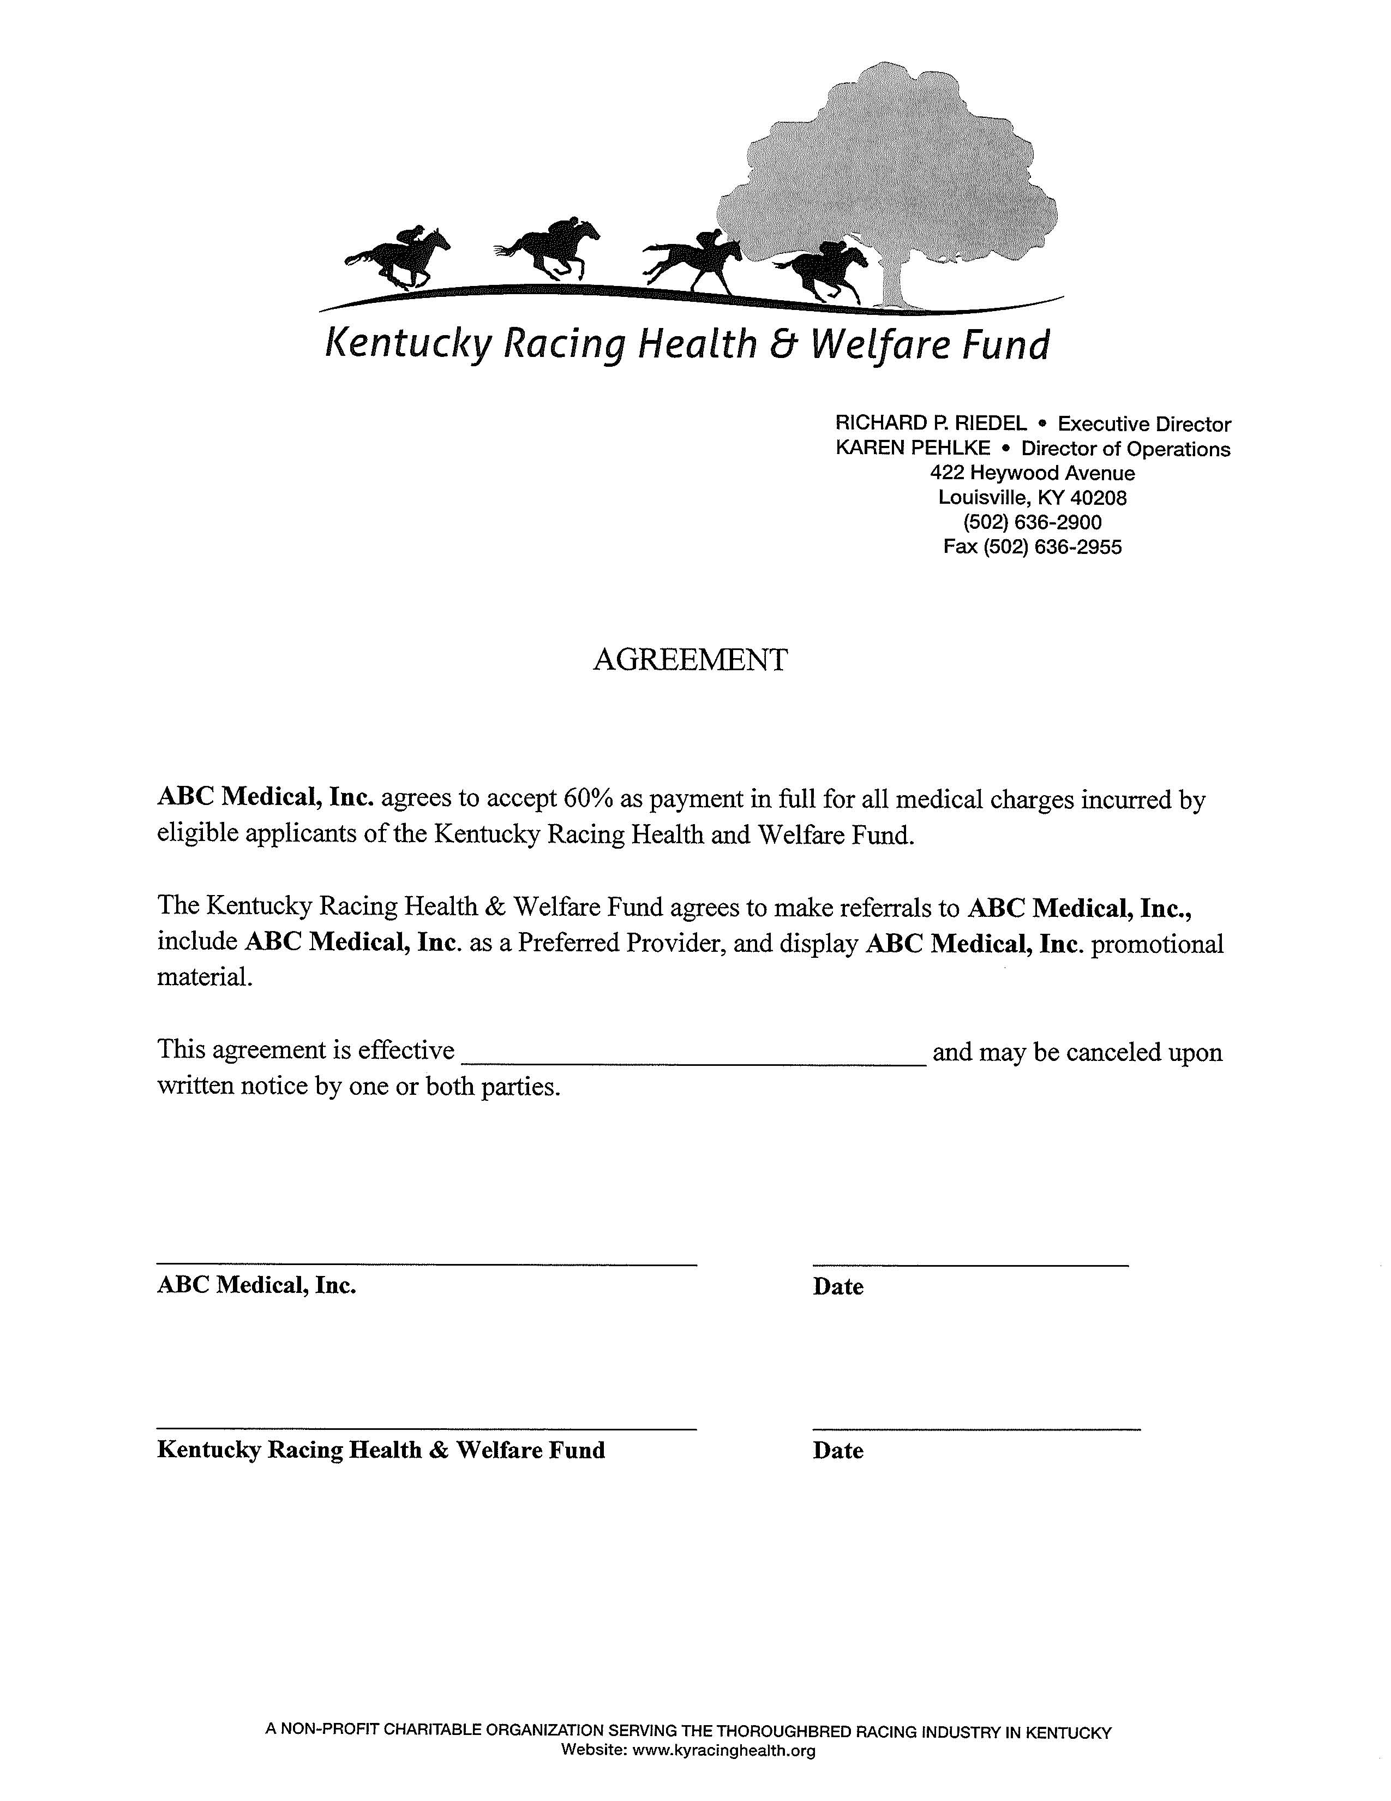
Agreement Template
Provider agrees to accept 60% as payment in full.
The Fund agrees to make referrals and display promotion materials.
Effective Date and agreement may be canceled upon written notice by one or both parties.

Slide 24
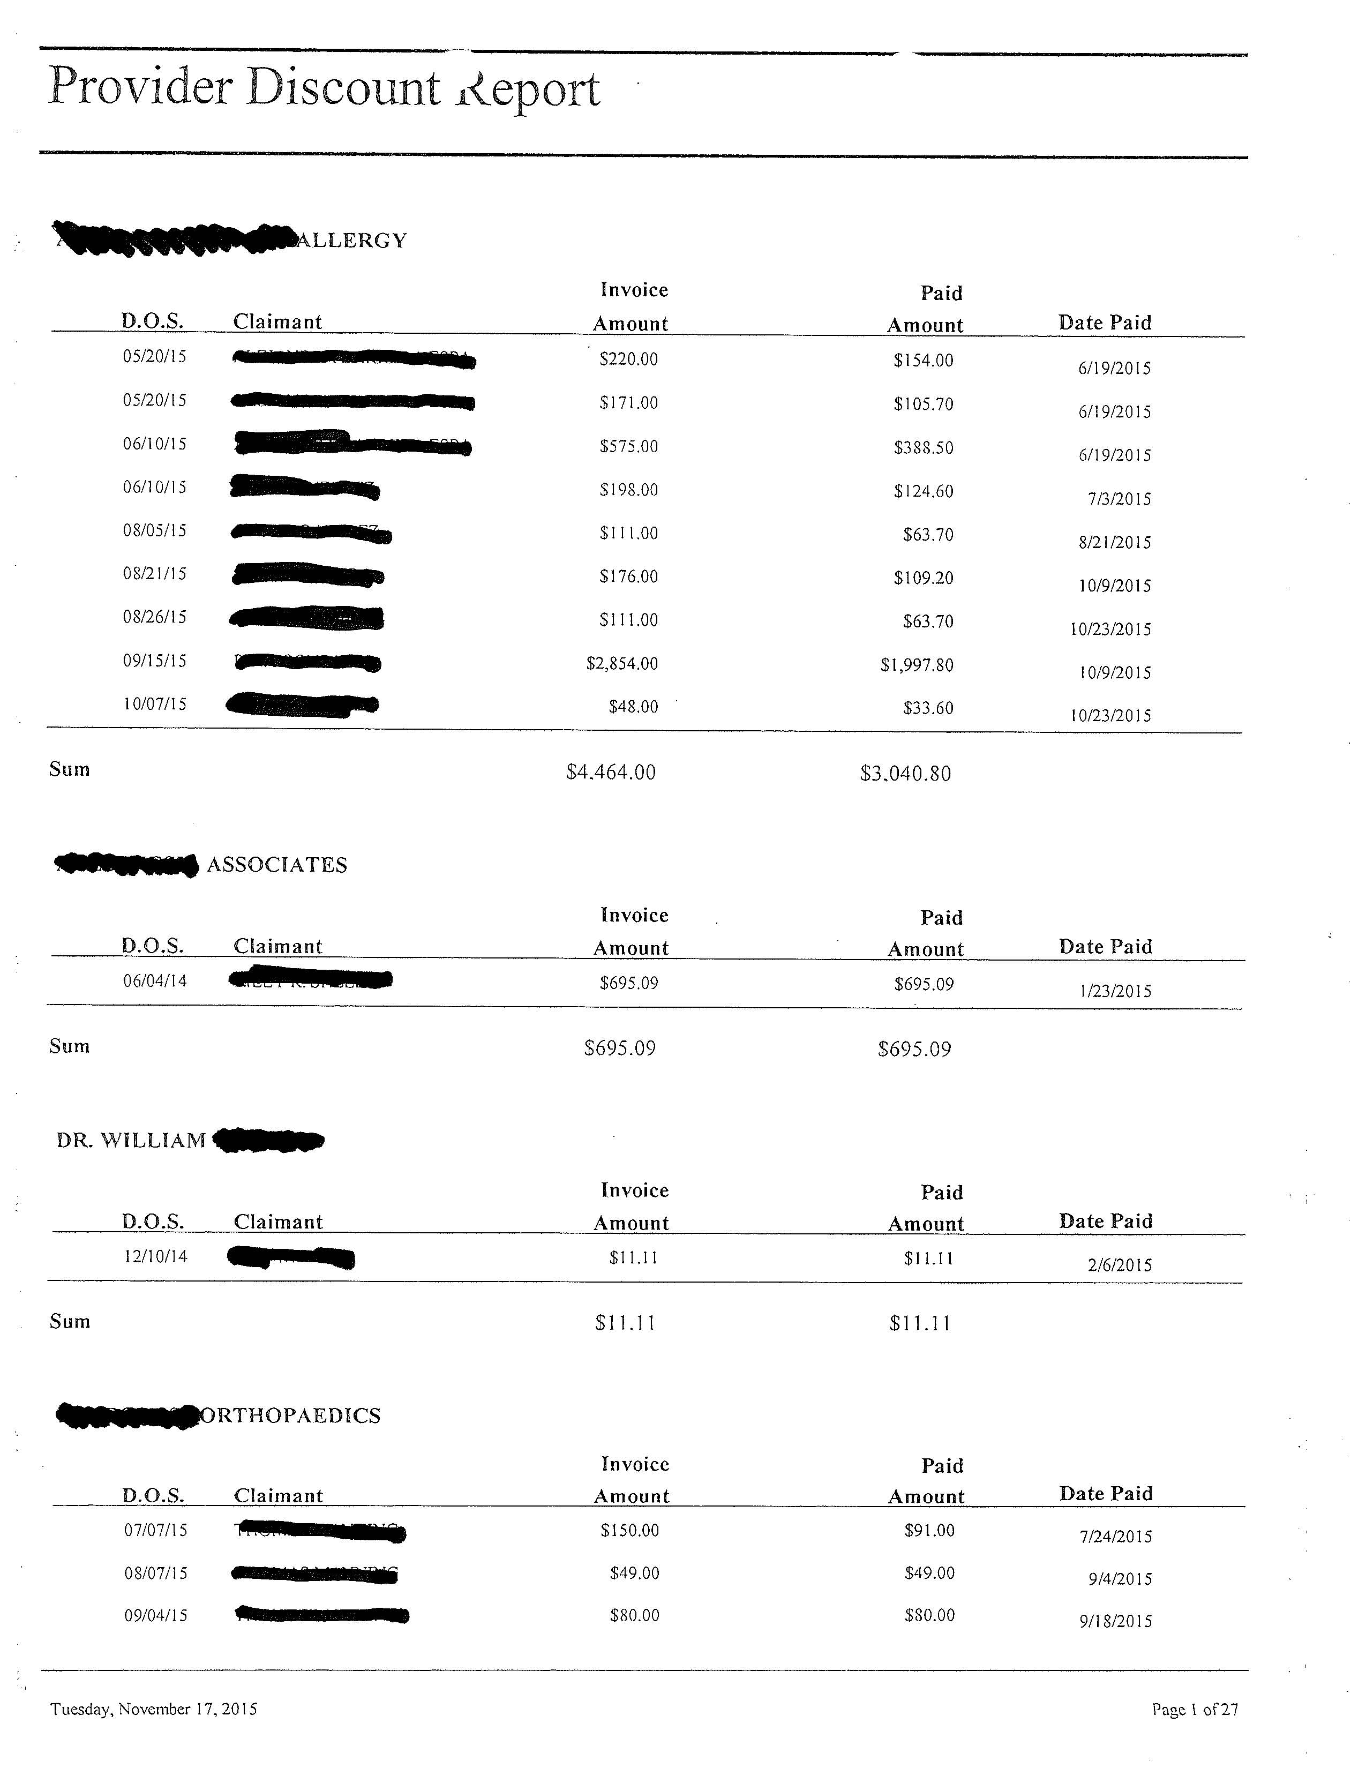
Provider Discount Report
Pg 1 of 30 - Computer Generated
Name of Provider
Date of service
Name of Client
Invoice Amount
Paid Amount
Date Invoice was paid
Details total amount of all invoices received from each provider ($4,464 from 9 accounts); the amount we paid, $3,040.80 the difference (1,423.20) is the amount we saved.
$163,679 was saved by 45 active contractual agreements in 2015.

Slide 25
For Templates of:
Faxable Settlement Offer
Medical Provider Agreement
Savings Tracking Reports
Either complete the Electronic Order Form you received at the Breakout Session (there are also copies available at the dais) and give it to me or email me at :
rriedel@kyracinghealth.org

