Slide 1
North American association of racetrack veterinarians
An Introduction:
Clara Fenger, DVM, PhD, DACVIM

Slide 2
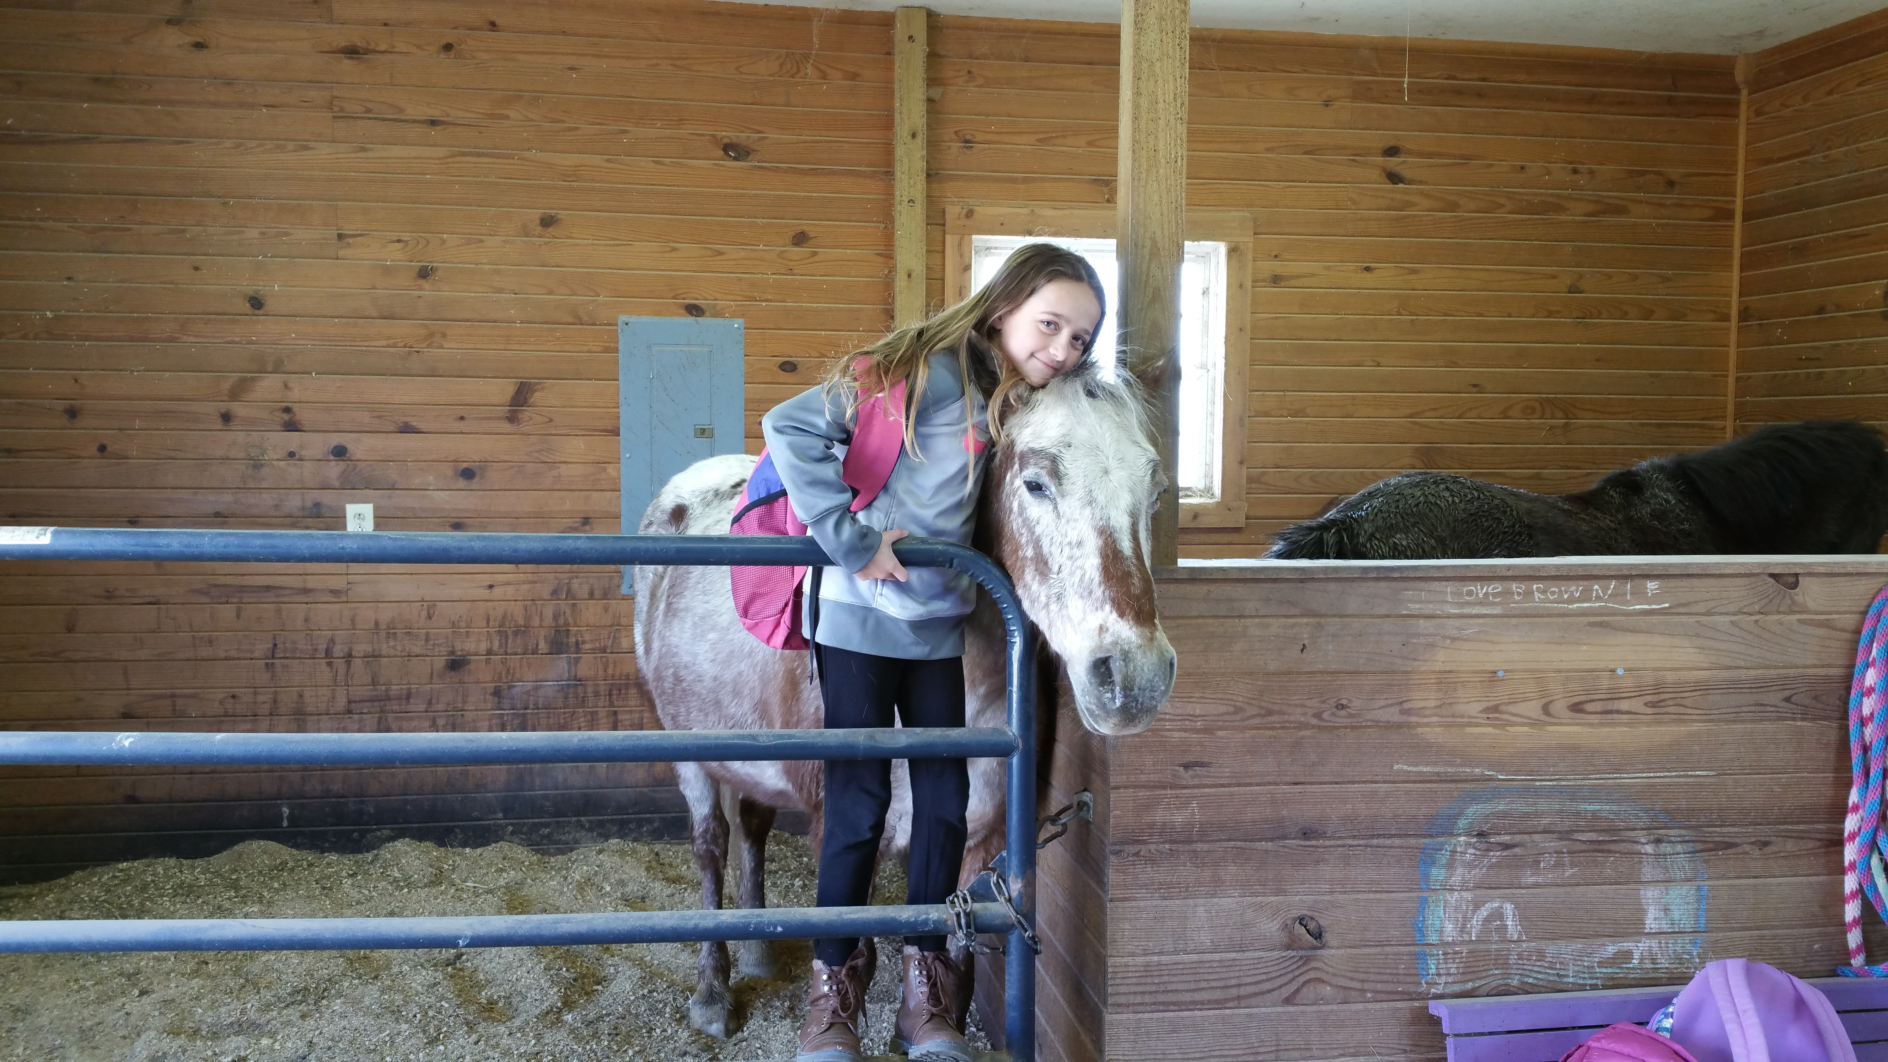
Racetrack practitioners:
How I see myself…

Slide 3
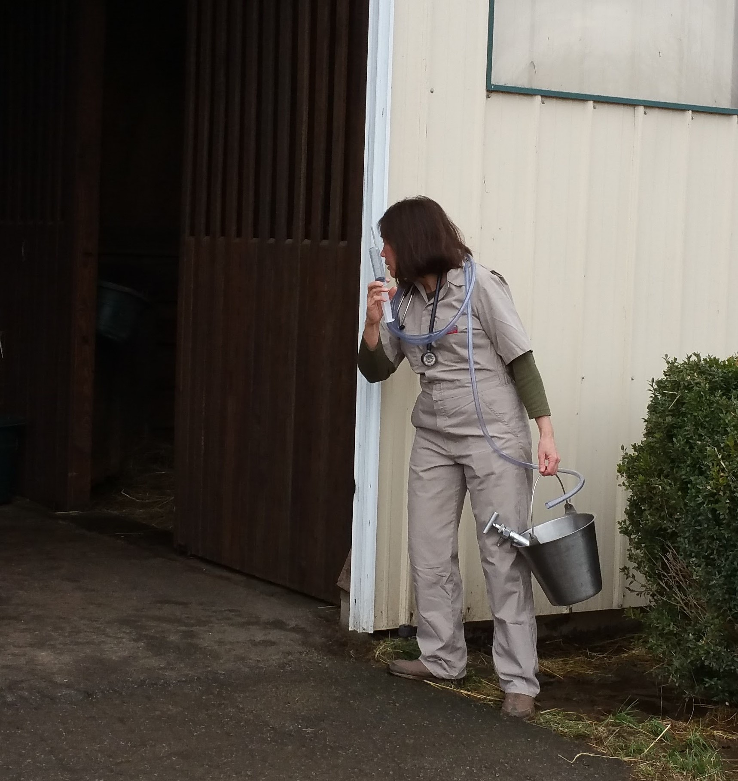
Racetrack practitioners:
Perception…

Slide 4
What is a Racetrack practitioner?
How I see myself: | Perception:
First line of defense for health of the horse
“Sneaking around” with illegal injections
Performing State-of-the-Art medicine
Drug-pushing for financial gain
Taking trainer requests into account
Doing procedures by trainer request
Careful and thorough examinations
No exams, just expensive procedures
Using the newest and latest technology
Vet bills many multiples of “the old days”

Slide 5
Racetrack practitioners:
So, which is it?

Slide 6
Racetrack practitioners:
The Veterinarian’s Oath:
“…I solemnly swear to use my scientific knowledge and skills for the benefit of society through the protection of animal health and welfare...”

Slide 7
Average veterinarian:
spends 8 years in college
student loan debt =$162,000
Cost of equipment in the truck=$250,000
Cost of licenses/dues = $400 -$1000/yr
I have too much to lose by cheating

Slide 8
Racetrack practitioners:
Progress for the benefit of the horse?
20 years ago: | Now:
Adjuncts with Lasix for bleeders
Lasix only by 3rd party Lasix vets
Calcium/B1 or Mag sulfate for calming
No calming treatment
Joint Injections when necessary
Joint injections restricted to 7 to >14 days
Practitioner can examine on raceday
No contact with practitioner on raceday
Multiple practitioners on track all day
Often no practitioners track on raceday

Slide 9
Racetrack practitioners:
Progress for the benefit of the horse?
The horse’s own vet cannot examine for fitness to race on the day of the race
Third party Lasix…because the practitioner is more likely to cheat than a regulatory practitioner?

Slide 10
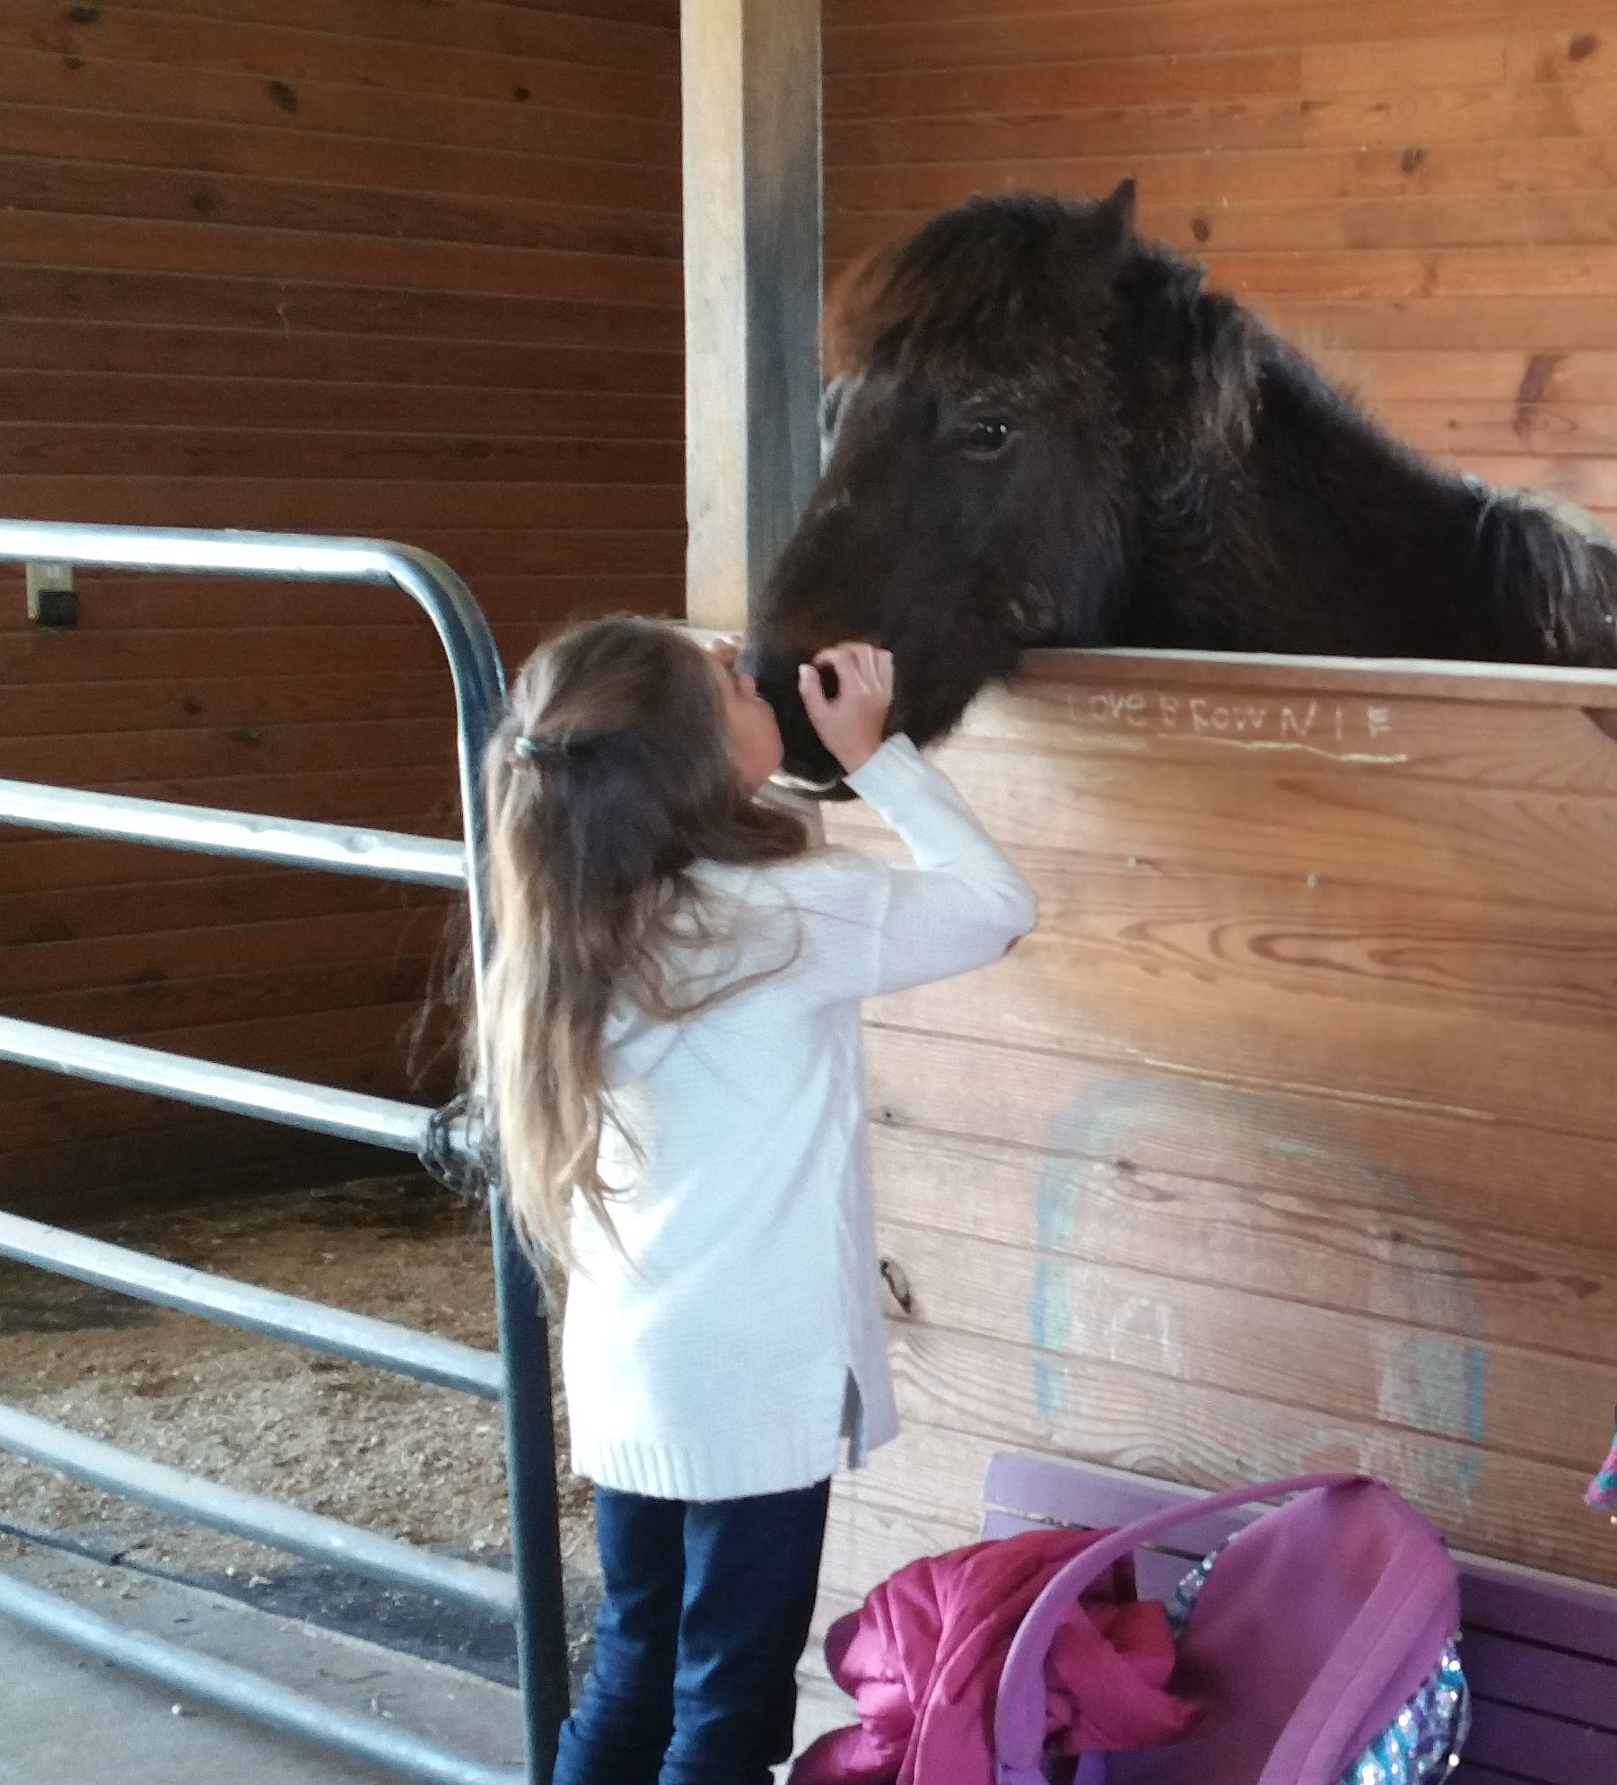
Racetrack practitioners:
Much like the horsemen, every one of us became an equine veterinarian for the love of the horse

Slide 11
Racetrack practitioners:
Criticism: Vet Bills are too high
Since 2000, the per capita cost of human health has doubled, exceeding rate of economic growth
Among the contributing factors has been the cost of generic drugs due to decreased competition

Slide 12
Racetrack practitioners:
Criticism: Vet Bills are too high
Generic human drugs are used in veterinary medicine, and have been similarly affected
Since 2000, vets have replaced aging technology with digital X-rays/ultrasounds
Regulations have criminalized the use of cheaper compounded drugs

Slide 13
Racetrack practitioners:
Criticism: Vet Bills are too high
The higher overhead because of expensive drugs and equipment have to be passed on to the client
Drug costs include cost of tying up capital, space on the truck, high receivables
All clients have the option of taking a written prescription and filling it a pharmacy

Slide 14
Racetrack practitioners:
Criticism: Vet Bills are too high
More emphasis is being put on higher priced diagnostics AND treatments:
MRI/Bone Scans
PRP/IRAP/Stem Cells
Hyperbaric Oxygen
As medical technology advances, COSTS GO UP

Slide 15
Racetrack practitioners:
Criticism: Vet Bills are too high
Solution?
It’s NOT further restriction of therapeutic medications
The restriction of therapeutic medications RAISES the cost of vet medicine

Slide 16
Vet bills too high? :
Try “no medications”:
With therapeutic medication: | Without therapeutic medication:
Lasix: $15-$25
Herbals: $2 to $5 per day*
Estrogen treatments: $15-$25 per week*
Vitamin K1: $10 per week*
*No proof of effectiveness
Change bedding to shavings: ??$*
Hyperbaric oxygen chamber: $250-$500*

Slide 17
Vet bills too high?:
Try “no medications” tying up
With therapeutic medications | Without therapeutic medications
Methocarbamol: $3/day
Vitamin E/selenium: $30*
Dantrolene: $32/day
Magnesium Sulfate Injection: $10/day*
Acepromazine: $1/day
Supplements: $1-$5 /day†
Xylazine: $1/day
*Might kill them
†no proof they work
Dexamethasone: $2/day

Slide 18
Vet bills too high?:
Try “no medications” Joint disease
With therapeutic medications | Without therapeutic medications
Inject hocks with Depo-Medrol: $300 x 6 mo
IRAP: $200/weekly x 4wks, every 6 mos
PRP: $800, every 6 weeks
*No proof of effectiveness
Zeel/Traumeel: $200/weekly*
OsPhos/Tildren: $400-1000, every 6 months
Retirement

Slide 19
Vet bills too high?:
The answer is NOT to increase regulation of therapeutic medications
The underlying problem is systemic and not because of profiteering by the racetrack vets

Slide 20
Economics and the condition book:
Owners complain more about training in perpetuity without getting to race than about their vet bills: the two go hand in hand
Many procedures are done to “make a race”
Current restrictive medication rules compound the problem, running owners out of the business

Slide 21
The solution: education of owners
Owners need to be equal partners in the decision making process of managing a racehorse
Trainers have care, custody and control: they need to be trusted to make the right decisions
“Hay, oats and water” does not mean depriving horses of medication. It means that if you are unwilling to treat a condition with medication, the horse must be retired.

Slide 22
Racetrack practitioners:
Criticism: Vets Do Not Examine horses
Veterinarians ALWAYS examine the patient. Owners have no idea that it took place, because they receive no bill
With owners complaining about vet bills, trainers would not have the vet examine the horses IF it resulted in a charge

Slide 23
Racetrack practitioners:
Criticism: Vets perform procedures by trainer request, not medical necessity
Veterinarians ALWAYS rely on trainer opinions as part of the work up and history
No one, including the vet, knows that horse as well as the trainer, so his/her input is an important part of the exam

Slide 24
NAARV:
In 2014, NAARV formed because of negative perceptions of the racetrack practitioners, and the direction of the current NUMPS which institutionalizes the vilification of the racetrack veterinarian

Slide 25
Racetrack practitioners:
After trusting the AAEP and other organization members of the RMTC
to develop rational uniform rules, with disastrous results, one of the main goals of NAARV is advocacy to work with RCI to effect appropriate reform:
To achieve science based Uniformity

Slide 26
NAARV: Based on the hbpa model:
Executive Director to keep the details of the organization in order
Each jurisdiction has a Director
The Directors sit on committees to further the goals of the organization
Chief role is advocacy in everything which affects horses and horse racing

Slide 27
NAARV: Based on the horsemen’s model:
Executive Committee
Board of Directors
Geographical Districts
Breed and Discipline
Liaisons with horsemen groups
President: Don Shields
Vice President: Nick Mettinis
Secretary: Clara Fenger

Slide 28
NAARV:
As part of our mission, we are spearheading research initiatives to guide vets and horsemen in the appropriate use of therapeutics in race horses

Slide 29
NAARV:
Our 501(c)3 charitable foundation to handle research and other funds is the
Equine Health and Welfare Alliance

