Slide 1
Environmental Contamination with Therapeutic Medications:
Clara Fenger, DVM, PhD, DACVIM

Slide 2
Environmental Contamination:
Advent of the Controlled Therapeutic Medication Schedule in April 2013
Permit the use of therapeutic medications for the treatment of a living breathing animal athlete using the most advanced Modern Medicine for the benefit of the horse
Prohibit the use of all performance enhancing drugs (PEDs) within proximity to racing for a level playing field
Impose penalties sufficiently harsh to discourage cheating
Substances not on the list = zero tolerance

Slide 3
Zero Tolerance?:
Consequences of Zero Tolerance in Human Forensics:
Increasing sensitivity of drug testing has resulted in the wrongful conviction of people on drug charges
Contamination of 90% of paper currency with cocaine
Federal Government considers 100 ng/mL BZE to be consistent with NO DRUG USE
Morphine at 50 ng/mL (urine)
Amphetamine 250 ng/mL (urine)
Methamphetamine 250 ng/mL (urine) and a positive REQUIRES presence of Amphetamine at 100 ng/mL (metabolite)
Wrongful accusations have resulted in:
Children taken away from parents
Drug convictions of innocent people
Return to prison of innocent parolees

Slide 4
Zero Tolerance?:
Consequences of Zero Tolerance in Horse Racing:
In Human Criminal Justice:
Cut-offs and screening limits have been established
Due process has been applied
In Horse Racing:
Most Class 1 violations occur at levels which are consistent with environmental contamination
Levels which could not possibly result in any effect on the animal
Picogram concentrations in blood (or nanogram concentrations in urine)
Pg/mL = ppb

Slide 5
Pg/mL = one a trillion
Jupiter
(picture courtesy of NASA)
Earth
(picture courtesy of NASA)
One in a trillion miles =
The trip to Jupiter and back
1000 times

Slide 6
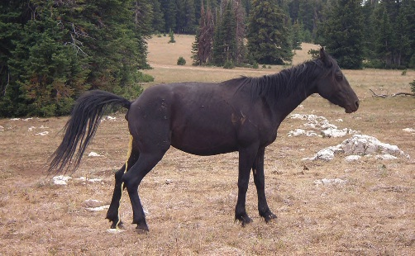
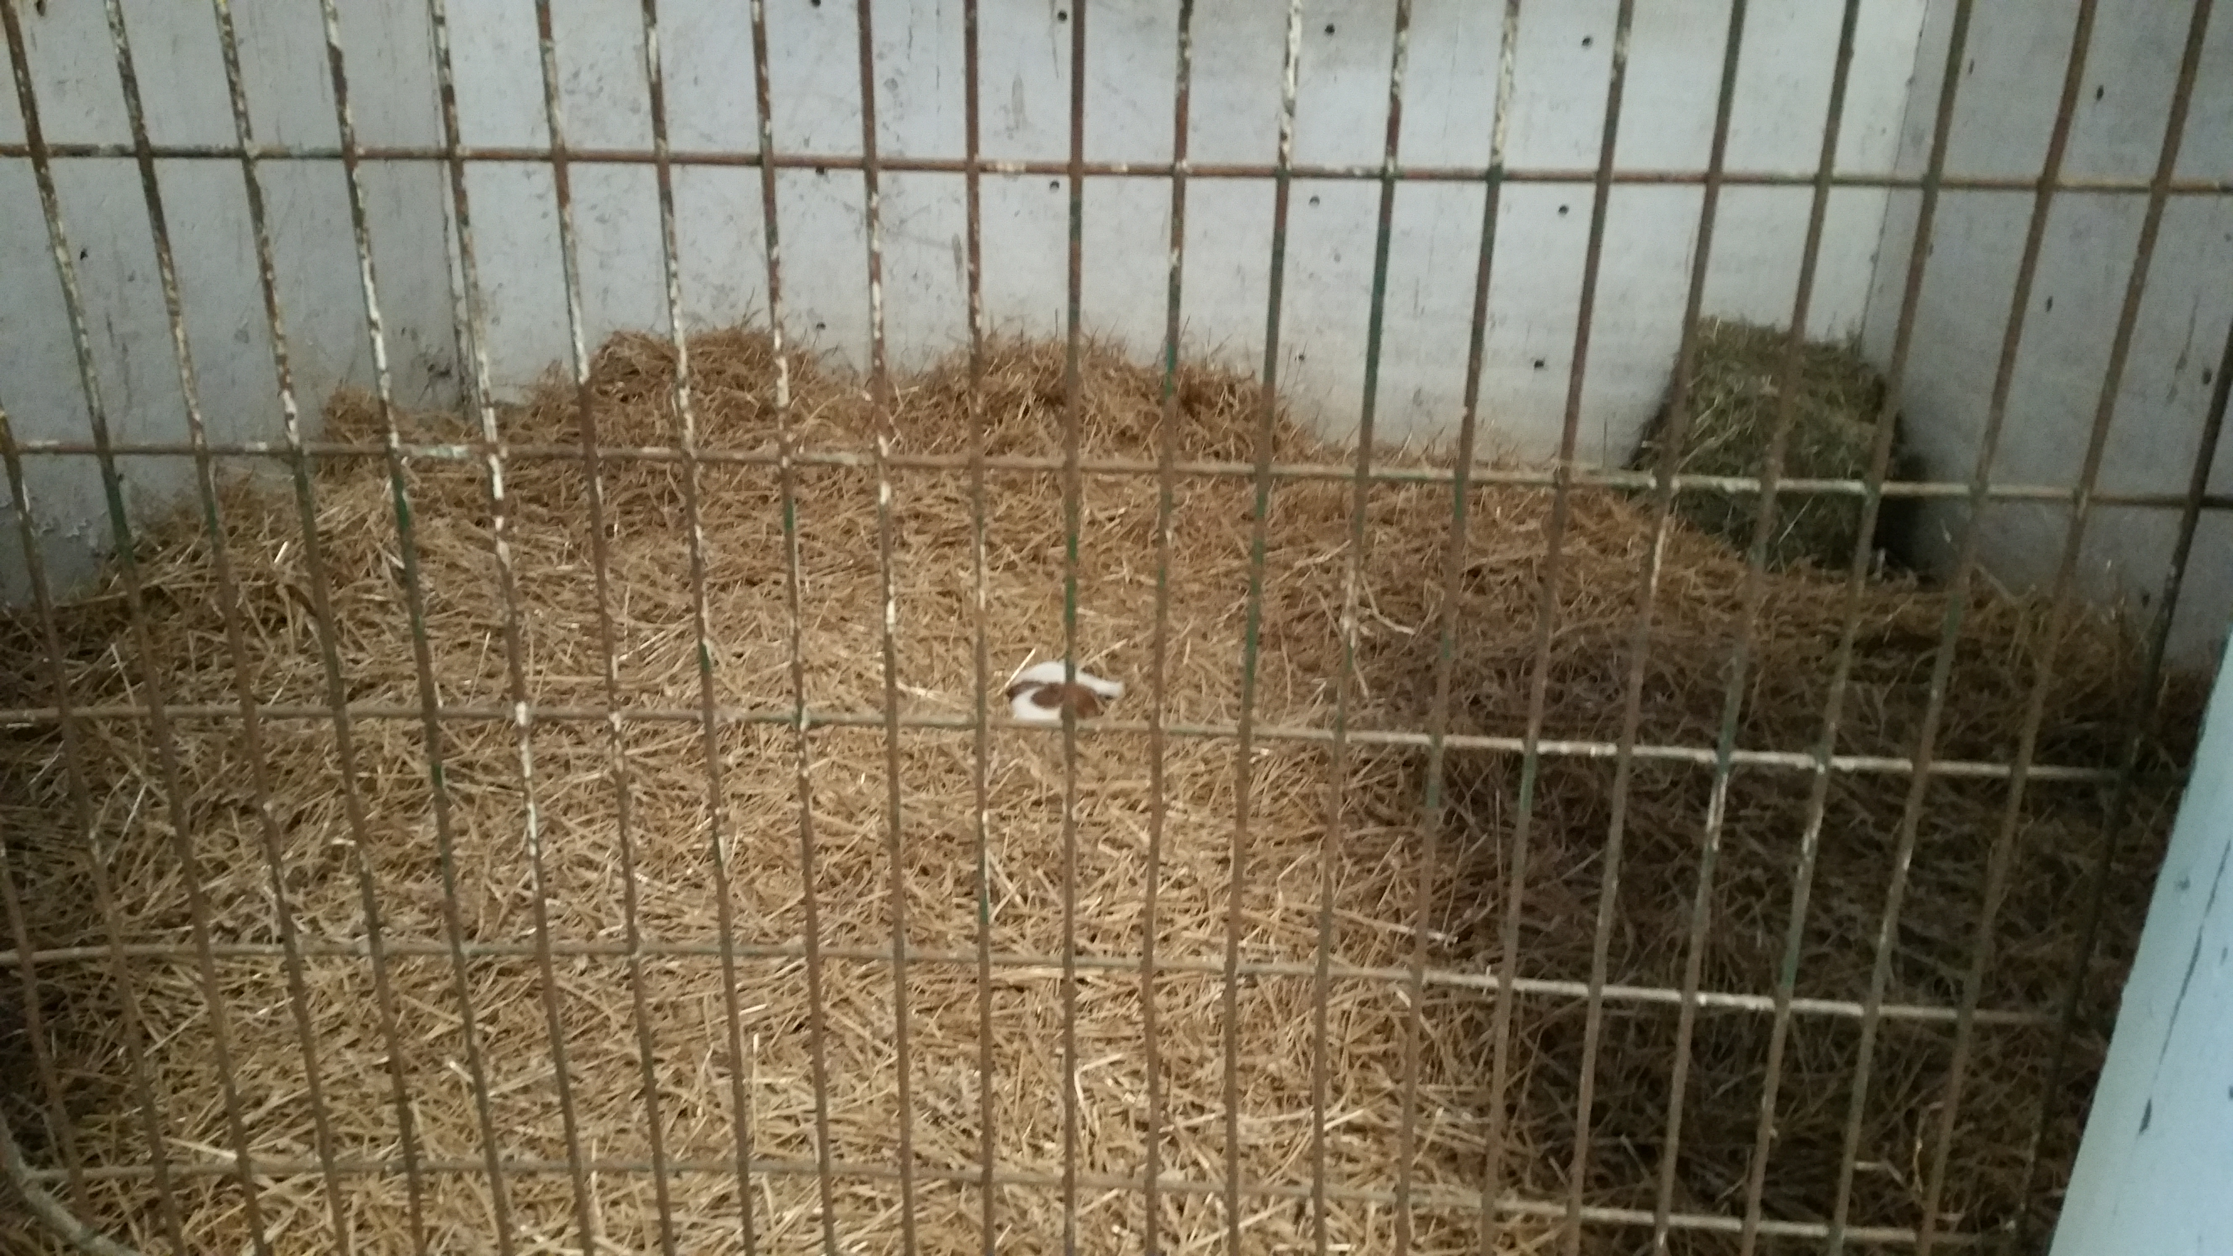
Environmental Contamination Three Key Characteristics:
1. Stable in the Environment
2. Readily Absorbed Orally
3. Eliminated in the Urine in High Concentrations

Slide 7
Environmental Contamination:
Typically think of Class 1 drugs
Methamphetamine
Tramadol
Morphine
Cocaine
BUT, ANY substance which fulfills the three key characteristics of an environmental contaminant COULD lead to a positive

Slide 8
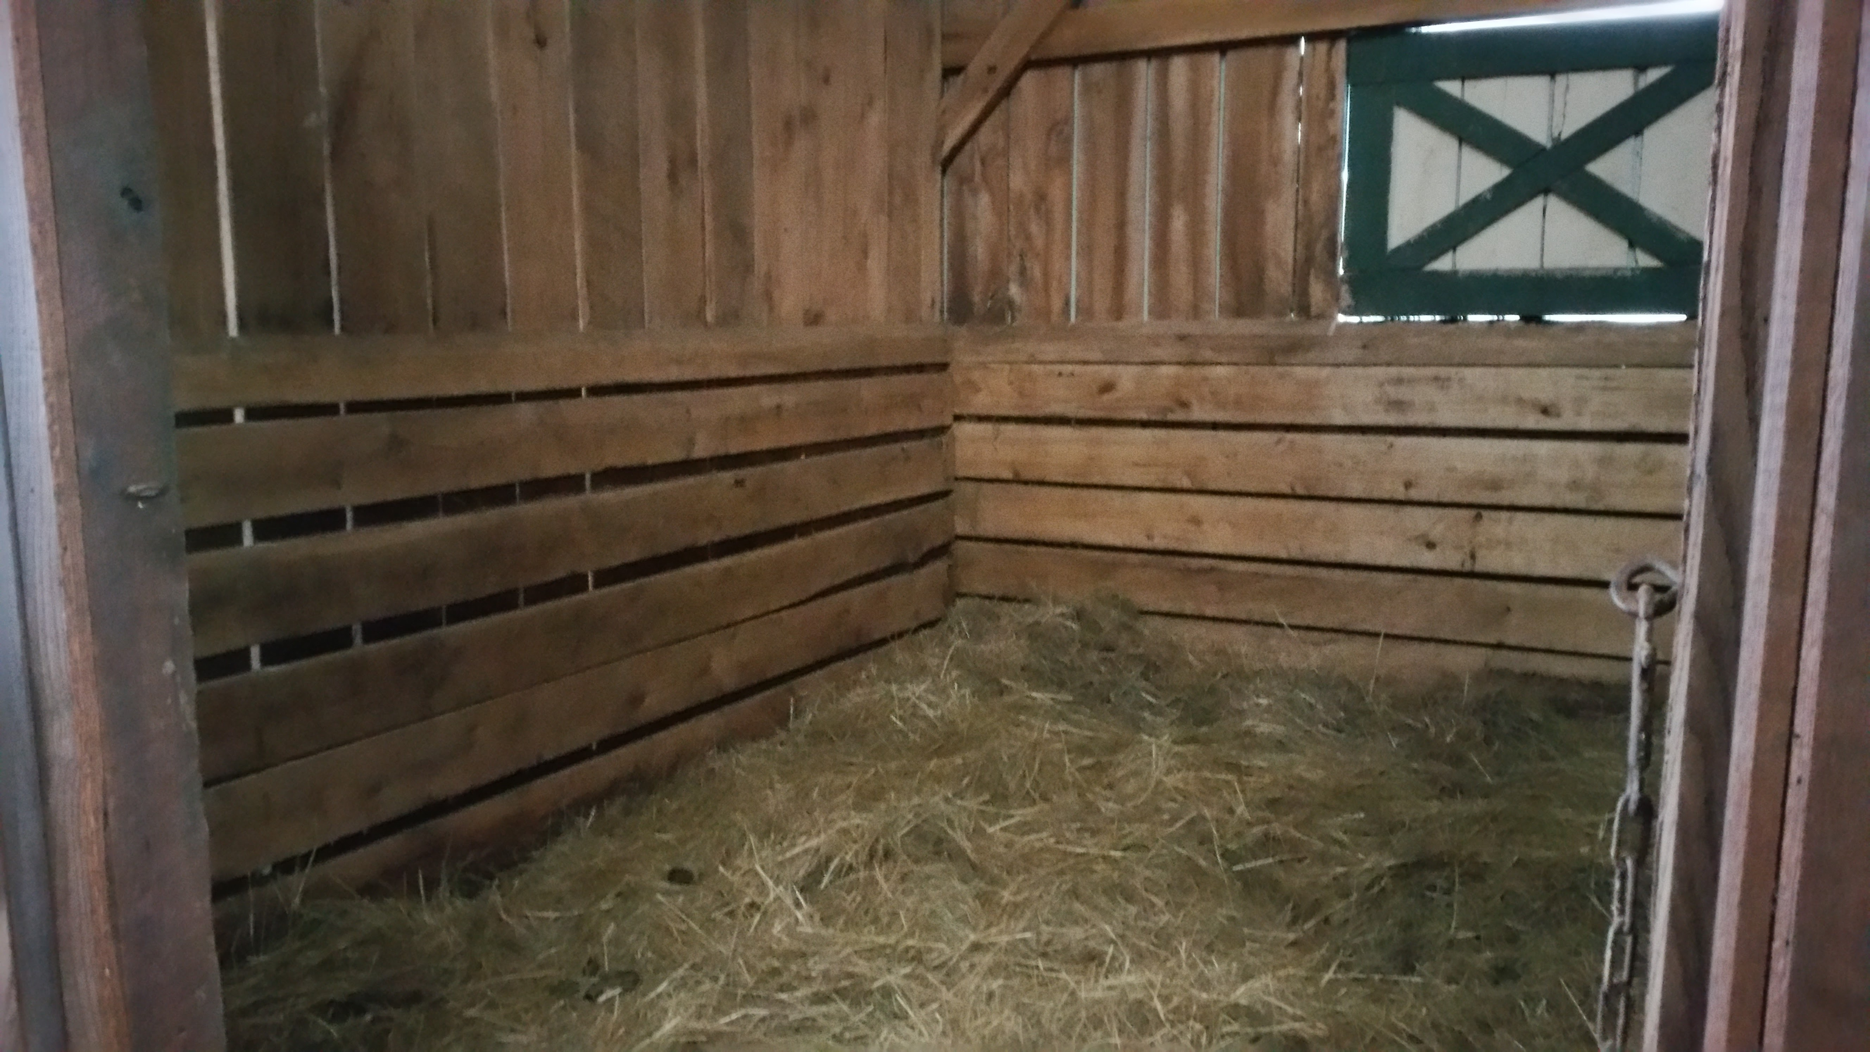
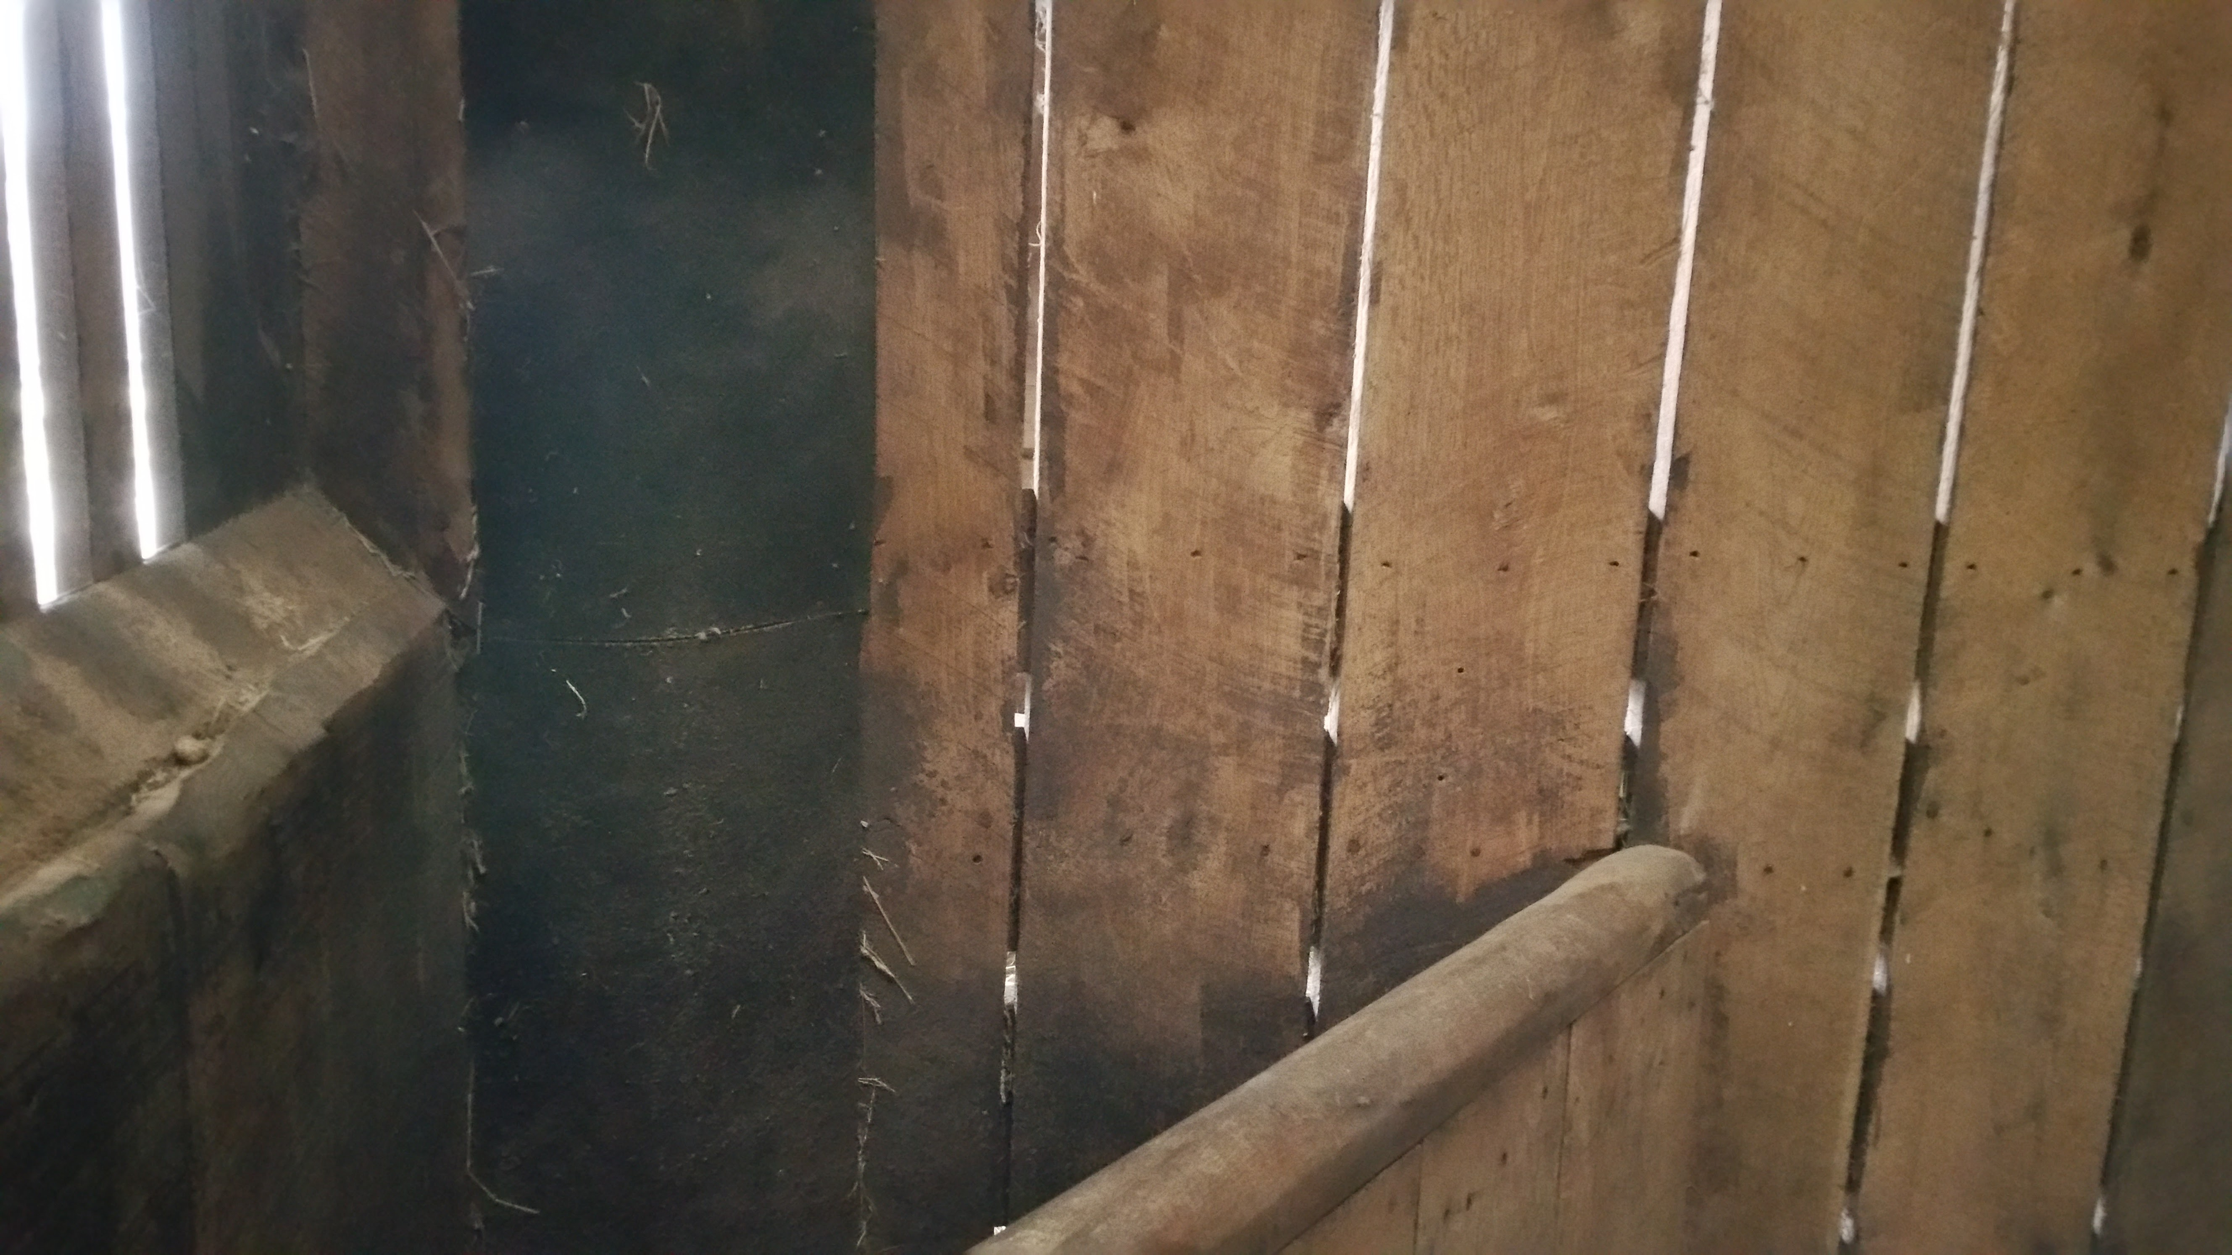
Environmental Contamination:
Classic Environmental Contamination with a Therapeutic substance: Isoxsuprine
Identified on the floor, walls, manger and even the cobwebs in the rafters.
Three weeks after discontinuation of Isoxsuprine

Slide 9
Environmental Contamination:
Naproxen:
A previously FDA approved formulation, Equiproxen
When allowed to remain in the same stall after a 10 day course of treatment, horses tested positive for 45 days
When an untreated horse was placed in the stall of the treated horse, it tested positive in urine for 3 days

Slide 10
Environmental Contamination:
Flunixin (Banamine ®):
Study administered flunixin IV or PO to groups of 2-6 horses
Route | Bedding | Type of Cleaning | Positive Flunixin Tests?
Oral | Sparse | Stripped | High Spikes
Oral | Deep | Stripped | Low spikes
IV | Deep | Stripped | Rare low spikes
IV | Deep | Cleaned | Low Spikes
IV | Deep | Moved stalls | NO Spikes
(Popot et al., 2011)

Slide 11
Environmental Contamination:
Flunixin (Banamine ®):
Only when horses were moved to clean stalls 24 h after flunixin administration, were there NO positive spikes consistent with environmental contamination
The highest positive spikes were in horses which were bedded on scant bedding
Next highest was in horses which did not have their stalls completely stripped
The positive spikes came on random days in the 9 days following flunixin administration, and only in random horses
(Popot et al., 2011)

Slide 12
Environmental Contamination:
What else?
Study investigated environmental contamination of the backside of a recently rebuilt racetrack in Louisiana
Test barn stalls, receiving barn stalls, a lagoon and dust samples were tested for drugs
Drug | #Samples positive
Bute | 16/17 positive
Flunixin | 15/17 positive
Naproxen | 14/17 positive (no dust samples)
Caffeine | 10/17 positive (no dust samples)
(Barker, 2008)

Slide 13
Environmental Contamination:
Dexamethasone
Important therapeutic medication
airway disease
allergic skin conditions (hives, “bumps”)
vasculitis (stocking up)
Short half life and duration of effect: Minimal effect after 24 hours, no detectable clinical effects after 48 hours
RMTC threshold of 5 pg (to Jupiter and back 200 times?) based on NO published research
University of Pennsylvania (Soma, 2012) paper used by RMTC as the basis despite lack of support for this threshold

Slide 14
Environmental Contamination:
Dexamethasone
Soma paper has problems as basis for threshold:
Soma himself claimed paper could not be the basis
Horses were not tested at 72 hours, LOQ = 10 pg/mL
Single horse is 57 pg/mL at 48 hours…no explanation offered in the paper
Across the country, rare positives in the sub-100 pg range are coming up: some with no history of Dexamethasone use
Need clinical field research to determine how Dexamethasone is distributed in a race horse population

Slide 15
Dexamethasone Field Threshold Study: Kevin Kersh, DVM, DACVS; Scott McClure, DVM, DACVS; Bradley Brown, DVM, Clara Fenger, DVM, PhD, DACVIM; George Maylin, DVM, PhD
Dexamethasone – Field Threshold Study
Racehorses in race training
Distributed among Thoroughbreds, Standardbreds and Quarter Horses
Horses which received joint injections within 7 days were excluded from the study
Other medications were recorded
All study horses were administered 20 mg Dexamethasone IV, and samples were collected at 48 and 72 hours for analysis
Dexamethasone was administered 1,2,3,4 or 5 days in a row as is used in the course of a typical clinical course of treatment

Slide 16
Dexamethasone Field Threshold Study:

Slide 17
Dexamethasone Field Threshold Study:

Slide 18
Dexamethasone Field Threshold Study:
Dexamethasone – Field Threshold Study
Most samples were below the threshold of 5 pg/mL at 48 and 72 hours
There were 3 “outlier” samples (in a total of 148 samples) which exceeded this threshold, at 10, 40 and 95 pg/mL
Soma has a similar “outlier” with a single horse out of 18 data points with a 48 h Dex of 57 pg/mL
This also fits with the “positives” which have been identified in post-race samples in CTMS jurisdictions

Slide 19
Most Likely Source of the “Outliers”?: Environmental Contamination
Dexamethasone
Further investigations are being planned:
Dexamethasone administered to one horse, and urine collected
Urine used to contaminate hay
Hay offered to 6 additional horses, and blood samples collected at 0, 1, 3, 6, 12 and 24 h.

Slide 20
Most Likely Source of the “Outliers”?: Environmental Contamination
Dexamethasone
A threshold CANNOT be set at a level so low that horses can randomly exceed the threshold from consuming an amount of drug so low that there is obviously NO physiologic effect (

Slide 21
Dexamethasone Study made possible by:
I
Iowa

