Slide 1
Presented to 2016 National HBPA Winter Convention

Slide 2
National HBPA Mission Statement
We are committed to the future of horse racing
We are horsemen who have one horse and a dream
We are horsemen who spend millions of dollars
We are horsemen who race throughout the country
We are horsemen who represent different breeds of race horses
We are owners, breeders, and trainers.
  Big and small, young and old
  From one end of the country to the other
  We horsemen are the HBPA
We are Horsemen Helping Horsemen.

Slide 3
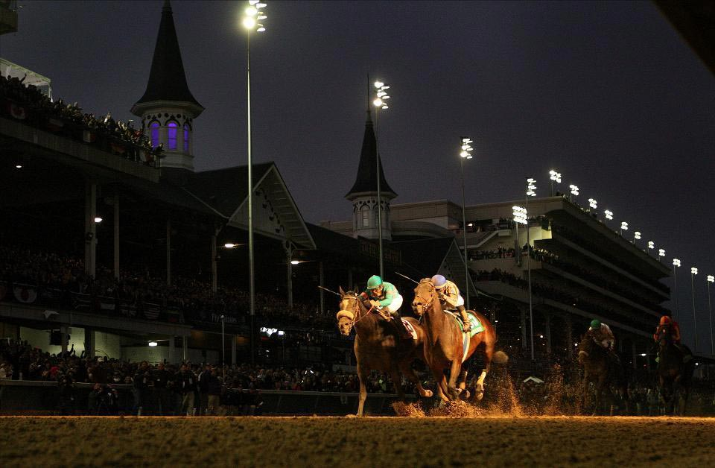
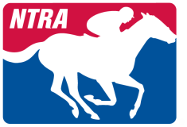
The NTRA was created to increase the popularity of horse racing, to improve the economics, safety and integrity of the horse industry.
We share similar missions

Slide 4
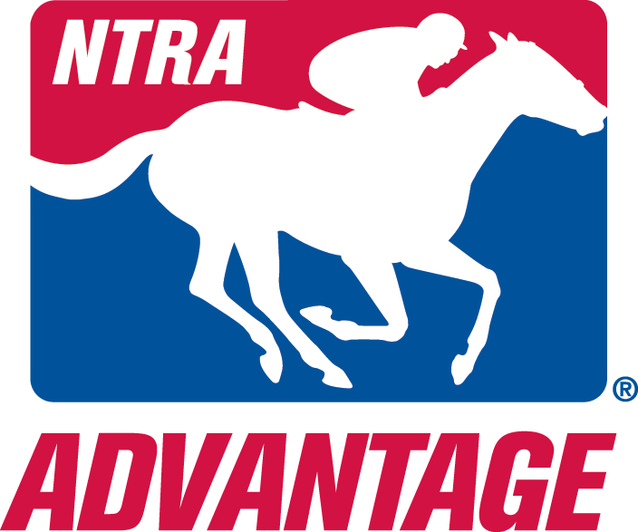
The NTRA Today
Our Focus
Safety & Integrity Alliance
Marketing & Communications
Legislative Advocacy
NTRA Advantage

Slide 5
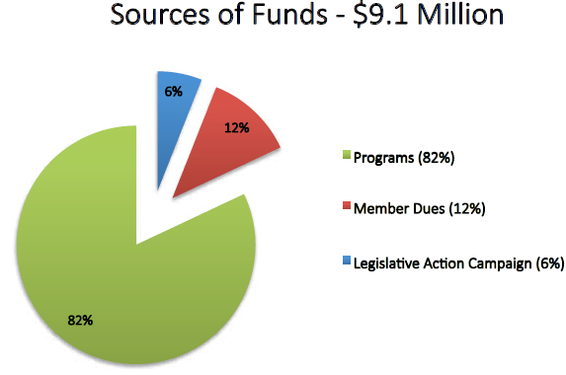
The NTRA Today
*FY 2016

Slide 6
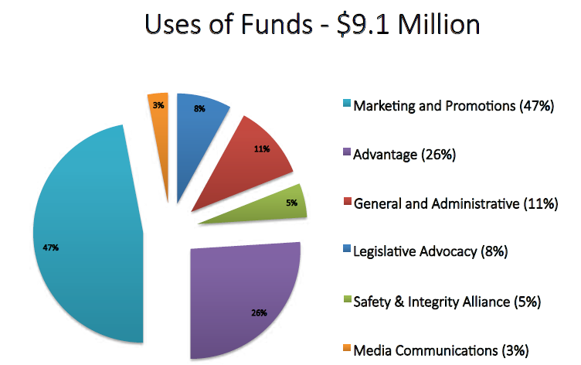
The NTRA Today
*FY 2016

Slide 7
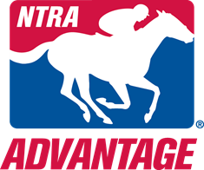








The NTRA Today
Powerful brands across all aspects of the industry

Slide 8
Safety & Integrity Alliance
Establishes and implements national uniform safety and integrity standards in horseracing:
Adopted Code of Standards
Racetrack Accreditation and Monitoring
Promote Safety and Integrity of Racing

Slide 9
Marketing and Communication
Key constituencies
Industry Stake Holders, Racing Fans
The Eclipse Awards
National Handicapping Championship
NTRA Communications
Weekly media teleconferences
Support industry events
Highlight industry initiatives
Insure maximum positive press

Slide 10
Legislative Advocacy
Address issues which have a direct effect on the Thoroughbred Industry
Legalize online pari-mutuel wagering
Accelerated depreciation on horses and equipment
Immigration
Horse Owner and Horseplayer Tax Equity
Support Congressional education
Agriculture, immigration
Legislative Action Campaign
Government relations and lobbying on behalf of the industry
Horse PAC
Supporting select local and national candidates for re-election

Slide 11
NTRA ADVANTAGE
Mission:
Provide substantial discounts on superior products to members of affiliate organizations
Member’s savings improve their business
Re-invest cash in each affiliate’s sport
Providing funds for each sport improves visibility, participation and longevity

Slide 12











NTRA Advantage Affiliates

Slide 13











ADVANTAGE
PARTNERS
NTRA Advantage has a dedicated staff committed to selling sponsor products into our industry. Since the inception of the program in 2002, the NTRA has sold over $811 million of Commercial Partner products to the industry resulting in over $137 million in savings. And Advantage has re-invested over $8 million back into the industry.

Slide 14

NTRA ADVANTAGE
  Secured $591+ MILLION in business for John Deere
  - Average of $45,000,000 in annual sales to farms and tracks

Slide 15
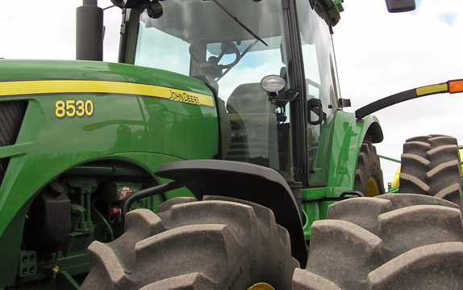
“John Deere is proud to support the NTRA. Through our partnership, we will continue to highlight the vital role the NTRA plays within the Equine Industry”
Ken Taylor, General Sales Manager – Corporate Business, John Deere

Slide 16
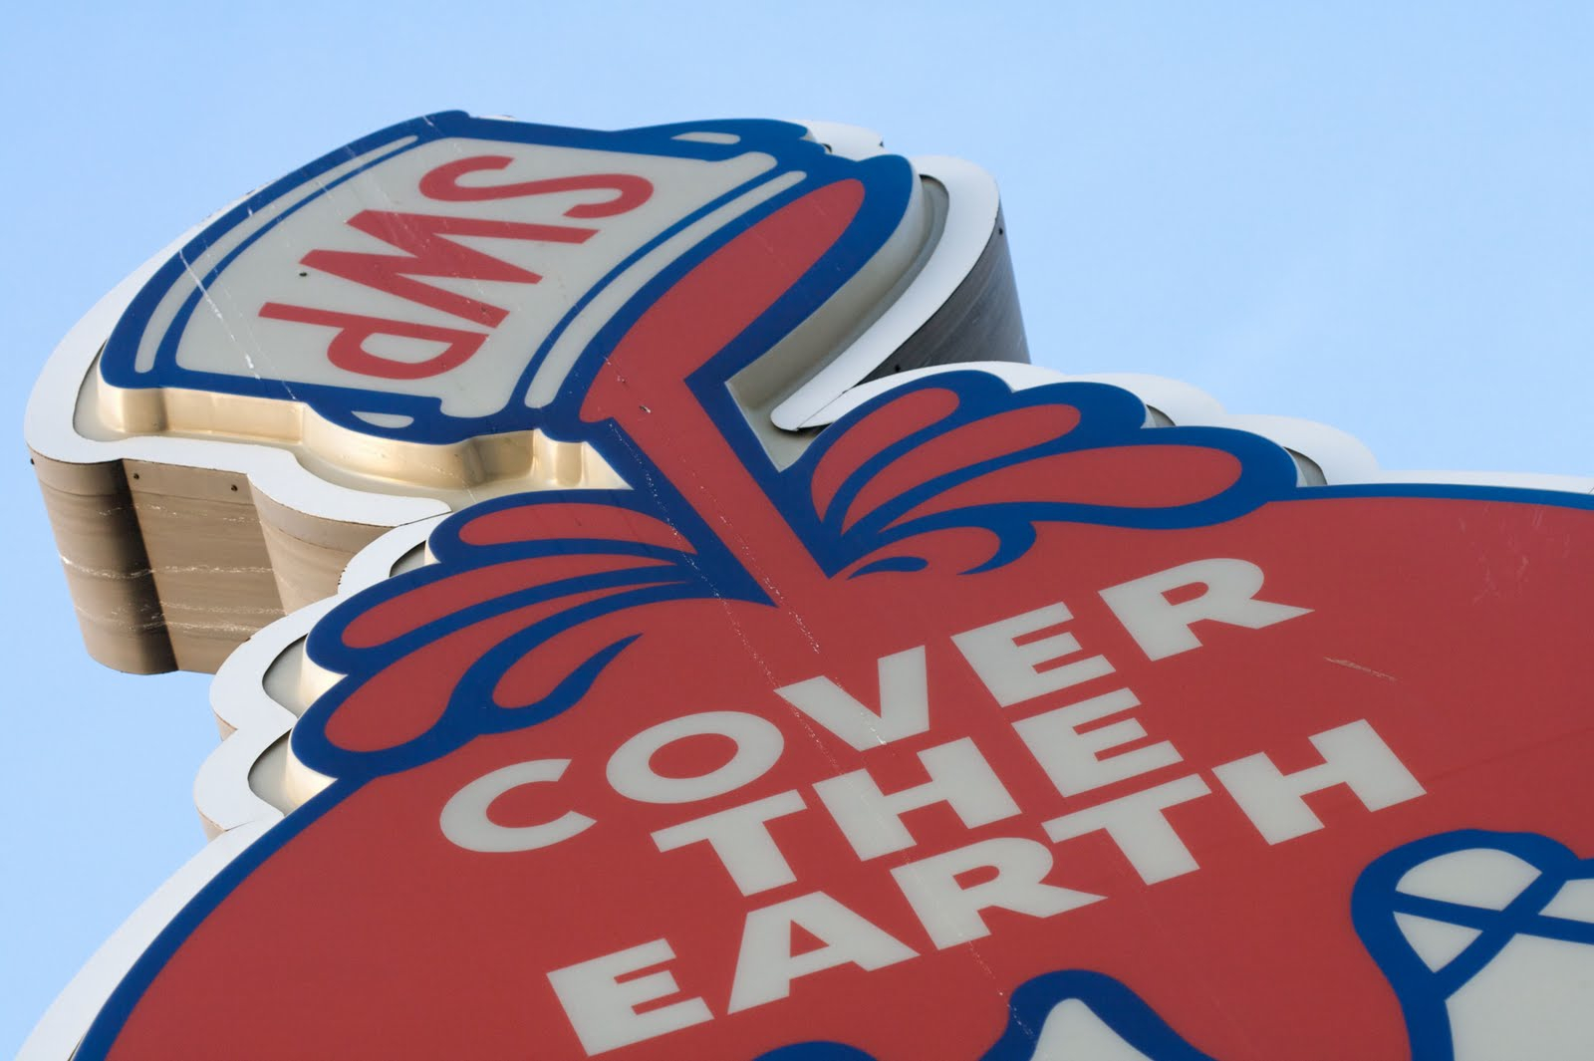
"We've been in a partnership with NTRA for over 10 years. We're amazed at the sales avenues that have been opened as a result of our relationship".
Al Lewis, National Account Manager, Sherwin Williams

Slide 17
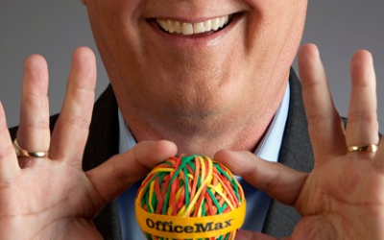
“The office supply business is very competitive and the NTRA program provides its members fantastic savings everyday”
Kevin O’Neal, National Account Manager, OfficeMax

Slide 18
NTRA ADVANTAGE
NTRA TRACKS and ARENAS
Demographics
80 Tracks in North America
  32 Large (600 acres plus / 40 race days a year)
  48 Medium / Small
532 Horse Arenas in North America
Innumerable Training Tracks

Slide 19

2015 Number of Tracks & Arenas in Each State
AK
0 Tracks
2 Other
BC
1 Track
3 Other
AB
SK
2 Tracks
3 Other
0 Tracks
1 Other
MB
0 Tracks
2 Other
WA
2 Tracks
5 Other
QB
ME
1 Tracks
4 Other
2 Tracks
3 Other
MT
0 Tracks
5 Other
ND
OR
1 Track
2 Other
1 Track
6 Other
MN
ONT
VT
NH
ID
SD
4 Tracks
8 Other
NY
1 Track
2 Other
1 Track
2 Other
2 Tracks
5 Other
WI
MI
10 Tracks
7 Other
WY
1 Tracks
3 Other
CT
1 Track
7 Other
1 Tracks
3 Other
IA
PA
NH
1 Tracks
2 Other
VT
3 Tracks
4 Other
CT
0 Tracks
3 Other
RI
0 Tracks
2 Other
MA
4 Tracks
3 Other
DE
2 Tracks
3 Other
NE
1 Track
3 Other
5 Tracks
8 Other
NV
1 Tracks
3 Other
OH
0 Tracks
5 Other
IL
IN
6 Tracks
10 Other
UT
5 Tracks
8 Other
2 Tracks
4 Other
WV
CA
0 Tracks
6 Other
CO
MO
2 Tracks
2 Other
VA
6 Tracks
16 Other
1 Track
3 Other
KS
0 Tracks
3 Other
KY
1 Tracks
3 Other
0 Tracks
4 Other
5 Tracks
5 Other
NC
0 Tracks
3 Other
OK
0 Tracks
8 Other
TN
AZ
NM
3 Tracks
4 Other
AR
SC
2 Tracks
5 Other
2 Tracks
3 Other
0 Tracks
1 Other
3 Tracks
7 Other
MS
AL
GA
0 Tracks
3 Other
0 Tracks
3 Other
0 Tracks
12 Other
TX
LA
6 Tracks
16 Other
4 Tracks
5 Other
4 Tracks
11 Other
Tracks – are major facilities running 20+ race
days annually. Fair tracks and training facilities are not included
Other – horse arenas and large training facilities (i.e. Kentucky
Thoroughbred Center and Kentucky Horse Park)
FL

Slide 20
NTRA ADVANTAGE
NTRA FARMS
Demographics
32,156 Member Farms in the North America
Thoroughbred
Quarter Horses
Paint Horses
Warm Bloods

Slide 21
2015 Number of Member Farms in Each State
AK
32
BC
38
AB
SK
193
32
MB
2
WA
354
QC
ME
MT
161
ND
13
129
OR
129
349
ID
MN
ONT
NH
96
SD
293
WI
161
NY
96
MI
933
WY
547
CT
96
IA
PA
NH
64
VT
57
CT
193
RI
31
MA
225
DE
161
NV
NE
579
OH
1,007
32
289
IN
1,897
UT
IL
675
CA
96
CO
933
WV
VA
KS
MO
183
740
482
386
514
KY
711
3,859
NC
643
OK
AR
707
TN
AZ
NM
3,409
SC
322
386
GA
707
193
MS
AL
257
193
643
TX
LA
3,762
740
1,994
FL

Slide 22
NTRA ADVANTAGE
How can an HBPA Member help?
Contact NTRA Advantage for discounts on planned purchases
Remind your connections that not only will Advantage provide savings, but we will re-invest in your sport

Slide 23
What This Means To HBPA Members and the Industry
As a member of the HBPA, enjoy the savings while supporting your industry
WIN
WIN
WIN
Members get the Savings! $137 Million in savings, since the beginning
A portion of every sale goes back to support the Horse Industry!
$8 million+ to date

