Slide 1
Why is aftercare important?
• It is our responsibility as owners to provide for our horses once their days on the track are over.
It is the right thing to do.
It is good for the racing industry and important for the racing industry
Everybody wins…owners, racing but most importantly the horse.

Slide 2
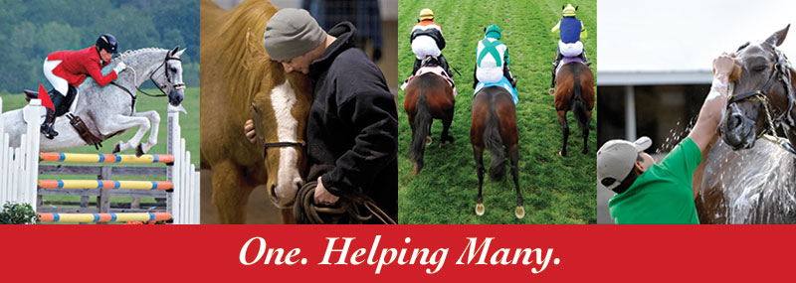
Thoroughbred Charities of America

Slide 3
Thoroughbred Charities of America
Founded in 1990, Thoroughbred Charities of America is a 501 (c) (3) charitable organization
Mission: to provide a better life for Thoroughbreds, both during and after their racing careers, by supporting qualified repurposing and retirement organizations, and by helping the people who care for them
TCA raises funds for distribution to charities across the country that work to fulfill our mission
TCA grants to non-profits in four categories – Thoroughbred rehabilitation, retraining, rehoming and retirement; backstretch and farm employee programs; equine research and equine-assisted therapy
TCA aims to be an extraordinary steward of the funds entrusted to us; therefore we employ an extensive grant application and review process each year

Slide 4
Thoroughbred Charities of America
Review process includes:
governance structure, financials, public education and outreach initiatives, volunteer program, vet reports, adoption contract evaluation, outreach to each person that adopted a horse from the applicant
More than 95% of our expenditures are allocated to program services including direct grants
In 2015, TCA granted over half a million to 67 charities
During the last quarter century, TCA has granted over $21 million to more than 200 Thoroughbred industry-related organizations
On average, more than 50% of our grant funds go to the aftercare category, followed by backstretch and farm worker programs
List of grant recipients available on tca.org
Largest annual fundraiser is a stallion season auction held each January

Slide 5
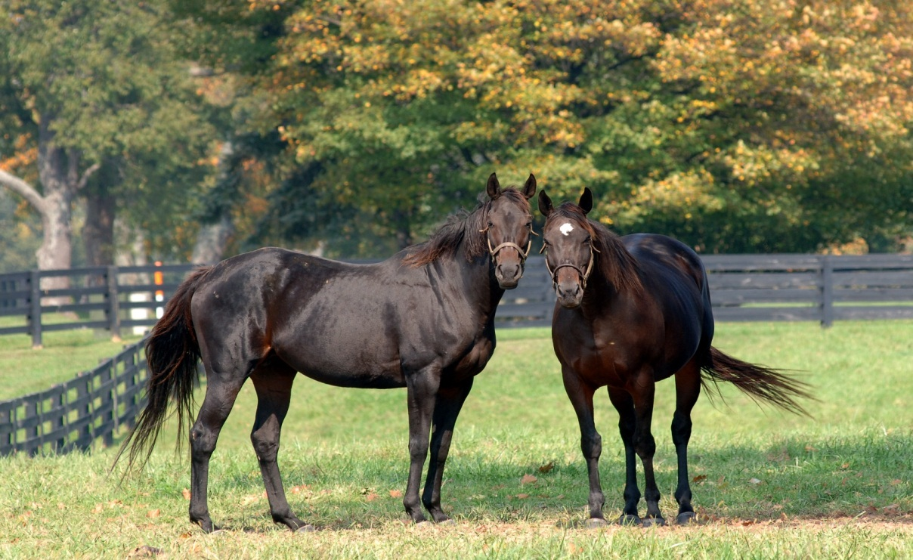
Sharing The Responsibility
thoroughbredaftercare.org

Slide 6
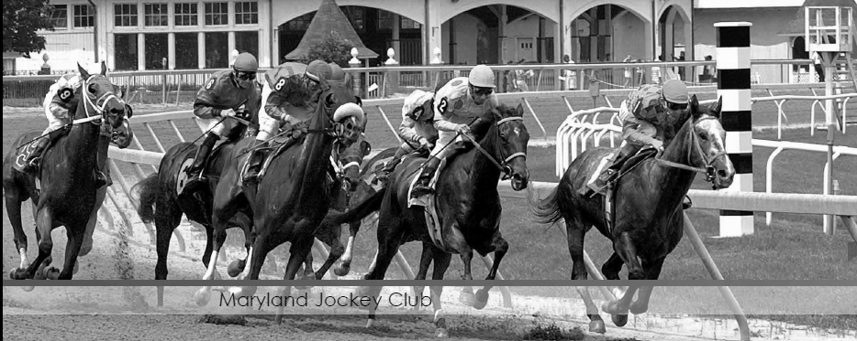
About Us
TAA Advantage
TAA Recognition
501(c)(3) non-profit
Industry united initiative.
Intensive accrediting system and a strong funding mechanism.
Funds raised provide support retire, retrain, and rehome racehorses.
Shared responsibility: The Jockey Club, Breeders' Cup, Keeneland, sales companies, horsemen groups, stallion farms, trainers and others.
The TAA’s Code of Standards and accreditation process have been reviewed and approved by the American Humane Association and the American Association of Equine Practitioners.
The TAA received the 2013 Special Eclipse Award
thoroughbredaftercare.org
Notes:
The Thoroughbred Aftercare Alliance (TAA) is a 501 (c) (3) non-profit that accredits aftercare organizations who retire, retrain, and rehome Thoroughbreds and fundraises to support these organizations.
Funded initially by seed money from Breeders’ Cup Ltd., The Jockey Club, and Keeneland Association, the TAA is comprised of and supported by owners, trainers, breeders, racetracks, aftercare professionals and other industry groups.
501(c)(3) non-profit
Industry united initiative.
Intensive accrediting system and a strong funding mechanism.
Funds raised provide support to accredited aftercare organizations to retire, retrain, and rehome racehorses.
The TAA is a shared responsibility of many Thoroughbred entities including: The Jockey Club, Breeders' Cup, Keeneland, sales companies, horsemen groups, stallion farms, trainers and others.
The TAA’s Code of Standards and accreditation process have been reviewed and approved by the American Humane Association and the American Association of Equine Practitioners.
The TAA received the 2013 Special Eclipse Award honoring extraordinary service, individual achievements in, or contributions to the sport of Thoroughbred racing

Slide 7
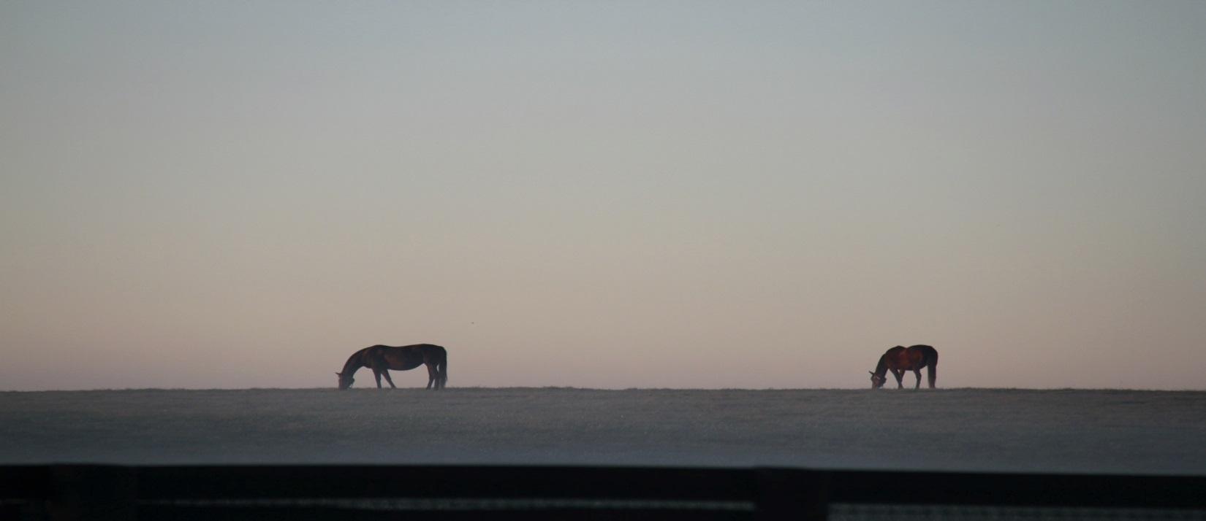
About Us
1. Accreditation
Application
Inspection
TAA accreditation has unprecedented value:
56 organizations in 2014 -2015
180 facilities needing inspections annually. This separates the TAA from any other funding program.
Many funding charities regard the TAA accreditation as organizations “Good Business Seal of Approval.”
thoroughbredaftercare.org

Slide 8
Accreditation
Minimum Requirements for Accreditation:
Organizations are evaluated based on the TAA Code of Standards :
Current status as a 501 (c)(3) tax-exempt organization or registered charity in Canada.
Operational for a minimum of three years.
House a minimum of 5 Thoroughbreds.
Have an official euthanasia policy consistent with the AAEP.
Operations.
Education.
Horse Health Care Management.
Facility Standards and Services.
Adoption Policies and Protocols.
Accreditation is awarded for a two-year period.
Only accredited organizations may apply for grants.
Grantees agree to surprise site inspections to ensure ongoing compliance with TAA’s Code of Standards.
thoroughbredaftercare.org
Notes:
The accreditation process is based on a Code of Standards, which covers five basic areas: Facility Operations; Education; Horse Health Care Management; Facility Standards and Services; and, Adoption Policies and Protocols. Accreditation is awarded for a two-year period and only accredited organizations may apply for grants. Grantees agree to surprise site inspections to ensure ongoing compliance with TAA’s Code of Standards.

Slide 9
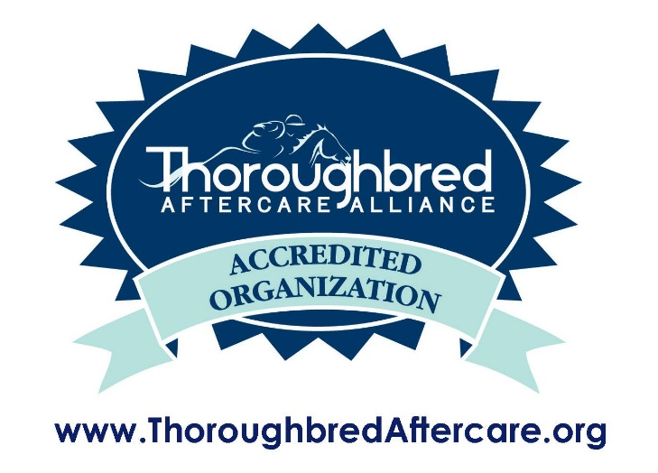
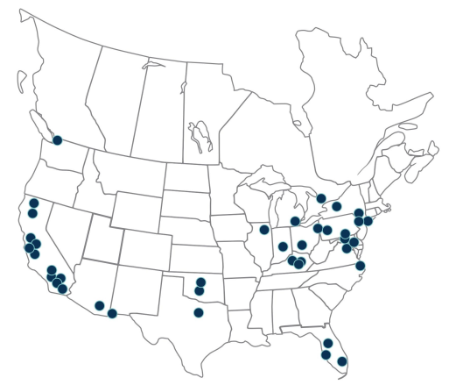
56 Organizations
25 States
2 Provinces
180 Facilities
2,400 Thoroughbreds
thoroughbredaftercare.org
Notes:
We have affected closer to 4- 5 thousand horses over the last four years

Slide 10
Funding
2. Funding
Comes from a variety of industry related sources:
Sustainable funding sources
Funding campaigns / events
Gift giving online development
Events/Promotions
thoroughbredaftercare.org
4

Slide 11
Funding
Broad-based funding mechanism at every touch point in a Thoroughbred’s life. Includes stallion owners; breeders; sales companies and sales participants; owners; trainers; jockeys; racetracks; service providers, including veterinarians and farriers; and even racing fans.
thoroughbredaftercare.org
12
Notes:
The TAA unites stakeholders from the Thoroughbred industry and establishes a broad-based funding mechanism at every touch point in a Thoroughbred’s life. This includes, but should not be limited to, stallion owners; breeders; sales companies and sales participants; owners; trainers; jockeys; racetracks; service providers, including veterinarians and farriers; and even racing fans. Anyone who benefits from the horse should contribute a small share, which collectively will create a sustainable program to retire, retrain, and place former racehorses.

Slide 12
Examples of Industry Stakeholders
Owners & Trainers
Enrolled in various agreements
17 trainers pledged
Sales Companies
Match contributions
Barretts, CTHS,
Fasig-Tipton
Keeneland, OBS
The Jockey Club
Contributes $25 per foal registration
Horsemen’s Groups
Enrolled in various agreements
HBPA, KY HBPA, MTHA, NYTHA,
Tampa Bay HBPA
Stallion Farms
Contribute 25% of one stallion fee
20 stallion farms participate
Consignors and Buyers
Contribute 50 cents per $1,000 transaction
Accredited Organizations
thoroughbredaftercare.org

Slide 13
“Our partners can rest easy knowing that their donations will go directly to retired Thoroughbreds; by way of grants the TAA sends twice a year to our accredited organizations.”
Jimmy Bell
President, TAA
Since TAA’s inception in 2012, $5,700,000 has been awarded to approved organizations.
+127%
+140%
56
$2.4
23
$1.0
2013
2015
2013
2015
Accredited
Organizations
Grants Awarded
(USD Millions)
thoroughbredaftercare.org

Slide 14
Contact Information
Thoroughbred Aftercare Alliance
c/o The Jockey Club
821 Corporate Drive
Lexington, Kentucky 40503
U.S.A
Tel: 859-224-2756
Fax: 859-296-3045
info@thoroughbredaftercare.org
www.thoroughbredaftercare.org

Slide 15
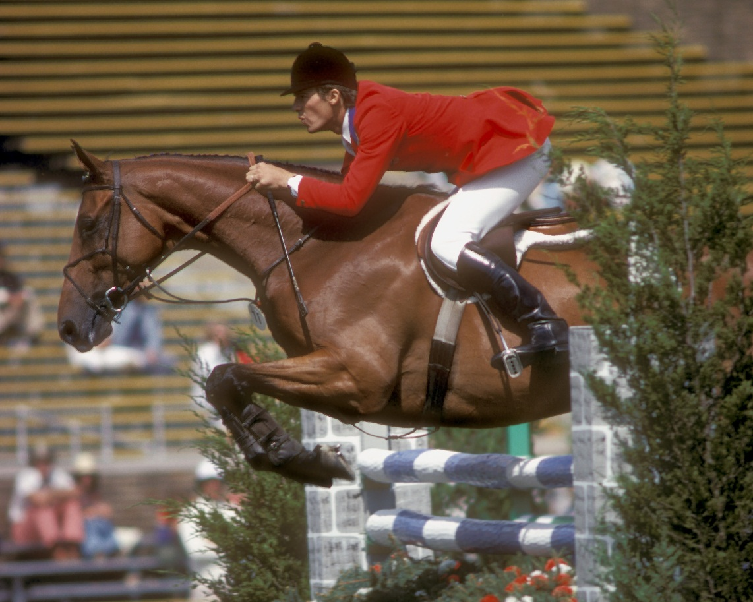
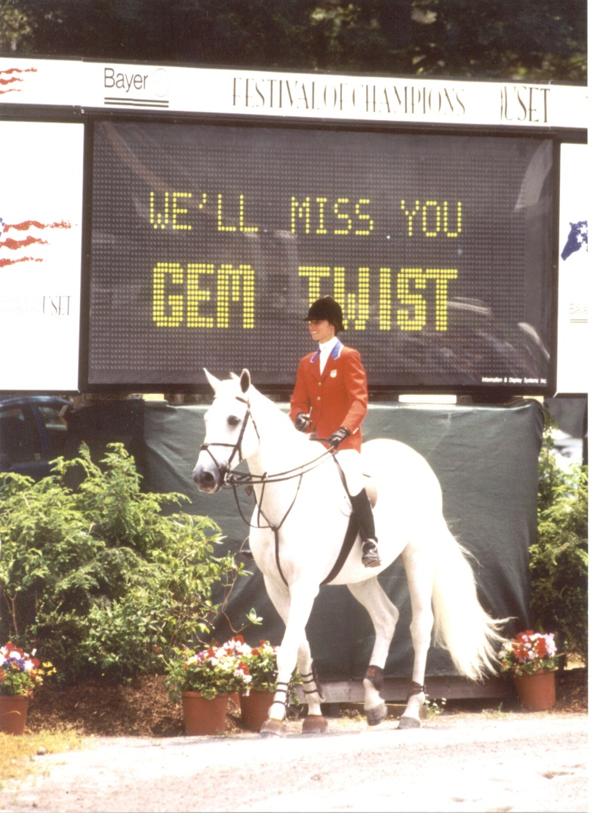
Creating Demand for Thoroughbreds

Slide 16
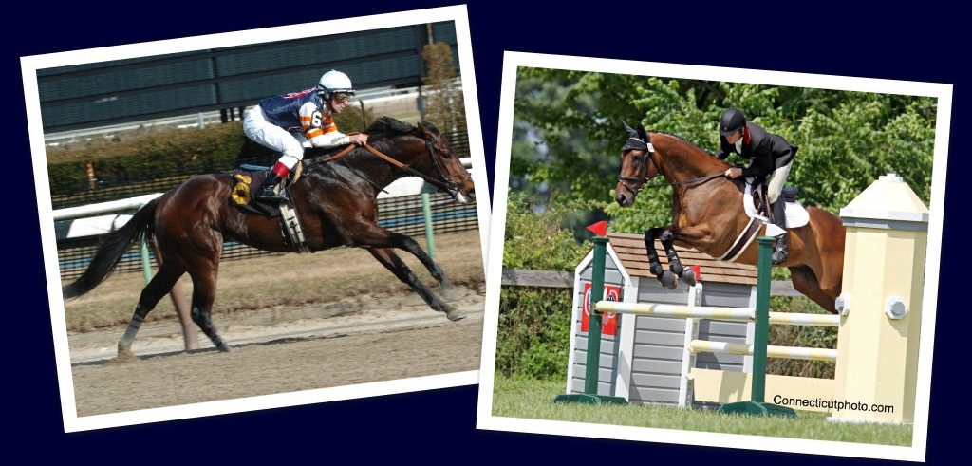
Creating Demand for Thoroughbreds
McLovin
19-5-1-0 Earnings - $75,638

Slide 17
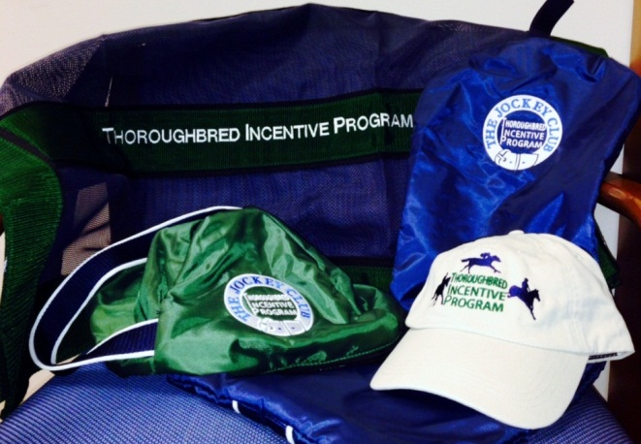
Awards
T.I.P. recognizes and rewards the versatility of the Thoroughbred through:
Sponsorship of Thoroughbred classes and high point awards at sanctioned horse shows;
Two annual awards, the T.I.P. Thoroughbred of the Year Award and the T.I.P. Young Rider of the Year Award.
Year end, self reported Performance Awards

Slide 18
T.I.P. Events and Horse Shows
Horse Show Awards | 2012 | 2013 | 2014 | 2015 | Total
Shows with T.I.P. Awards - Actual | 157 | 410 | 435 | 700 | 1,702
Horses Entered for Awards | 2,140 | 4,130 | 5,103 | 6,000 | 17,373
T.I.P. Numbers Granted | n/a | 5,422 | 4,090 | 3,988 | 13,500
# States/Provinces with Shows/Awards | 28 | 40 | 38 | 44 | 45

Slide 19
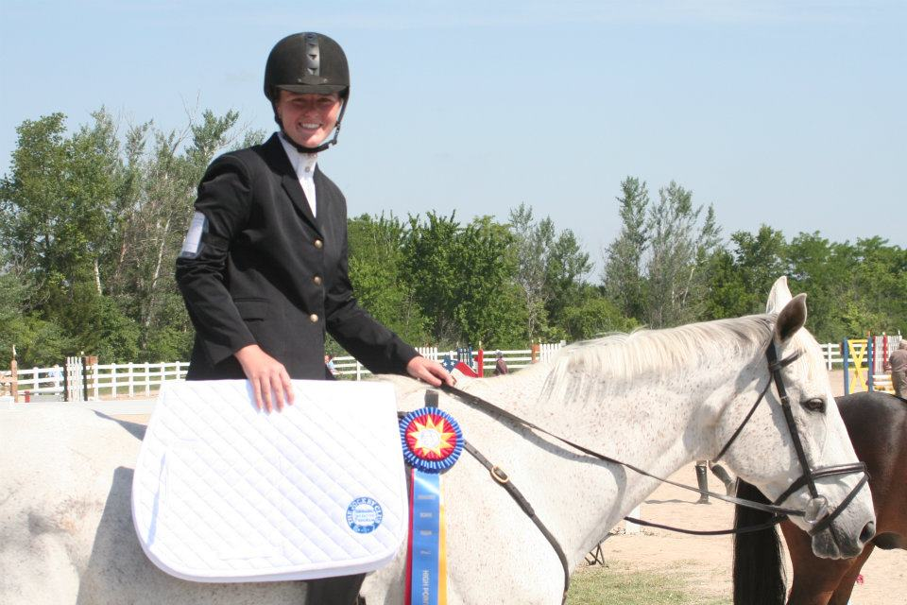
2016…
850+ sponsored shows.
Awards approved in 42 U.S. states
and Canadian provinces.
National awards offered at the Intercollegiate Horse Show Association National Finals, American Eventing Championships, USEA FEH/YEH Championships and the American Endurance Ride Conference.
tjctip.com facebook.com/tjctip

Slide 20
Creating Demand
Retired Racehorse Project
Makeover
Directory
Take 2 Thoroughbreds
League
Thoroughbred Only Shows
TASS
Canada
Others
Notes:
The Retired Racehorse Project is an effort to increase demand for retired Thoroughbred race horses as pleasure and sport horses through public events, clinics, training publications, videos and internet tools. Their mission is to facilitate the placement of retired Thoroughbred racehorses in second careers by educating the public about the history, distinctive characteristics, versatility of use, and appropriate care and training of the iconic American Thoroughbred.
TAKE2 Second Career Thoroughbred Program Inc.was created to promote second careers for retired Thoroughbred racehorses as hunters and jumpers. Supported by members of the racing and breeding industries, the program rewards those who compete on Thoroughbreds with awards and prize money in restricted classes and divisions at horse shows across the country, and highlights the success of the Thoroughbred in the sport horse world. TAKE2 classes are offered at more than 140 horse shows in 21 states.
2013 was a BIGGER and BETTER year for OTTB’s with the premiere of theThoroughbred Alliance Show Series. In order to build on the success of 2012, a group of OTTB advocates came together and formed this alliance. The show series consisted of several Thoroughbred Only horse shows in the MidAtlantic region; each show benefitted rescue and rehoming programs in the area. Horses and riders accumulated points throughout the series towards year end awards.
We have continued our series in 2014 and 2015-since we started, we have raised over $50K!!! for aftercare programs throughout the region, including CANTER, Foxie G Foundation, MidAtlantic Horse Rescue, and Our Mims Retirement Haven-- our exhibitors, sponsors, volunteers, and friends-- because of your support, retiring racehorses were the winners~

Slide 21
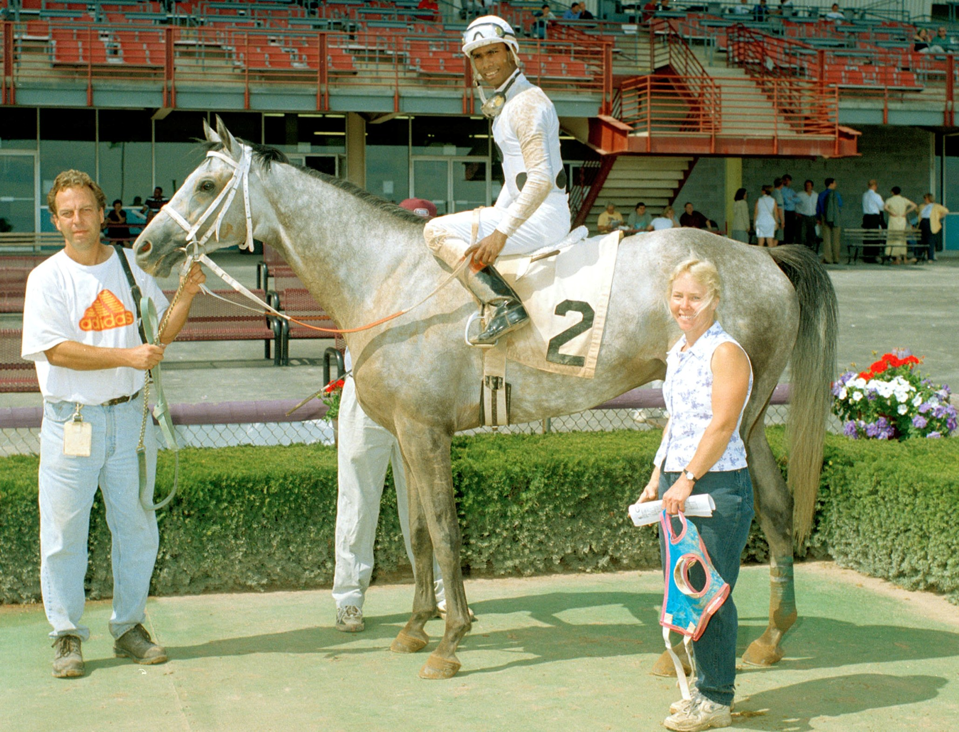
Thoroughbred Charities of America
Courageous Comet
36 starts
Earned: $71,780

Slide 22
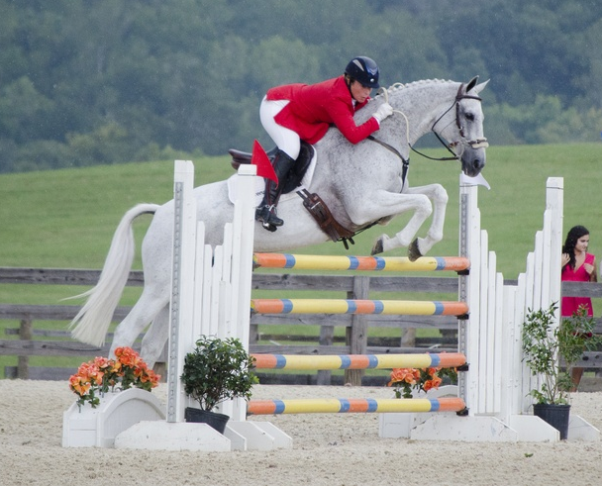
Thoroughbred Charities of America
Member of the United States 2008 Olympic team
2010 World Equestrian Games competitor
Won the Adequan USEA Gold Cup Series in 2007 & 2012
Rood & Riddle Thoroughbred Sport Horse of the Year 2009 & 2010
Won the American Eventing Championships in 2012

Slide 23
Hunter
Versatility

Slide 24
Jumper
Versatility

Slide 25
Eventing
Versatility

Slide 26
Dressage
Versatility

Slide 27
Western Games
Versatility

Slide 28
Barrel Racing
Versatility

Slide 29
Polocrosse
Versatility

Slide 30
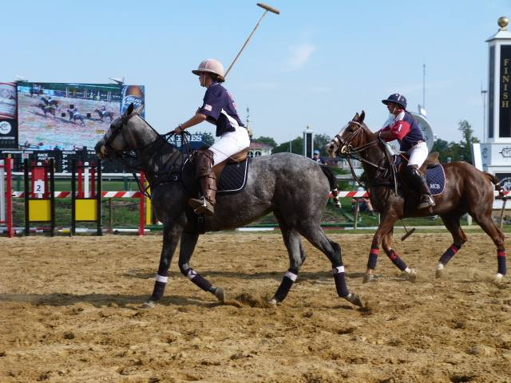
Polo
Versatility

Slide 31
Intercollegiate Horse
Versatility

Slide 32
Endurance
Versatility

Slide 33
Therapeutic Riding Horse
Versatility

Slide 34
Parades
Versatility

Slide 35
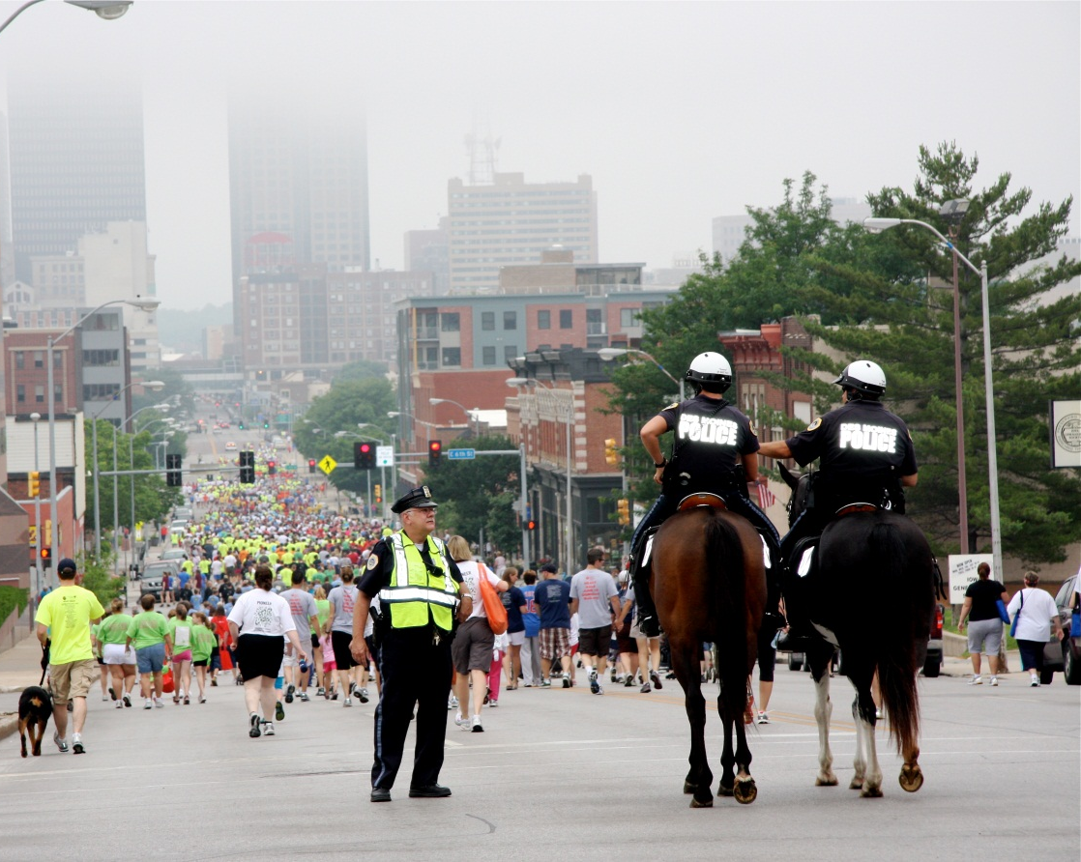
Police Horse
Versatility

Slide 36
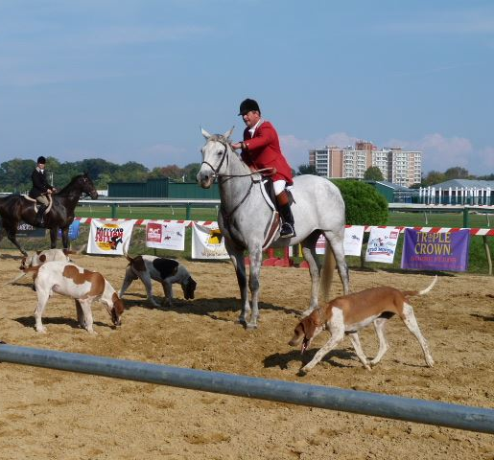
Hunt Horse
Versatility

Slide 37
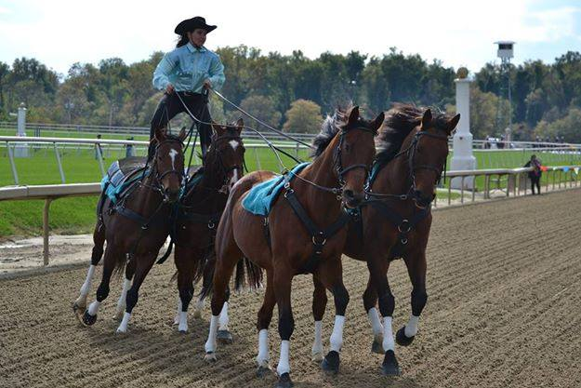
Trick Horse
Versatility

Slide 38
Vaulting
Versatility

Slide 39
Kids Horse
Versatility

Slide 40
Companion
Versatility

Slide 41
Barbi Moline – Executive Director
772-485-3799
www.fltrac.org

Slide 42
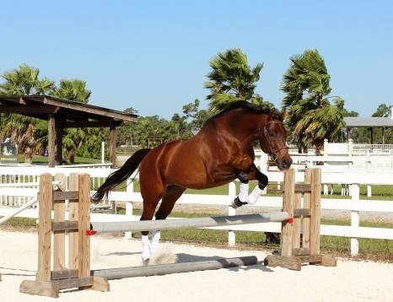
Our Commitment
In April 2009, recognizing the need for a South Florida based Thoroughbred retirement program, a group of committed volunteers began a retirement and placement program dedicated specifically to horses that competed at either Calder Race Course or Gulfstream Park during their racing careers. Spearheaded by the Florida Horsemen’s Benevolent and Protective Association (FHBPA), Calder Race Course, Gulfstream Park and professional jockeys, a program was created for the sole purpose of finding adoptive “forever” homes for retired Thoroughbreds. The group has since evolved into Florida TRAC (Thoroughbred Retirement and Adoptive Care Program). Since its inception in 2009, over 600 horses have entered the program.
www.fltrac.org

Slide 43
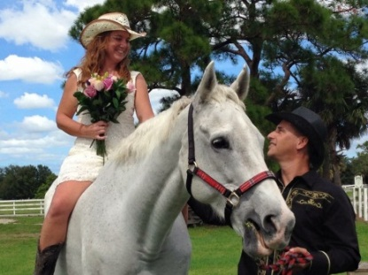
Metamorphous of the Race Horse:
Horses can have more than one purpose. Horses entering the TRAC program receive hands on care, professional retraining, and the chance for a second career. TRAC strives in every way to find suitable adopters for each and every horse. These retired Thoroughbreds go on to success in the show world, on the polo field, in therapeutic riding programs or simply as loving companions. Our adopters are screened and provided with a legal adoption contract. Affordable adoption fees vary per horse. After our horses are placed in adoptive homes, TRAC continues to monitor their progress and care. Preparing our horses for a second career and a renewed sense of love and belonging is the ultimate goal.
www.fltrac.org

Slide 44
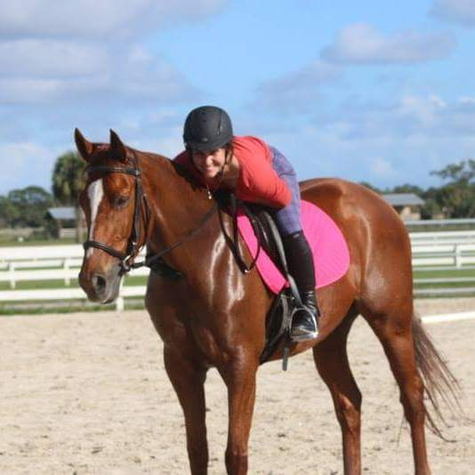
Public Awareness
The racing industry continues to support our efforts through purse contributions and annual donations. However, the continued success of our program depends on caring and generous individuals who are dedicated to providing a dignified retirement for our gallant equine athletes.
It is a sad truth however, that a vast majority of the general public and even many racing fans are unaware of the potentially bleak fate that awaits many retired Thoroughbreds each year. With your help we can increase the number of horses in the program, while at the same time, increase the public’s awareness of our mission.
www.fltrac.org

Slide 45
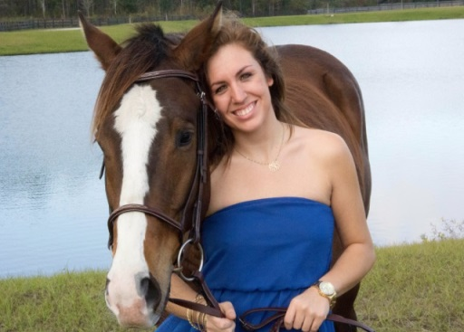
Our Approach
Our efforts depend on a strong alliance between race tracks, industry officials, horsemen, owners, trainers, jockeys and fans. Each and every donation brings us closer to achieving our ultimate goal to see all our horses in successful second careers. Why do we need your help? Monthly expenses include basic care such as transportation, feed, veterinary care, supplies, retraining and board, including placement at satellite farms when our main facilities become overcrowded.
www.fltrac.org

Slide 46
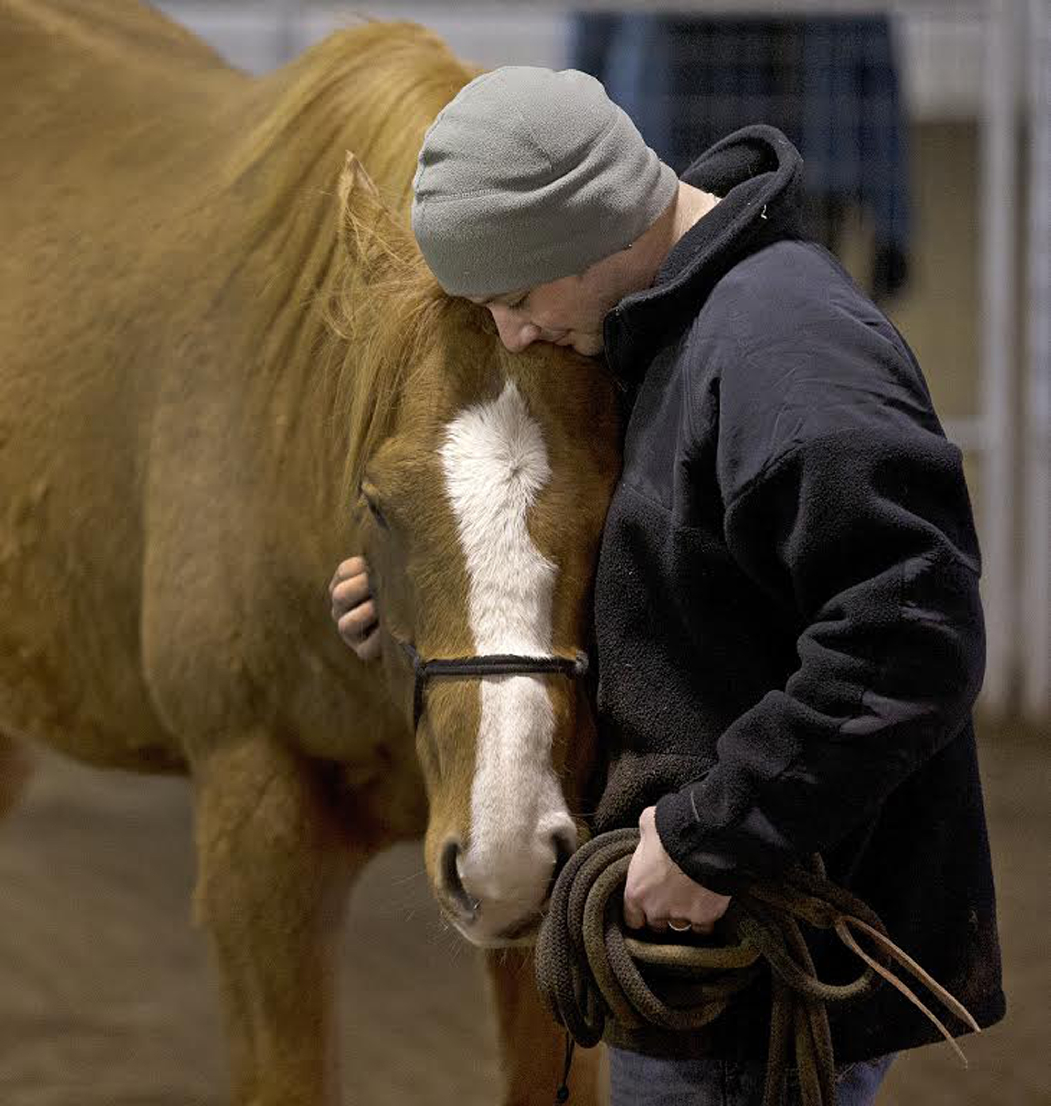
Thoroughbred Charities of America
Three Lions
Nine starts
Earned: $17,848

Slide 47
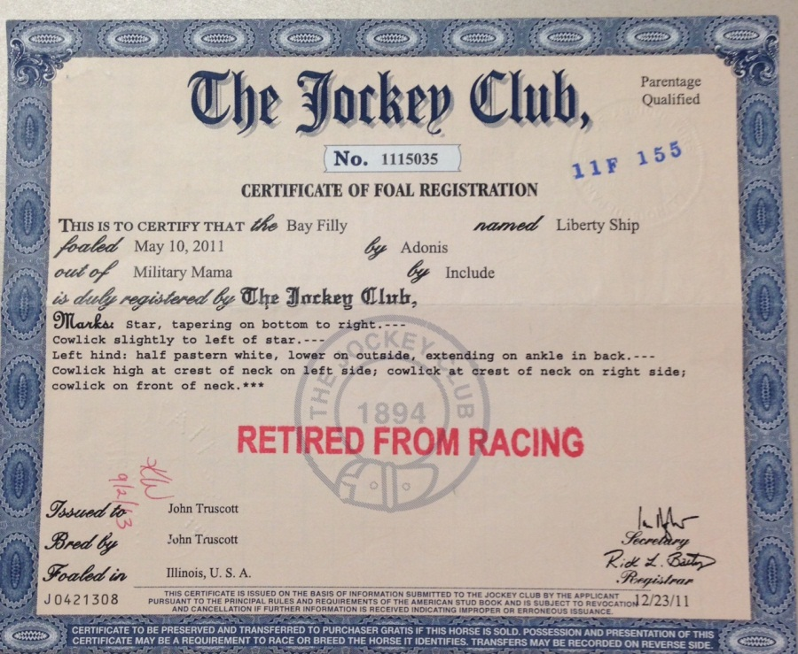
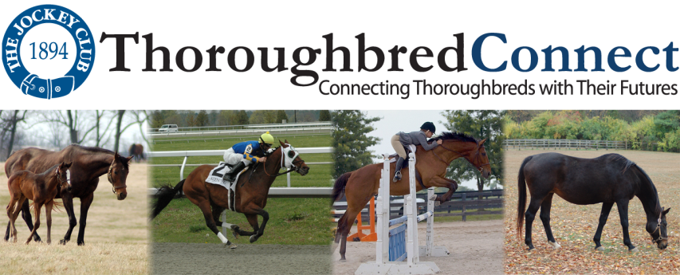
www.registry.jockeyclub.com
www.thoroughbredconnect.com

