Slide 1


Recruiting Millennials
To Your Track
FINALIST at RTIP Innovator’s Circle Competition
National Racing Symposium December 4, 2015 Tucson, Arizona

Slide 2

Tracks need a new fan base for racing.
It’s millennials, right?
YES, they’re our future.

Slide 3
Why aren’t more millennials at our tracks?
Research shows they haven’t been properly introduced to racing
They don’t understand handicapping, rules, or types of wagers
Won’t be seen in public looking like they don’t fit in
Therefore, they’re not interested

Slide 4
How do we get their interest?
The excitement of WINNING!

Slide 5
Winning what?
An interactive game called 20 Wins A Million, where they learn to handicap horse racing “free” with a chance to win something really BIG!

Slide 6
They come to our track to play a game?
No, the millennial won’t learn at the track. They’ll self teach playing game at home, then 20 sends them to the track as a reward!

Slide 7
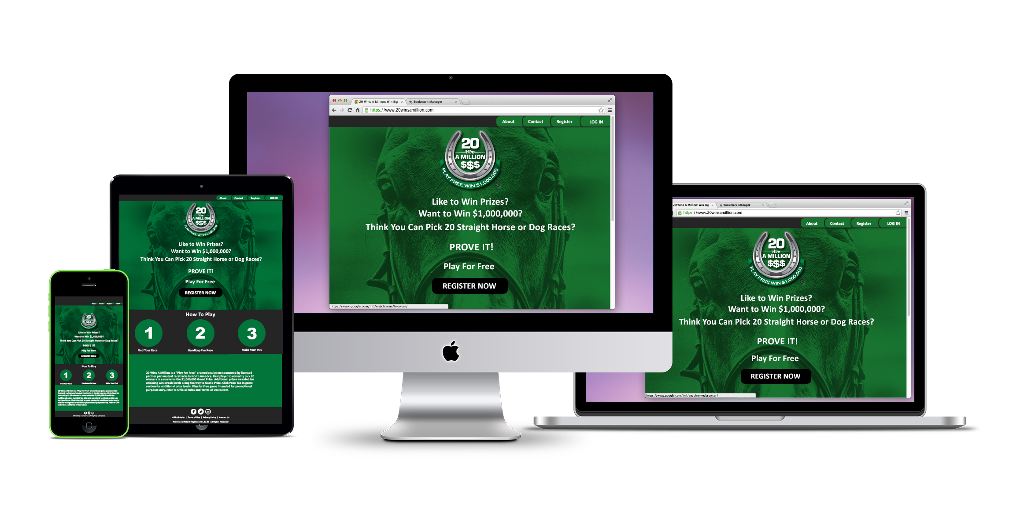
How do they play this game?
Cell phones
Laptops
Computers

Slide 8
This game helps them understand horse racing?
Betting on fantasy sports was a “quick study” for millennials, and they’ll learn to handicap and wager on racing the same way.

Slide 9
What’s concept of the game?
First player to pick 20 winning races in-a-row wins $1,000,000.
Like this…

Slide 10

Notes:
LIKE THIS

Slide 11
Our track’s not giving away $1,000,000
You don’t have to!

Slide 12
Why?
Nobody’s gonna pick 20 winners in-a-row!

Slide 13
What if somebody does win?
We’re insured!

Slide 14
If it’s too tough to pick 20 in-a-row they won’t play.
Yes they will.

Slide 15
Why?
There’s more prizes to win without picking 20 in-a-row!

Slide 16
What kind of prizes?
Free track and ADW bets, concert tickets, merchandise, clubhouse meals and a $10,000 prize to the player with longest streak of the year if nobody gets 20.

Slide 17
How do they win track prizes?
Reaching smaller streaks starting at 3 in a row…then 5, 7 etc.
Winning players must come in to pick up their prize!

Slide 18
We like them
“coming in to our track” but even 3 in-a-row is tough!
No, we’ve made it easy!
They’ll start winning with
teaser rounds!

Slide 19
What’s a teaser round?
There’s one race to pick each day.
First round: If horse comes in
1st, 2nd or 3rd they win!

Slide 20
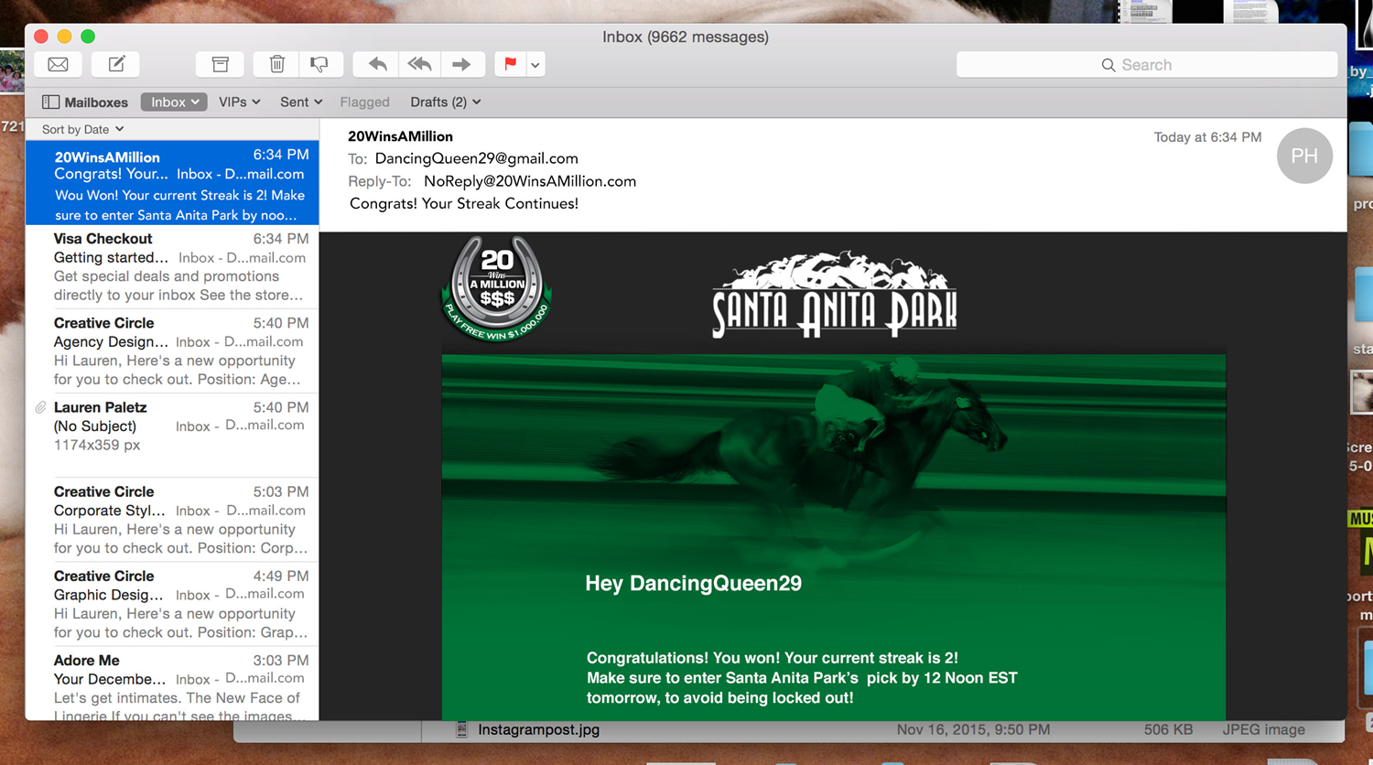
Email To Player.
“Congratulations AdamsMan your pick won today and your streak has started. Good luck tomorrow!.”

Slide 21
Next Day, Round 2:
If pick finishes
1st or 2nd they win again!
“ Hey, ToddB you’re good. That’s 2 wins in a row! Win tomorrow and get a game prize.”

Slide 22
Next Day, Round 3:
Horse must finish 1st
“You won 3 in-a-row
and a free $10 win bet!
Scan this at your track
and collect your prize.”
…and if they lose, streak goes to zero but they can start again next race day.

Slide 23
How do players know to pick races from our track?
At game registration, they select their local Host Track (YOU) where they’ll play 20 by picking only your races, and come in to collect their prize.

Slide 24
How are we part of game’s learning process?
They’ll rely on handicapper selections
Watch your races online
Learn track stats, wager options, etc.
They’ll get to know you and you’ll get to know them.

Slide 25
What happens as they win?
HERE’S YOUR PAYOFF!
Imagine game winners and friends stampeding to your track riding their winning streak.
They understand, they’ve won something, and they’re eager for excitement, food, beverage, wagering and trackside fun.

Slide 26
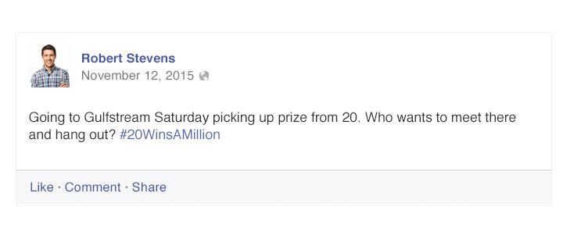
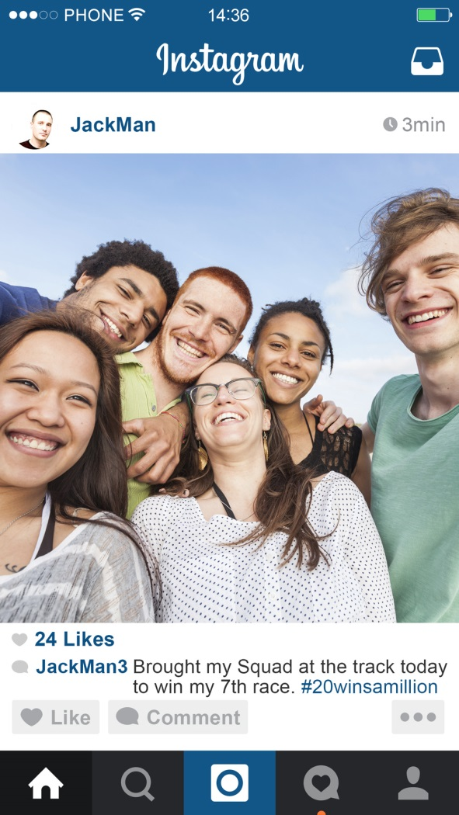
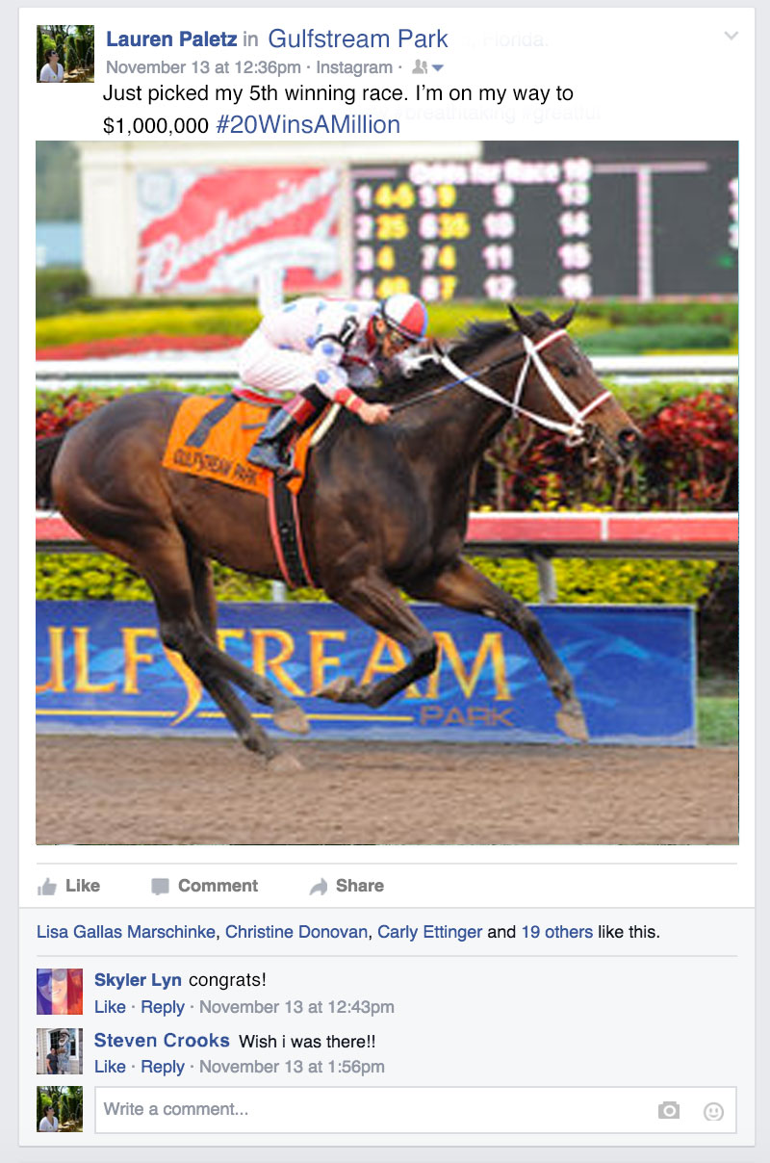
They’ll post on Facebook, Instagram and Twitter
*Won $15 on 20 game
*Picked my 1st winner!
*Meet Saturday at turf
bar with Hannah,
Brandon and Michelle
Word’s getting out!
All good!

Slide 27
Will we have email access to players?
Yes, 20 is all about communicating with millennials!
Invite them to stake races, concerts, tournaments and casino events.

Slide 28
How do they find out about the game?
20 will be all over the internet with postings, boosts, and stories on millennial sites.
Track supports with web postings, PA announcements, winning player interviews, signage & special promotions.
Playing and winning is contagious.

Slide 29
What does it cost them to play?
Nothing…ever!
20 is a free promotional game sponsored by pari-mutuel tracks.
As a non-gambling site there are very few restrictions.

Slide 30
What’s the game cost to our track?
One time start fee of $3,000 + 50 per new player.
Monthly game maintenance is $1,500-$2,500 depending on your number of race days per week

Slide 31
When is the 20 launch date?
This spring 2016.

Slide 32
Where can we see the game?
Demo is at www.20winsamillion.com/DEMO , or
2. Register as player www.20winsamillion.com , or
Review and control this presentation manually without sound at www.20winsamillion.com/sales1

Slide 33
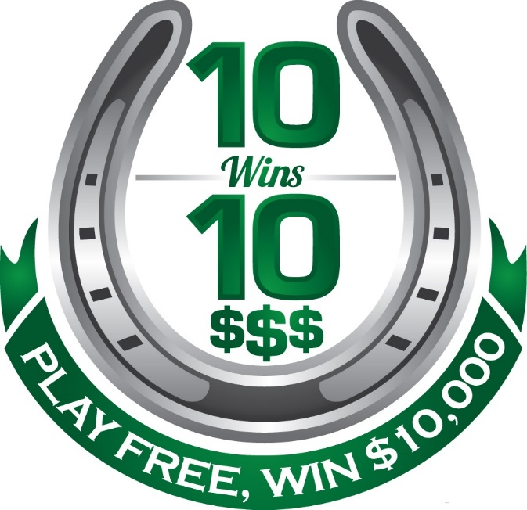
What is this new game we have seen on the internet called 10wins10?
10wins10 is the pilot site that will lead into 20winsamillion.

Slide 34
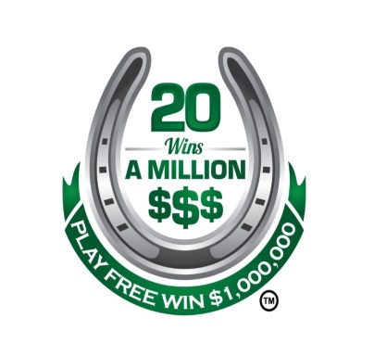
Who do we contact about the game?
Steve Wolf: VP Sales & Operations stevew@20winsamillion.com
A wholly owned division of www.eventnetusa.com
954-654-3757

Slide 35
Notes:
LIKE THIS

